Slide 1
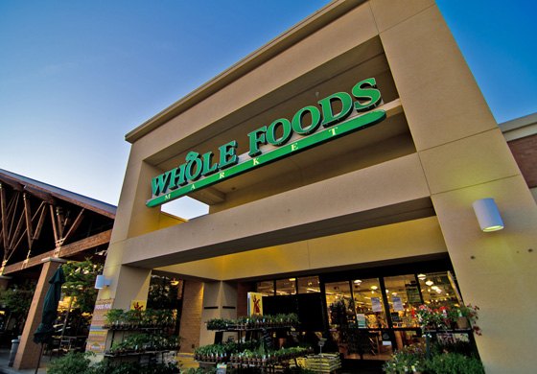
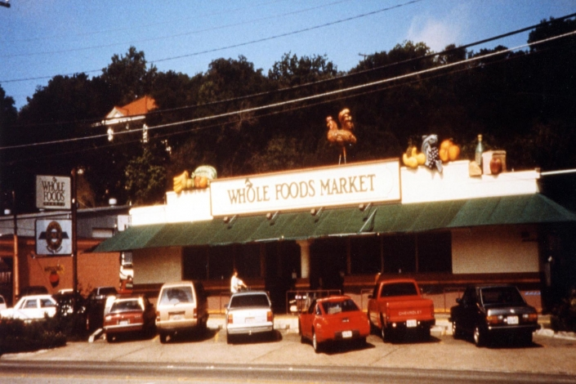
Whole Foods Market
Strategic Analysis

Slide 2
Company Introduction
Whole Foods Market (WFM) is a supermarket that specializes in natural and organic goods.
It is one of the largest natural food stores in the world.
As of September 2013 it has a total of 362 stores and over one hundred in development.
Stores in 40 US states, Canada and the United Kingdom.
Attracts customers wanting to live a healthier lifestyle and are environmentally conscience.

Slide 3
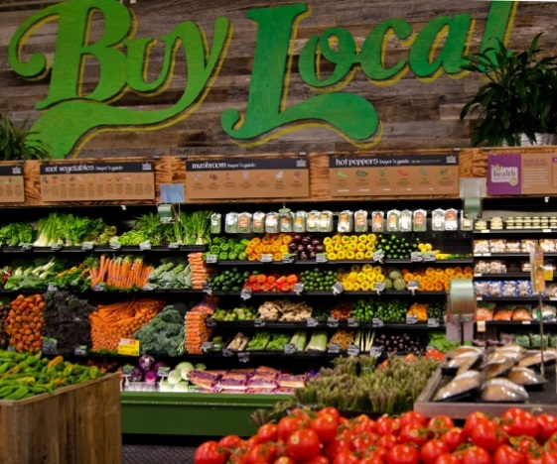
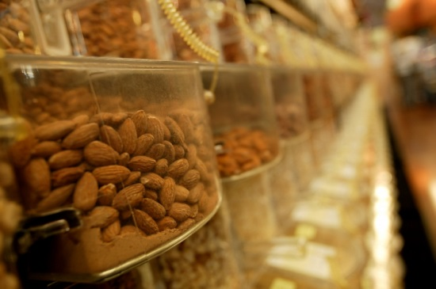
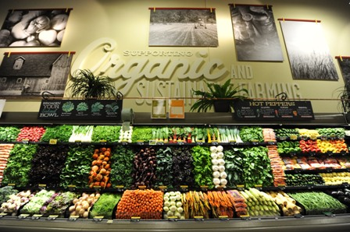
Whole Foods Market Mission
Whole Foods aims to help support the health, well-being, and healing of people, customers, Team Members, business organizations, as well as the planet.
Intends on providing the best quality in organic and natural foods to satisfy, delight and nourish its customers.

Slide 4
Whole Foods Market Declaration
“ Whole Foods Market is a dynamic leader in the quality food business and is a mission driven company that aims to set the standards of excellence for food retailers. We are building a business in which high standards permeate all aspects of our company. Quality is a state of mind at Whole Foods Market.”

Slide 5
Whole Foods Market Core Values
Sell the highest quality natural and organic products available
Satisfy, Delight and Nourish customers
Support Team Members happiness and excellence
Open and timely information
Create wealth trough profits and growth
Serve and Support our local and global communities
Practice and Advance environmental stewardship

Slide 6
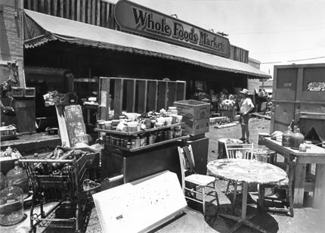
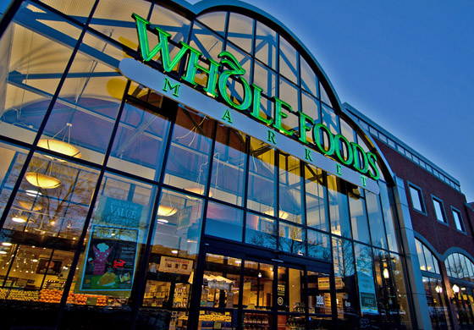
Whole Foods Market Background
Craig Weller,
Renee Lawson Hardy,
John Mackey
1978-started by John Mackey and Rene Lawson in Austin, TX as SaferWay
1980-partnered with Craig Weller and Mark Skiles to merge their Natural Grocery to create the First Whole Foods Market.
1984-expanded outside of Ausitn, TX
2000s- expanded outside of the United States

Slide 7
Whole Foods Market Dedication
Highest quality food at competitive prices
Food is evaluated by nutrition, freshness, appearance and taste.
Food Safety
Purchase products locally, to provide the freshest products available and reduces the environmental impact of transporting products
Boost local economies

Slide 8
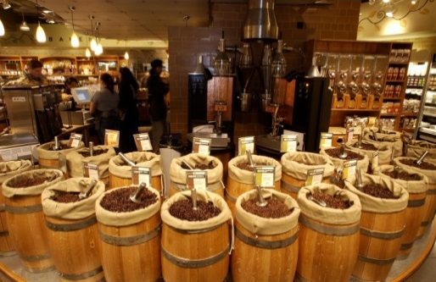
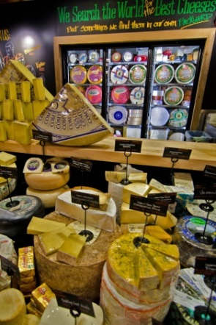
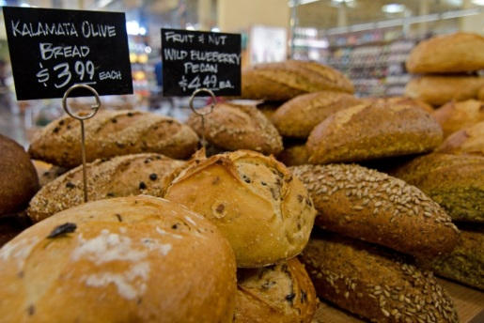
Products
Fresh Produce: Fruits and Vegetables
Organic and Natural Meats, Poultry, and Seafood
Daily baked bread and pastries
Prepared goods
Salad Bars and Sandwich Stations
Cheeses and Frozen Foods
Beer and Wines
Coffees and Teas
Grocery and Household products
Body Care and Nutritional items
Pet products
Educational Materials
Private Label items at lower costs

Slide 9
Strategy SWOT Analysis
Broad framework of analysis
Allows for the evaluation of the internal and external environment of a firm
Explains Whole Foods Market’s
Strengths
Weaknesses
Opportunities
Threats

Slide 10
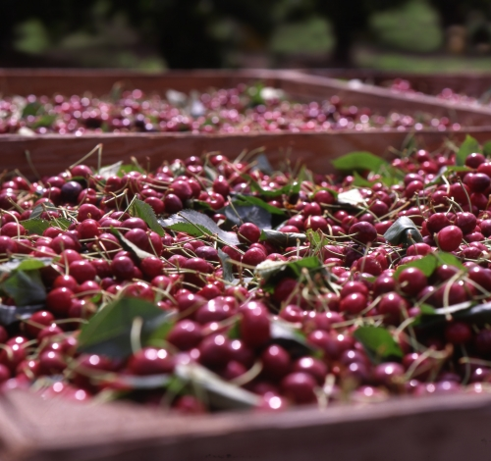
Strengths
Broad Product Offering and Rapid Distribution.
WFM has a product selection with a strong emphasis on perishable foods designed to appeal to a diverse customer base that includes individuals interested in both natural and organic foods as well as customers interested in fresh gourmet items.

Slide 11
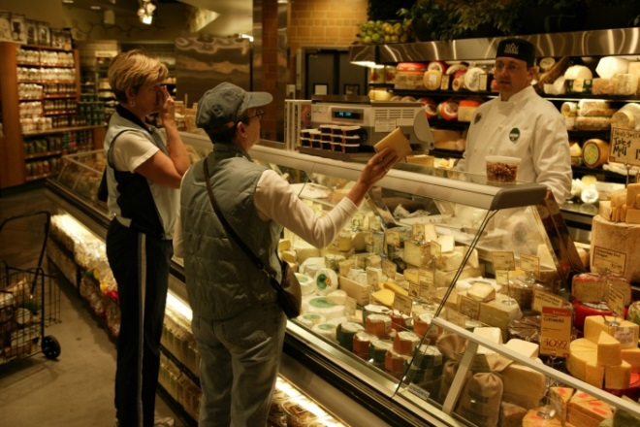
Strengths
Focused Growth Strategy
WFM management focuses on expansion
Opening of new stores in new and existing trade areas
Managements strategy to grow through identical store sales growth, acquisition and new store openings has enabled WFM to grow at a compounded annual growth rate of 27% since 1991

Slide 12
Strengths
Revenue Growth
WFM’s food strategy is well suited for the market conditions prevalent in the industries.
Rapid growth in sales for natural and organic foods returned about $30 to $35 billion in revenue for 2009
In 2011 the company reported net revenue of $10.1 billion, representing 11.22% annual growth per year
Analysts anticipate a continuation of growth and estimate 2016 revenues to yield $20 billion.

Slide 13
Weaknesses
Product Recalls
Contamination Recalls including recalls on items from the private label brand
Negatively affect the brand image and customer confidence
Leads to low customer loyalty and brand equity

Slide 14
Weaknesses
International Operations
Operates only eight stores in Canada
Operates only seven stores in the United Kingdom
Operation are not large enough internationally to reach economies of scale in purchasing and logistics.
Inability to yield economies of scale stimulated the need for an increase in product pricing
Competition has a competitive advantage with the more efficient network structure that allows for a decrease in product pricing
95% of WFM stores are located within the United states.
Existing portfolio distribution makes WFM highly sensitive to the US economic market

Slide 15
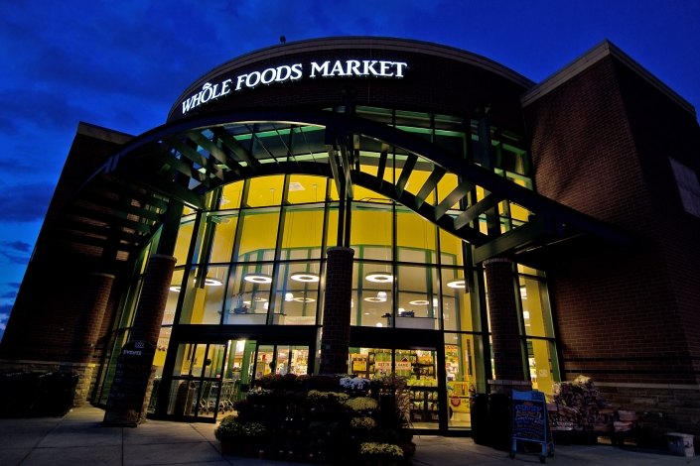
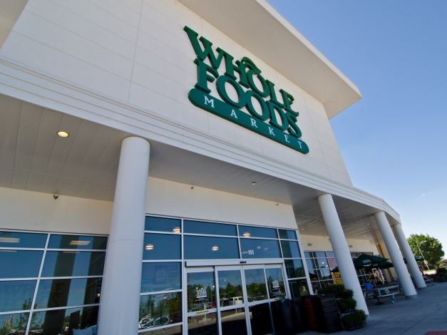
Weaknesses
Rental Agreements
Many Obligations under certain capital leases for facilities and equipment
Capital leases are subject to the laws and therefore directly effect the company’s financial position
Increasing rental expenses affect the company’s profitability
Rental Expenses for:
2010-303.5 million
2009- 281.9 million
2008- 257.5 million

Slide 16
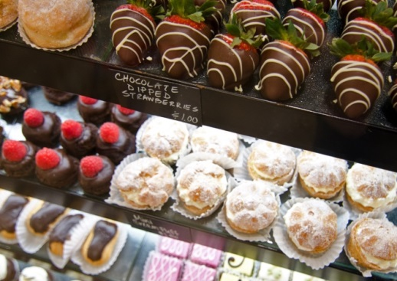
Weaknesses
Pricing
A major Weakness to WFM is that in general, individuals view organic food as high priced.
Weak distribution network in Canada and the UK are barriers to WFM’s ability to achieve economies of scale.
To effectively compete with other stores, WFM must invest heavily in logistic abroad and brand image in the US

Slide 17
Opportunities
Changing Market Conditions
Increase in amount of people interested in natural and organic foods as part of a healthy lifestyle
Global sales of organic products grows every year
Present opportunities for development and expansion in the area of natural and organic foods in mainstream customer markets

Slide 18
Opportunities
Political Interest and Regulation
New USDA standards for labeling organic food products sold in grocery
Presents an opportunity for WFM to promote the merits of organically grown products to consumers
Political and celebrity interest also presents a significant opportunity to WFM

Slide 19
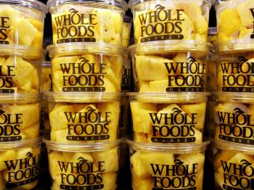
Threats
Regulation
Natural and organic food markets are subject to laws and regulations relating to health, sanitation and food labeling.
Critical Standards are in place for the manufacture, processing , formulation, packaging, labeling and advertising of products.
Failure to comply results in penalties, seizure of marketing and sales licenses, and additional compliance costs.
Notes:
Food and Drug Administration (FDA), Federal Trade Commission (FTC) Consumer Product Safety Commission (CPSC), United States Department of Agriculture (USDA), Environmental Protection Agency (EPA)

Slide 20
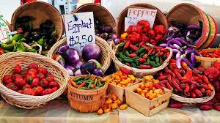
Threats
Competition
Food retailing is a large intensely competitive industry
Competes with local, regional, national, conventional and specialty supermarkets, natural food stores, warehouse membership clubs, smaller specially stores, farmers’ markets and restaurants.
Competition stores carry similar products, meaning loss of sales and profits are highly dependent on price and quality of products, as well as customer loyalty.

Slide 21
Threats
Competition
Top 3 competitors for WFM are Walmart, Safeway, and Kroger
Many other supermarkets are beginning to enter into the organic market and offering healthy alternatives to mainstream customers.

Slide 22
Whole Foods Strategies
Marketing Strategy
Expansion Strategy
Merchandising Strategy
Pricing Strategy
Financial Strategy

Slide 23
Marketing Strategy
Spends very little on advertising
Advertising fee is only .5% of revenues
Relies on Word-of –Mouth recommendations
Whole Foods also participates in Social Media outlets
Majority of advertising budget is used for in-store signage and local events.
Aims to convert highly satisfied customers into advocates for Whole Foods Market.

Slide 24
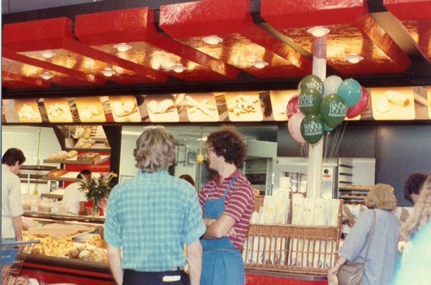
Expansion Strategy
50% of Whole Foods Market stores bases were acquired through acquisitions.
Biggest and most important acquisition is the acquisition of Wild Oats Market.
Average size of stores range from 35,000 to 50,000 square feet
“Showcase” or “Flagship” stores in major cites range from 58,000 to 78,000 square feet.
Focusing on acquiring smaller sized stores from 12,000 to 44,000 square feet.
Smaller stores allow for expansion to smaller geographic market areas.
Will result in lower cost for both per-store and per-square foot, decreasing fixed costs for a greater advantage on price setting

Slide 25
Merchandising Strategy
Layout of each store is customized to best enhance the particular product mix chosen for the specific stores target clientele.
Strong presentation of stores through attractive décor, bright colors, hand stacked fruits, high quality foods, great customers service , wide aisles and cleanliness.
Offers an Information “Take Action Center”, sit-down eating section, cooking classes and chef in the kitchen.

Slide 26
Financial Strategy
In 2006 WFM reported net revenue of $6.6 billion and in 2011 the company reported net revenue of $10.1 billion, representing 11.22% year over year annual growth.
Estimates put 2016 net revenues at nearly $20 billion
Pays quarterly dividends of 20 cents annualized puts the dividend as yielding 0.87%.
Institutional investors hold 85% of shares outstanding.

Slide 27
Whole Foods Market Strategy Recommendations
Whole Foods Market has done well with their existing strategies, but theirs is always room for Improvement.

Slide 28
Marketing Strategy
Advertising and Company Image
Focus on expanding its customer base by changing the image of organic products.
According to industry estimates, organic sales have increased three fold since 2000. This trend is likely to continue in the future
Michelle Obama’s Let’s Move Campaign is helping to expand and alter the perception of healthy eating in the US and presents WFM with an opportunity to capitalize on free marketing strategy implemented by the Obama Administration.
WFM will coordinate with the Obama Administration in the effort to change America’s eating habits.

Slide 29
Marketing Strategy
Advertising and Company Image
WFM will increase its advertising budget from 0.4% to the industry average of 1.5%
Weekly store advertisements will shed the Whole Paycheck nickname by advertising weekly specials and low prices.
Focus of a national campaign linking the name Whole Foods Market and organic produce with low prices.

Slide 30
Expansion Strategy
Diversification
Will diversity its investment portfolio and continue to expand abroad.
Currently more than 95% of WFM holdings are in the US.
WFM will aggressively invest in foreign markets and diversify operational locations and expand its distribution network abroad.

Slide 31
Merchandising Strategy
Private Labels
WFM will focus on selling their private brands (365 Everyday Value and 365 Organic)
Private label products in the US are witnessing strong growth sales.
In 2010 private label products accounted for nearly 20% of the dollar share and more than 20% of the unit share in stores in the US.
WFM total private label sales accounted for approximately 11% of its retail sales in FY 2010 and FY 2009

Slide 32
Restaurant Partnerships
WFM will seek out partnerships with “healthy” restaurants and seafood restaurants.
Example: Partner with Red Lobster to become their supplier of fresh fish.
The partnerships will benefit both companies by combing distribution networks, which would lower the fossil footprint, further enhancing companies commitment to the environment.

Slide 33
Technology Testing Store
Will test new concepts, ideas and new technologies and look for ways to revolutionize the shopping experience.
Utilize current radio tagging technology and robot technology.
All goods would be tracked coming in and going out of the store and could be automatically re-stocked.
Drone delivery service of store products.
Develop Apps for nutritional information.

Slide 34
THANK YOU!!!!

