Slide 1
IHRM in cross-border M&As, international alliances, and SMEs
Chapter 4

Slide 2
IHRM in cross-border M&As, international alliances, and SMEs
Chapter 4
Vocabulary
Objectives
Cross-border alliances
Cross-border mergers & acquisitions
International equity joint ventures
International SMEs

Slide 3
Vocabulary
non-equity cross-border alliance
equity modes
TNCs, EEA
Greenfield investments, acquisitions, mergers, M&As
pre M&A, due diligence, integration planning, & implementation phases
resources, processes, values
knowledge transfer, embedded knowledge
performance-related pay
IJVs
recruitment, training, & development
partnership role, change facilitator, strategy implementer, innovator, collaborator
multicultural teams
SMEs
internationalization process theory
experiential market knowledge

Slide 4
Objectives
You want to understand how these relate to IHRM:
Cross-border alliances
Equity-based alliances (M&As, IJVs)
Globalizing SMEs

Slide 5
Cross-border alliances

Slide 6
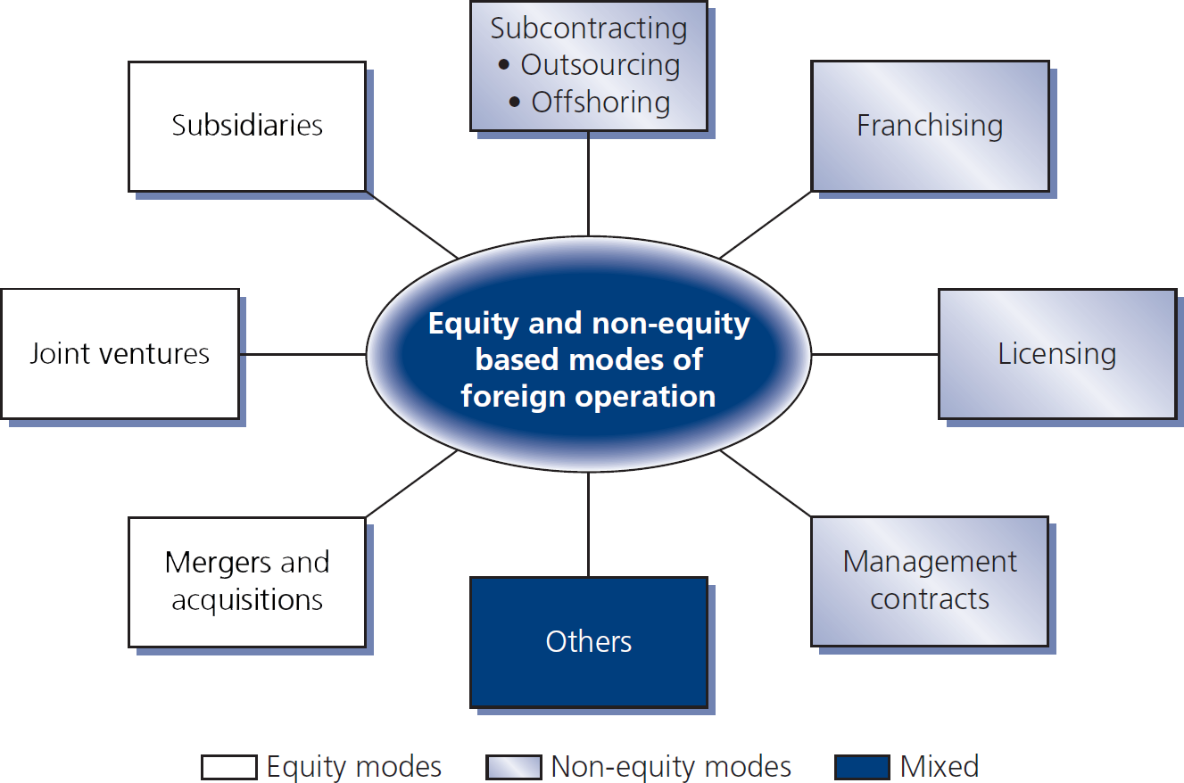
Figure 4.1
Equity & non-equity modes of foreign operation

Slide 7
Cross-Border mergers & acquisitions

Slide 8
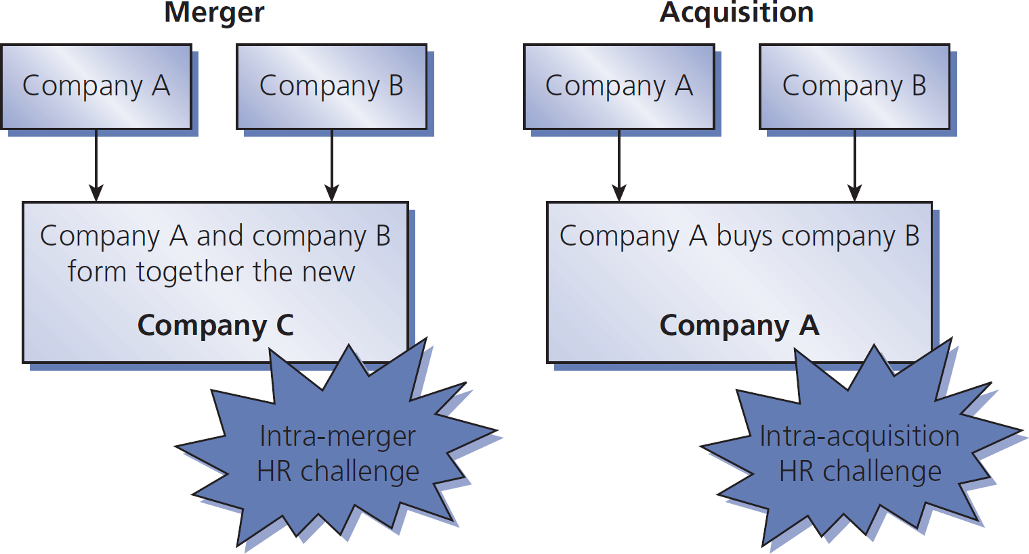
Figure 4.2
The formation processes of M&As and HR challenges

Slide 9
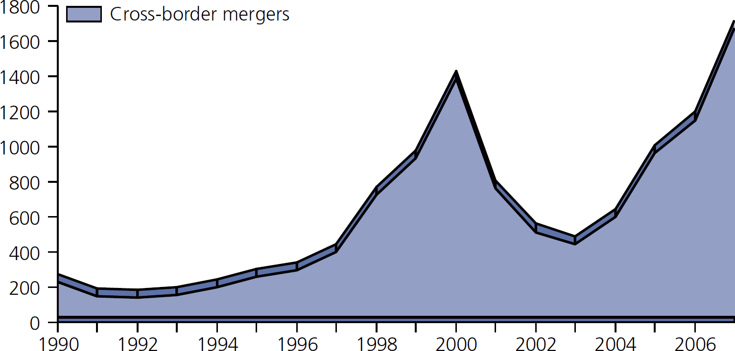
Figure 4.3
Mergers and acquisitions in US$ billions

Slide 10
Typical cross-border M&A problems
Within the first year of a merger, up to 20% of executives may be lost
The percentage lost gets worse over more than one year after a merger
Personnel issues are often neglected
A large number of M&As fail or do not produce the intended results

Slide 11
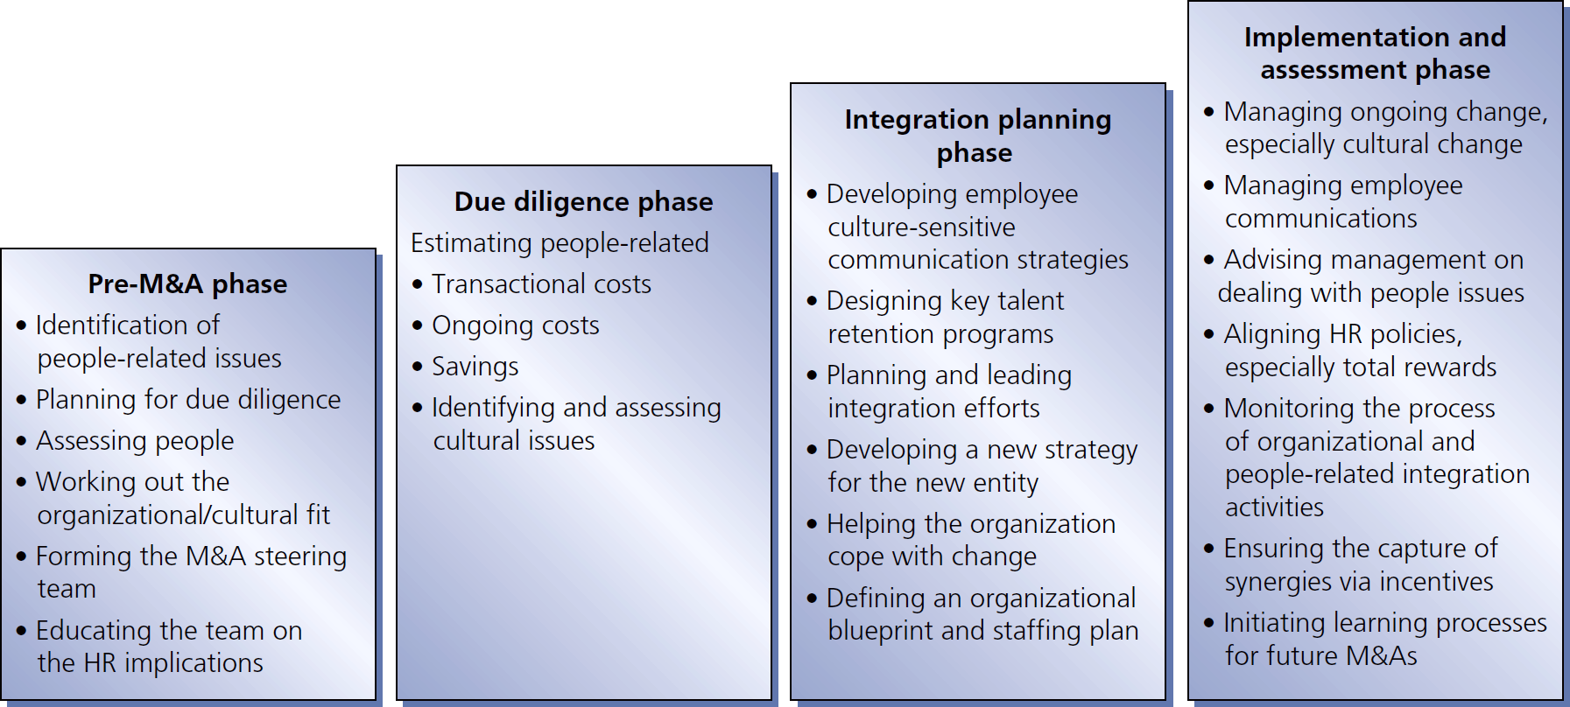
Figure 4.4
HR activities in the phases of a cross-border M&A

Slide 12
Strategic HRM in M&As
Firms should rely on three conceptual tools:
Resources money, people, brands, relationships
Processes activities used to convert resources into goods & services
Values the way employees think about what they do & why they do it

Slide 13
Comparing HRM in M&As
Performance-related pay is more popular in US than in Japan or Germany
Recruitment in US is more short-term than in Germany, France, & UK
Japan still has longest-term focus
US training & career planning is the most extensive
French still favor French managers
Germans are the most anxious to adopt international practices for their M&As

Slide 14
International equity joint ventures

Slide 15
IJV challenges include
HR must manage relations at the interfaces between IJV & parent companies Different rules can create critical dualities
HR must develop appropriate HRM practices & strategies for the IJV itself. HR must recruit, develop, motivate, retain human resources at IJV level

Slide 16
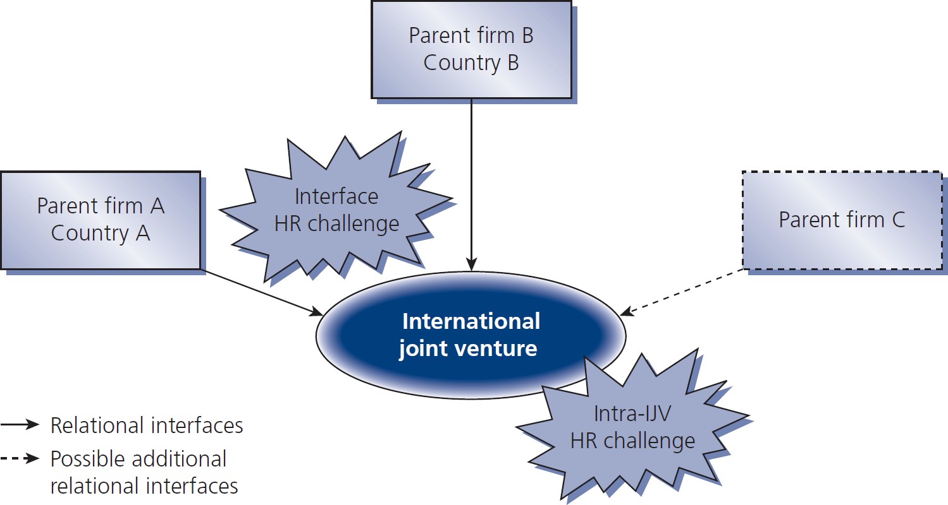
Figure 4.5
Formation of an international equity joint venture

Slide 17
The main reasons for an IJV
To gain knowledge & transfer that knowledge
The host government insists
Increased economies of scale
To gain local knowledge
To obtain vital raw materials
To share risks (e.g., financial)
To improve global competitive advantage
Provide an efficient & cost effective response required by market globalization

Slide 18
IJV development stages
Partnership role
Change facilitator & strategy implementer
Innovator
Collaborator

Slide 19
International SMEs

Slide 20
Table 4.1
SME definition

Slide 21
SMEs are very important
In EEA & Sweden:
99+% of 16 million enterprises in EEA & Sweden are SMEs
Two thirds of jobs are in SMEs
In Asia Pacific region:
SMEs are 90% of all enterprises
32-48% employment is by SMEs
In US:
80+% employment is by SMEs with less than 20 employees

Slide 22
Barriers to international markets by SMEs
TOP
10
1. Not enough working capital to finance exports
2. Inability to identify foreign business opportunities
Limited information to locate/analyze markets
Inability to contact potential overseas customers
Inability to obtain reliable foreign representation
Lack of managerial time to handle internationalization
Untrained or not enough personnel to go international
Difficulty in managing competitors’ prices
Lack of home government assistance & incentives
Excessive transportation & insurance costs

Slide 23
IHRM features in SMEs
The founder or owner has large impact
Recruitment, selection, & retention: SMEs struggle because of perceptions
Yet SME requirements are similar to those of large organizations
Human resource development – learning
Expatriate management
Limited HR dept resources & outsourcing

