Slide 1
INTERNATIONAL COMPENSATION
Chapter 8

Slide 2
INTERNATIONAL COMPENSATION
Chapter 8
Vocabulary
Objectives
Introduction
Components of an international compensation program for expatriates
Approaches to international compensation of expatriates
Tentative conclusions: patterns in complexity, challenges, & choices

Slide 3
Vocabulary
compensation
HRIS = HR information system
base salary
hardship premium
foreign service inducements
COLA = cost-of-living allowance
housing allowance
home leave allowances
education allowances
relocation allowances
spouse assistance
balance sheet, going rate, & local plus approaches
tax equalization
tax protection, ad hoc & laissez-faire approaches
international base pay
pay strategies

Slide 4
Objectives
In this chapter we:
Examine the complexities caused by moving compensation from a domestic to an international context
Detail components of a international compensation program
Outline the two main approaches to international compensation & the advantages/disadvantages of each
Introduce a third emerging approach: local plus
Examine the special problem areas of taxation, valid international living cost data, & the problem of managing TCN compensation
Examine recent developments & issues

Slide 5
Introduction

Slide 6
Compensation is increasingly seen as
Mechanism to develop & reinforce a global corporate culture
Primary source of corporate control
Explicitly linking performance outcomes with associated costs

Slide 7
International compensation complexities
Pay
Taxes
Cost of living
Housing
Safety
Transportation
Education of children
Length of stay

Slide 8
Objectives of international compensation
The policy …
should be consistent with overall strategy, structure, & business needs of the MNE
must attract & retain staff in areas where the MNE has the greatest needs & opportunities
should facilitate the transfer of international employees in the most cost-effective way for the firm
must give due consideration to equity & ease of administration

Slide 9
International employee expectations
Financial protection in terms of benefits, social security, & living costs in the foreign location
Opportunities for financial advancement through income & savings
Housing, children’s education, & recreation will be addressed
Career will be advanced

Slide 10
Components of international compensation for expatriates

Slide 11
Key components for expatriates
Base salary
Foreign service inducement & hardship premium
Allowances COLA, housing, home leave, education, relocation, spouse assistance
Benefits

Slide 12
Approaches to international compensation of expatriates

Slide 13
Three approaches to international compensation
Going rate approach
Balance sheet approach
Local plus

Slide 14
Table 8.1
Going rate approach

Slide 15
Table 8.2
Advantages & disadvantages of the going rate approach

Slide 16
Table 8.3
The balance sheet approach

Slide 17
4 balance sheet approach categories
Goods & services
Housing
Income taxes PC & HC income taxes
Reserve contributions to savings, payments for benefits, pension contributions, investments, education expenses, S.S. taxes, etc.

Slide 18
Local plus approach
The expatriate employee is paid according to prevailing salary levels, structure, & administrative guidelines of the home country …
expatriate-type benefits in recognition of foreign status
Does not typically include: COLA, mobility premiums, hardship allowances, familiarization visits, home leave, cross-cultural training, other pre-departure or spouse assistance

Slide 19
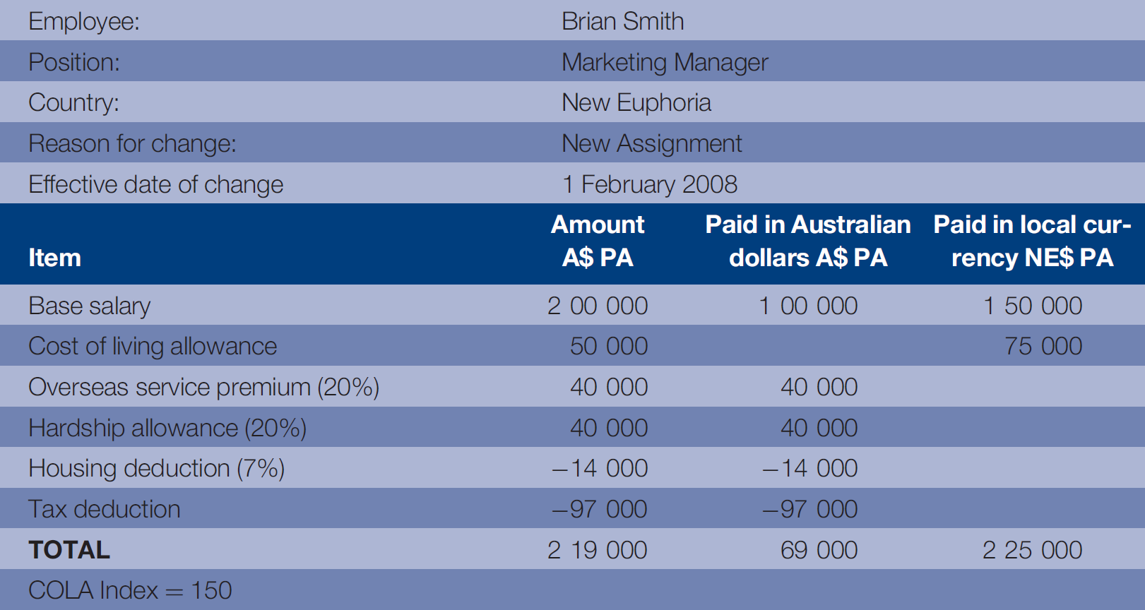
Table 8.4
Expatriation compensation worksheet

Slide 20
Table 8.5
Advantages & disadvantages of the balance sheet approach

Slide 21
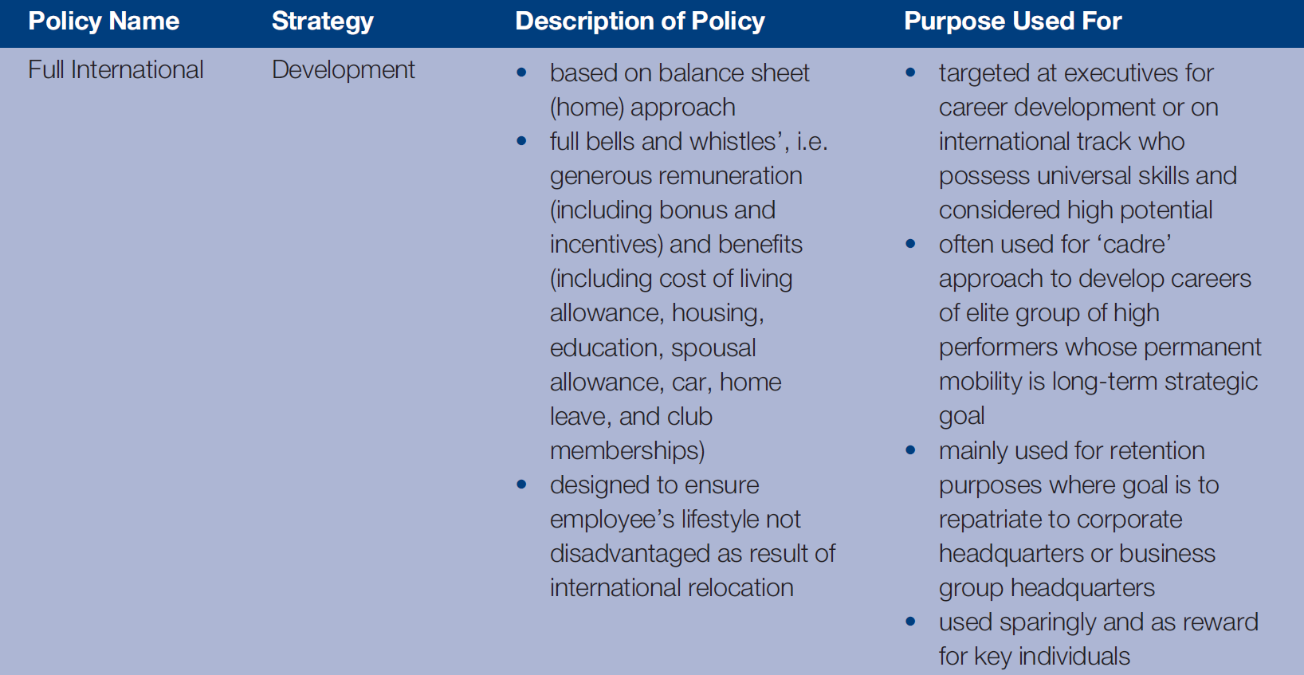
Table 8.6a
Compensation approaches & strategies for long-term international assignments
Chapter 8

Slide 22
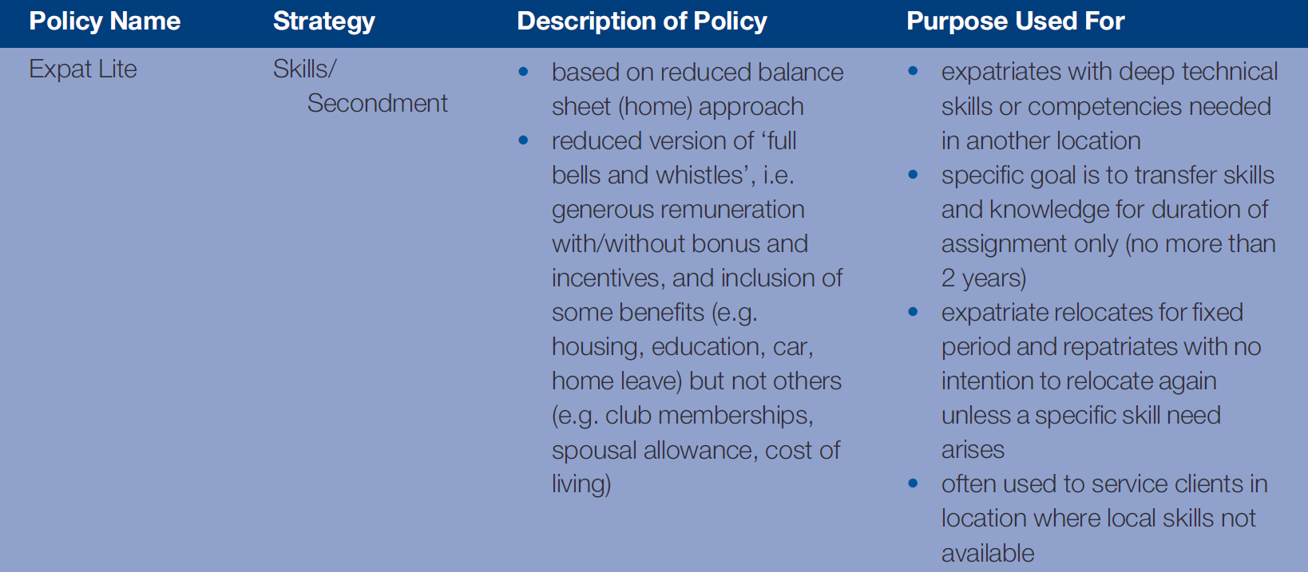
Table 8.6b
Compensation approaches & strategies for long-term international assignments

Slide 23
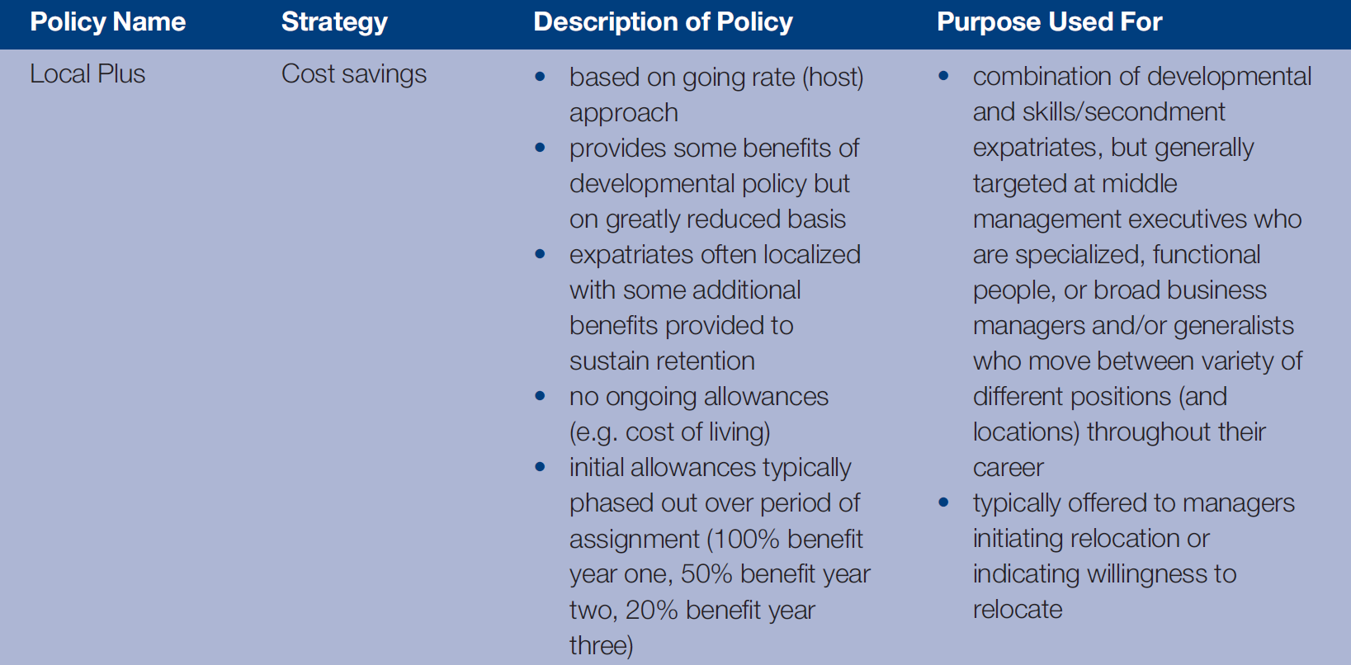
Table 8.6c
Compensation approaches & strategies for long-term international assignments

Slide 24
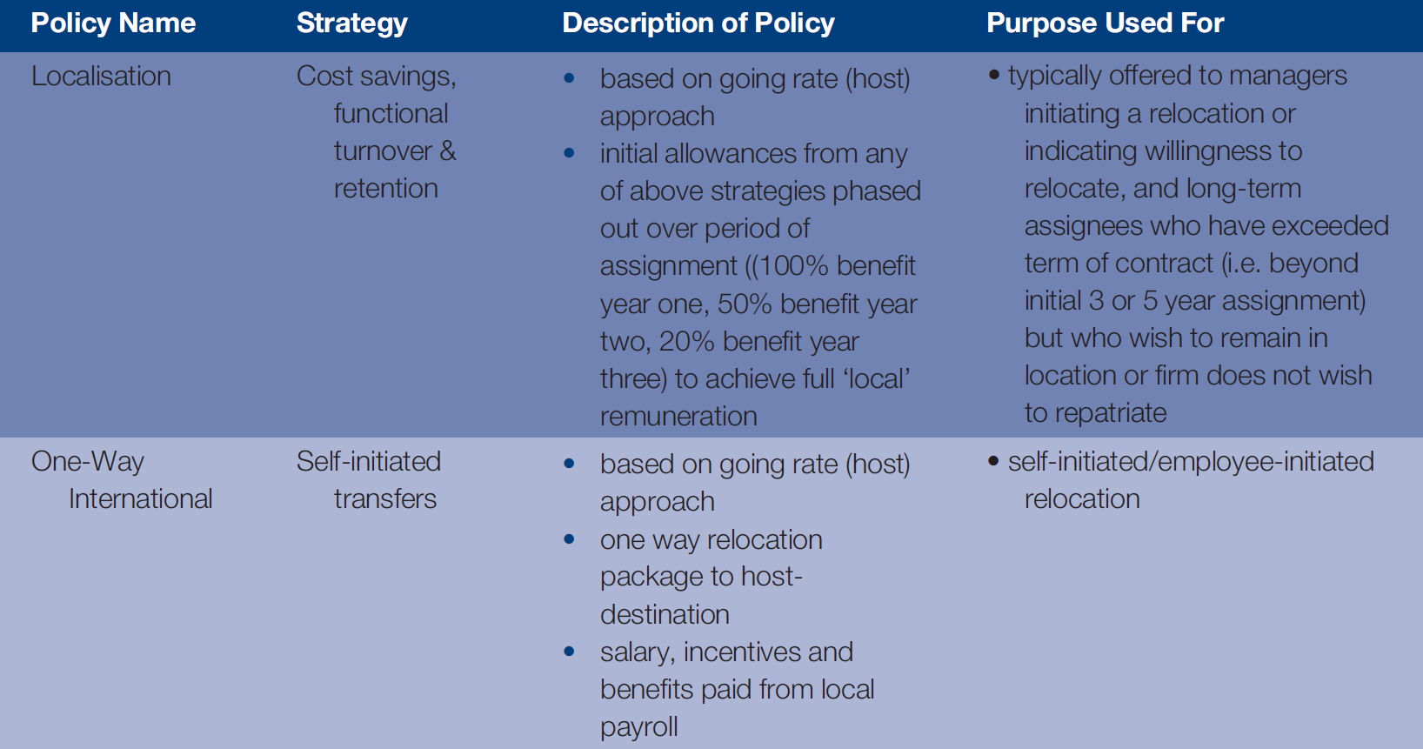
Table 8.6d
Compensation approaches & strategies for long-term international assignments

Slide 25
MNE approaches to international taxation
Tax equalization MNE withholds tax obligation & then pays all taxes in HC
Tax protection Employee pays up to amount s/he would pay on compensation in HC
Ad hoc – each expatriate handled differently
Laissez-faire – each is on their own

Slide 26
Table 8.7
Maximum marginal federal tax rates
Country | Max. marginal % rate
Australia | 45.00
Belgium | 50.00
Canada | 29.00
Chile | 40.00
Denmark | 26.48
France | 40.00
Germany | 45.00
Italy | 43.00
Japan | 40.00
Korea | 35.00
Country | Max. marginal % rate
Mexico | 28.00
Netherlands | 52.00
New Zealand | 39.00
Poland | 40.00
Spain | 27.13
Sweden | 25.00
Switzerland | 11.50
Turkey | 35.00
United Kingdom | 40.00
United States | 35.00
Chapter 8

Slide 27
Table 8.7a
Working time required to buy one Big Mac
City | 1 Big Mac in min
Chicago, Tokyo, Toronto | 12
London, Los Angeles, Miami | 13
Hong Kong, New York, Sydney | 14
Dublin, Frankfurt, Luxembourg, Montreal, Zurich | 15
Copenhagen, Geneva, Vienna | 17
Dubai, Nicosia | 18
Amsterdam, Auckland, Berlin, Brussels | 19
Lyon, Munich, Paris, Stockholm, Taipei | 20
Barcelona, Moscow, Oslo | 21
Lisbon | 23
Tel Aviv | 24
Manama | 25
Johannesburg | 26

Slide 28
Table 8.7b
Working time required to buy one Big Mac
 | 1 Big Mac in min
Helsinki, Madrid, Milan, Rome, Seoul | 27
Athens, Shanghai, Tallinn | 30
Warsaw, Doha | 31
Ljubljana | 34
Singapore | 34
Prague | 38
São Paulo | 40
Kuala Lumpur, Vilnius | 41
Bucharest, Riga | 42
Beijing | 44
Bangkok, Kiev | 45
Istanbul | 48
Delhi | 49
Río de Janeiro | 51

Slide 29
Table 8.7c
Working time required to buy one Big Mac
 | 1 Big Mac in min
Sofia | 56
Buenos Aires | 57
Bogotá, Lima | 58
Budapest | 59
Mumbai | 61
Bratislava | 62
Santiago de Chile | 69
Cairo | 82
Manila | 88
Caracas | 126
Mexico City | 129
Jakarta | 136
Nairobi | 158

Slide 30
Issues to consider for expatriate benefits
Keep expatriates in home-country programs, particularly if the firm receives no tax deduction for it?
Option to enroll expatriates in host-country benefit programs &/or make up any difference in coverage?
Do expatriates receive home-country or are eligible to receive host-country social security benefits?

Slide 31
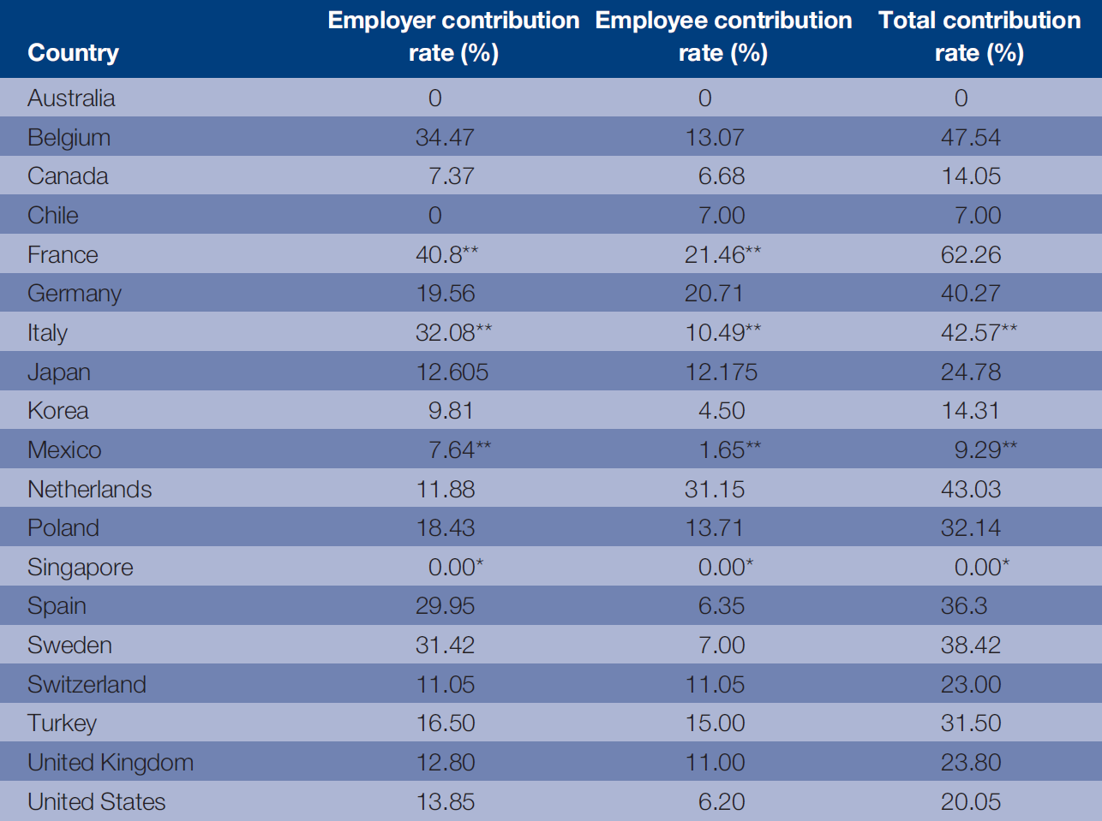
Table 8.8
Social security contributions by employers & employees

Slide 32
Tentative conclusions: patterns in complexity, challenges, & choices

Slide 33
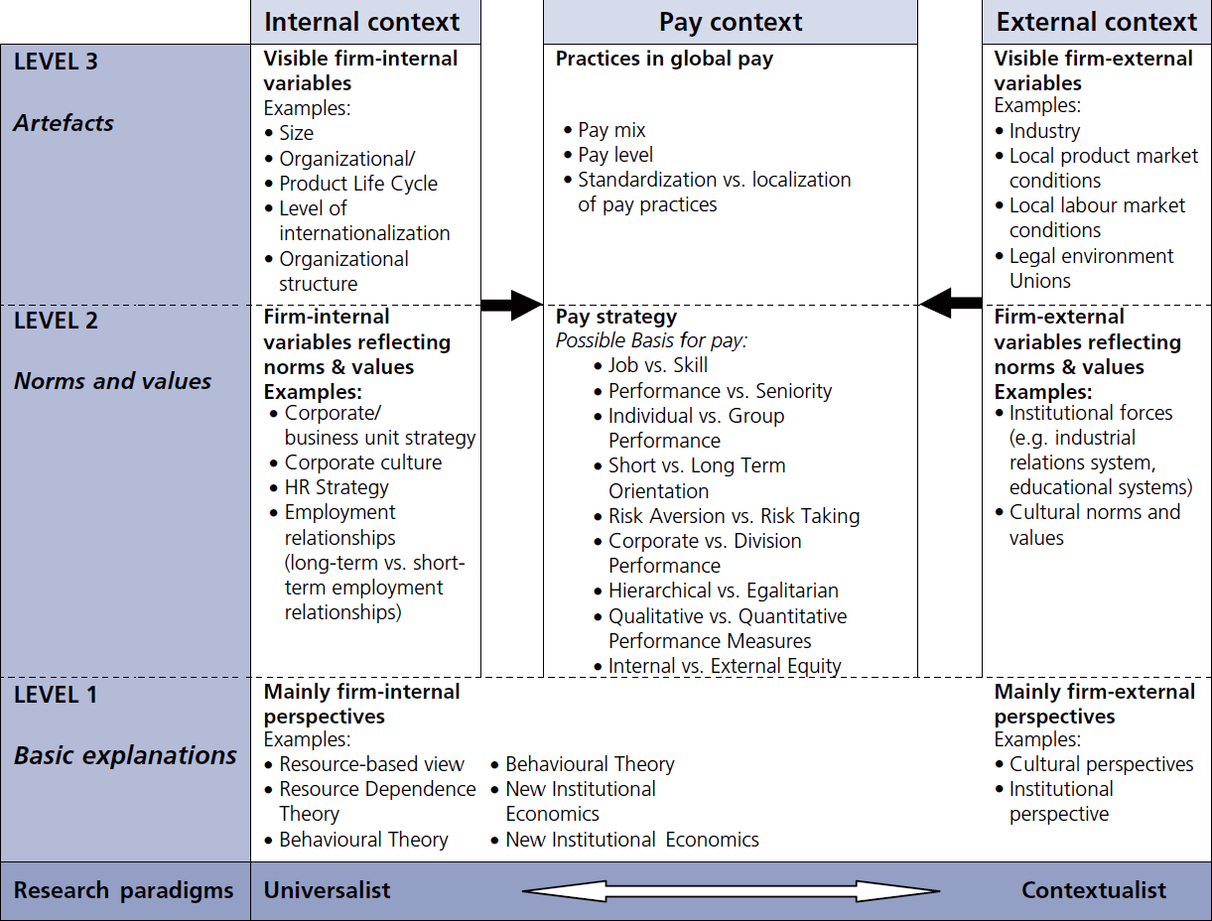
Figure 8.1
Complexity, challenges & choices in global pay
Chapter 8

