Slide 1
MANAGEMENT
TWELFTH EDITION
Ricky W. Griffin
Part One: Introducing Management
Chapter One: Managing and the Manager’s Job

Slide 2
Learning Outcomes
Describe the nature of management, define management and managers, and characterize their importance to contemporary organizations.
Identify and briefly explain the four basic management functions in organizations.
Describe the kinds of managers found at different levels and in different areas of the organization.
Identify the basic managerial roles that managers play and the skills they need to be successful.
Discuss the science and the art of management, describe how people become managers, and summarize the scope of management in organizations.
Characterize the new workplace that is emerging in organizations today.

Slide 3
An Introduction to Management
Organization
A group of people working together in a structured and coordinated fashion to achieve a set of goals.

Slide 4
An Introduction to Management
Organization
Human Resources
Financial Resources
Information Resources
Physical Resources
Many definitions of management exist. This textbook uses a resource-based definition.

Slide 5
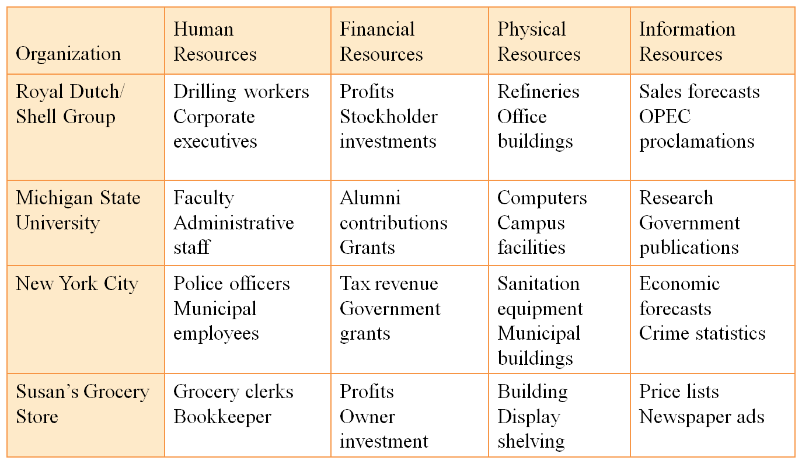
Table 1.1
Examples of Resources Used by Organizations

Slide 6
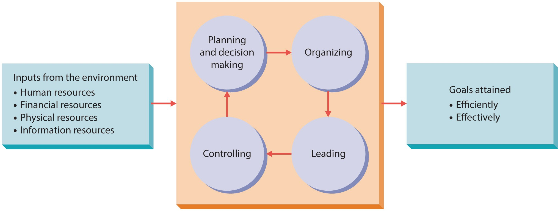
Figure 1.1
Management in Organizations
Management is a set of activities – planning and decision making, organizing, leading, and controlling – directed at an organization’s human, financial, physical, and information resources with the aim of achieving organizational goals in an efficient and effective manner.

Slide 7
An Introduction to Management
Efficient
Effective
Manager
Using resources wisely and in a cost effective way.
Making the right decisions and successfully implementing them.
Someone whose primary responsibility is to carry out the management process.

Slide 8
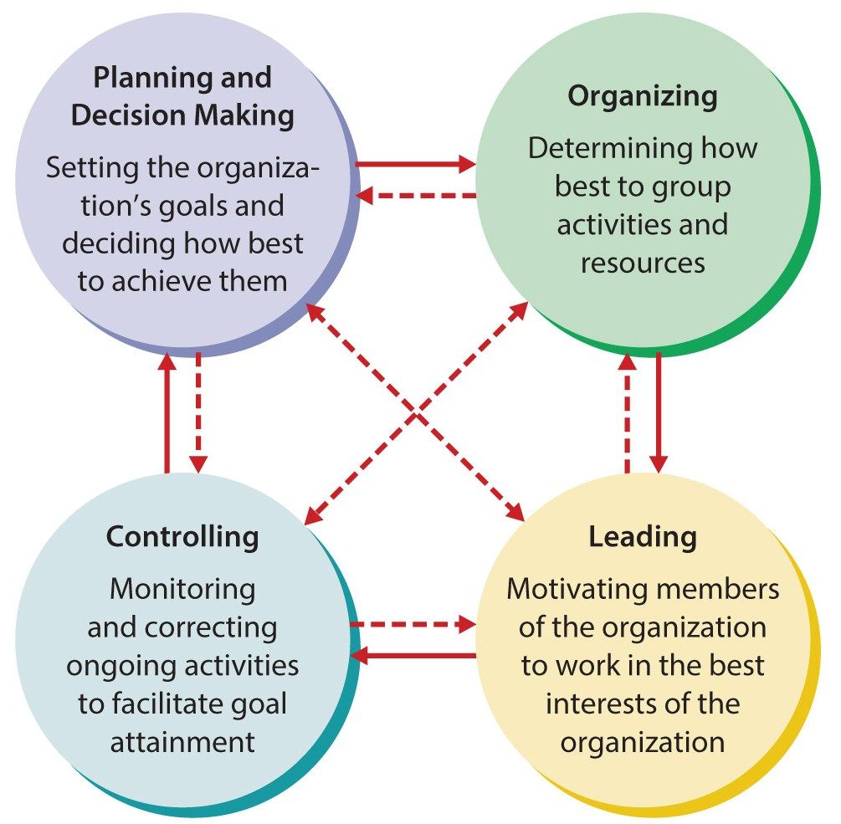
Figure 1.2
The Management Process
Management involves four basic activities – planning and decision making, organizing, leading, and controlling.
Most managers engage in more than one activity at a time and often move back and forth between the activities in unpredictable ways.

Slide 9
The Management Process
Planning
means setting an organization’s goals and deciding how best to achieve them.
Decision making
involves selecting a course of action from a set of alternatives.
Organizing
involves determining how activities and resources are to be grouped.

Slide 10
The Management Process
Leading
is the set of processes used to get members of the organization to work together to further the interests of the organization.
Controlling
is monitoring organizational progress toward goal attainment.

Slide 11
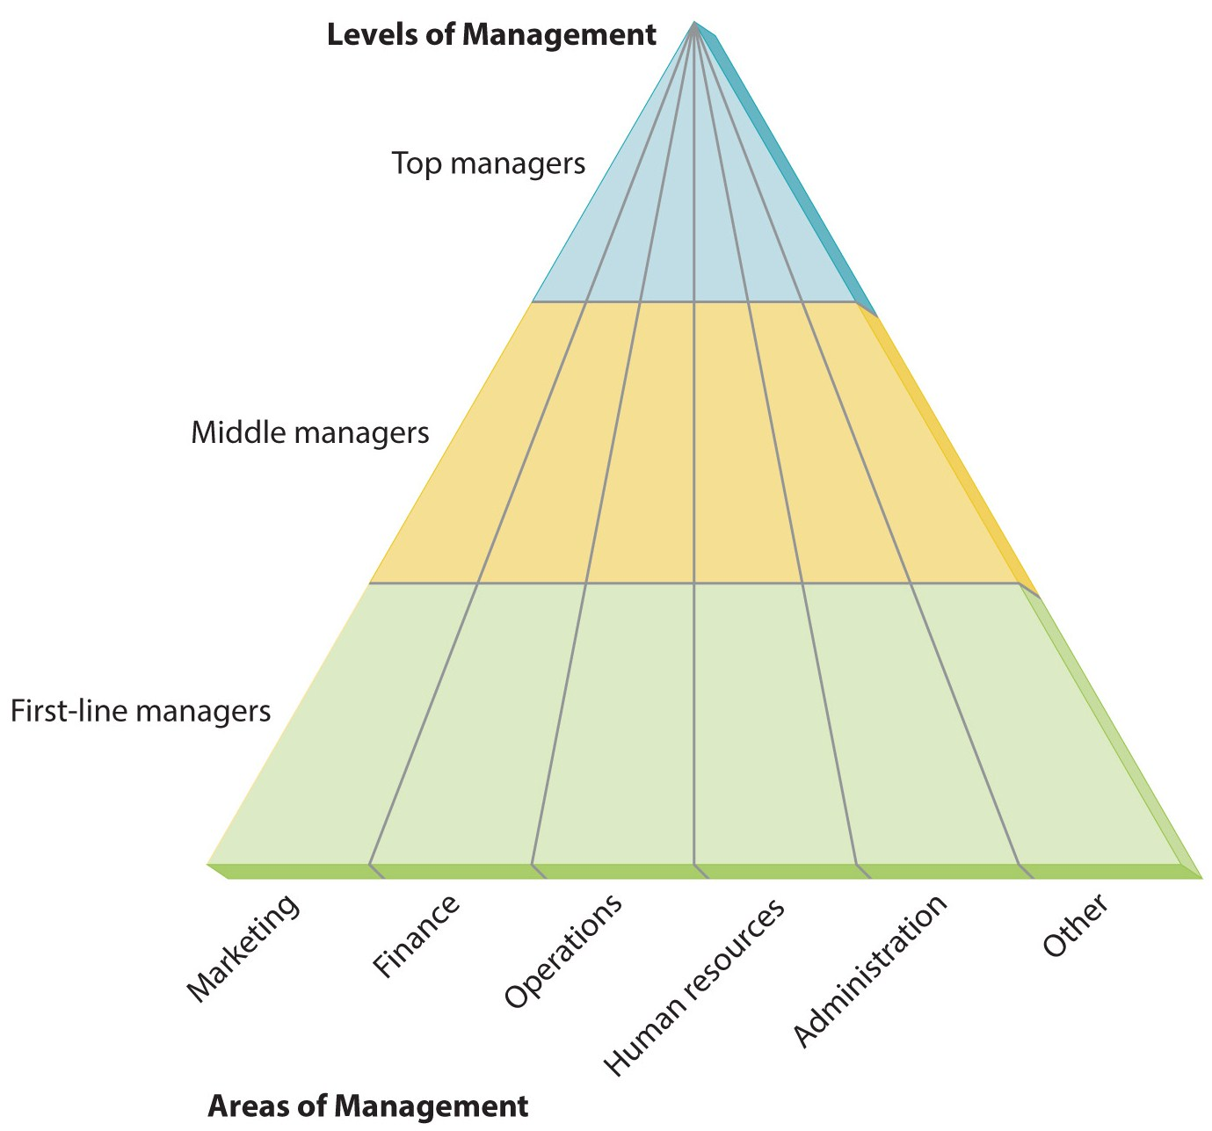
Figure 1.3
Kinds of Managers by Level and Area
Levels of management is the differentiation of managers into three basic categories – top, middle, and first-line.

Slide 12
Kinds of Managers
Top managers
are the small group of executives who manage the overall organization. They create the organization’s goals, overall strategy, and operating policies.
Middle Managers
are primarily responsible for implementing the policies and plans of top managers. They also supervise and coordinate the activities of lower level managers.
First-Line Managers
supervise and coordinate the activities of operating employees.

Slide 13
Managing in Different Areas of the Organization
Marketing
Financial
Operations
Human resources
Administrative
Other areas
Areas of management may include marketing, financial operations, human resource, administrative, and other areas.

Slide 14
Kinds of Managers
Marketing mangers
sell the product and work in new-product development, promotion, and distribution.
Financial managers
undertake accounting, cash management, and investments.
Operations mangers
control production, inventory, quality and plant layout.

Slide 15
Kinds of Managers
Human resource managers
hire and develop employees.
Administrative managers
are generalists and familiar with all areas of management.
Other kinds of managers
include public relations and research and development.

Slide 16
Managerial Roles
Interpersonal Roles
Figurehead
Leader
Informational Roles
Monitor
Spokesperson
Decisional Roles
Entrepreneur
Negotiator
Liaison
Disseminator
Disturbance handler
Resource allocator
Relates primarily to making decisions.
Involves the processing of information.
Involves dealing with other people.

Slide 17
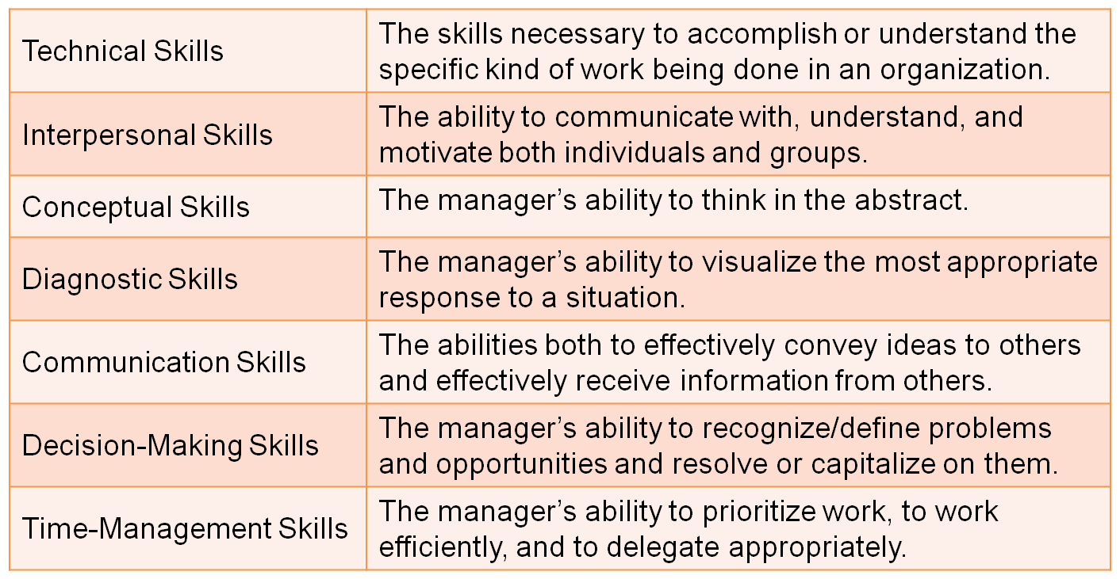
Table 1.2
Basic Managerial Skills

Slide 18
Managerial Skills
Technical skills
are necessary to accomplish to understand the specific kind of work being done in an organization.
Interpersonal skills
are the ability to communicate with, understand, and motivate both individuals and groups.

Slide 19
Managerial Skills
Conceptual skills
the manager’s ability to think in the abstract.
Diagnostic skills
the manager’s ability to visualize the most appropriate response to a situation.
Communication skills
the manager’s abilities both to effectively convey ideas and information to others and to effectively receive ideas and information from others.

Slide 20
Managerial Skills
Decision-making skills
the manager’s ability to correctly recognize and define problems and opportunities and to then select an appropriate course of action to solve problems and capitalize on opportunities.
Time-management skills
the manager’s ability to prioritize work, to work efficiently, and to delegate appropriately.

Slide 21
The Nature of Managerial Work
The Science of Management
Assumes that problems can be approached using rational, logical, objective, and systematic ways.
Requires the use of technical, diagnostic, and decision-making skills and techniques to solve problems.
The Art of Management
Making decisions and solving problems using a blend of intuition, experience, instinct, and personal insights.
Using conceptual, communication, interpersonal, and time-management skills to accomplish the tasks associated with managerial activities.

Slide 22
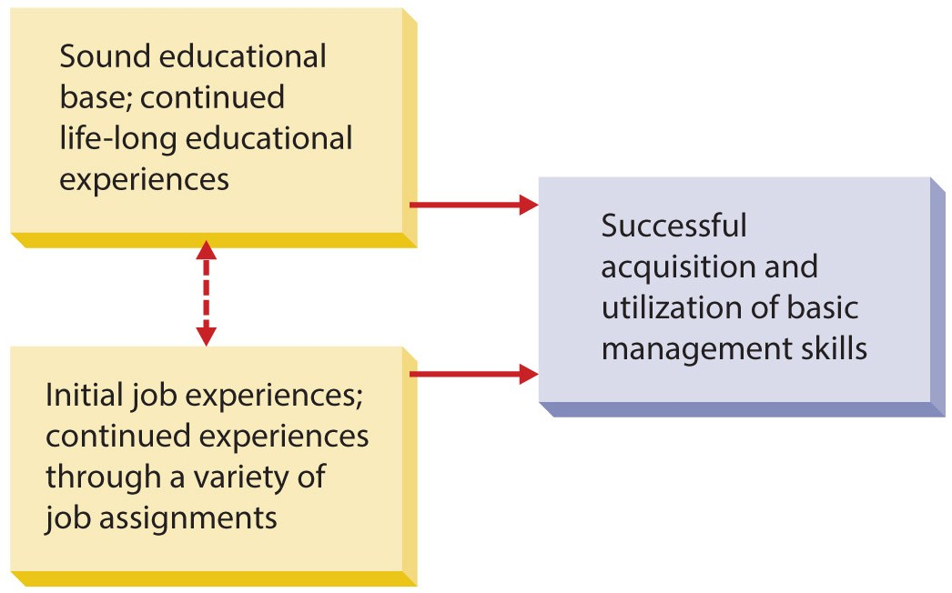
Figure 1.4
Sources of Management Skills
Most managers acquire their skills as a result of education and experience. Though a few CEOs today do not hold college degrees, most students preparing for management careers earn college degrees and may go on to enroll in MBA programs.

Slide 23
The Nature of Managerial Work
Profit Seeking
Not-For-Profit
Large businesses – Industrial firms, commercial banks, insurance firms, retailers, transportation firms, utilities, communication firms, service organizations.
Small businesses and start-up businesses.
International management.
Governmental organizations – local, state, and federal.
Educational organizations – public and private schools, colleges, and universities.
Healthcare facilities – public hospitals and HMOs.
Nontraditional settings – community, social, spiritual groups.

Slide 24
The New Workplace
Diversity is increasing in the workforce
Diversity has numerous dimensions, but most common are age, gender, ethnicity, and physical abilities and disabilities.
Work ethics are changing
The highly motivated “yuppies” of the ‘80’s.
Generation X, Y, and Millennials desire flexibility and individuality.

Slide 25
The New Workplace
Managers must create an attractive environment for today’s worker.
Must provide incentives to motivate a diverse workforce.
Be prepared to cope with continual change.
New technology remains a challenge.
Managers now have a complex array of organizing possibilities.

Slide 26
Summary
Chapter one discussed management, and the manager’s job, including
the management process,
the various kinds (and levels) of managers, and
the basic managerial roles and skills.
Next, the text examined the scope of management in profit-seeking and not-for-profit organizations.
The chapter concluded addressing the various challenges facing managers today.

