Slide 1
MANAGEMENT
TWELFTH EDITION
Ricky W. Griffin
Part Two: Understanding the Environmental Context of Management
Chapter Three: Understanding the Organization’s Environment

Slide 2
Learning Outcomes
Discuss the nature of the organizational environment and identify the environments of interest to most organizations.
Describe the components of the general and task environments and discuss their impact on organizations.
Identify the components of the internal environment and discuss their impact on organizations.

Slide 3
Learning Outcomes
Discuss the importance and determinants of an organization’s culture and how the culture can be managed.
Describe the multicultural environment of business and identify major trends and dimensions of diversity and multiculturalism.
Identify and describe how the environment affects organizations and how organizations adapt to their environment.

Slide 4
Organization’s Environments
External environment
Everything outside an organization’s boundaries that might affect it.
Internal environment
The conditions and forces within an organization.

Slide 5
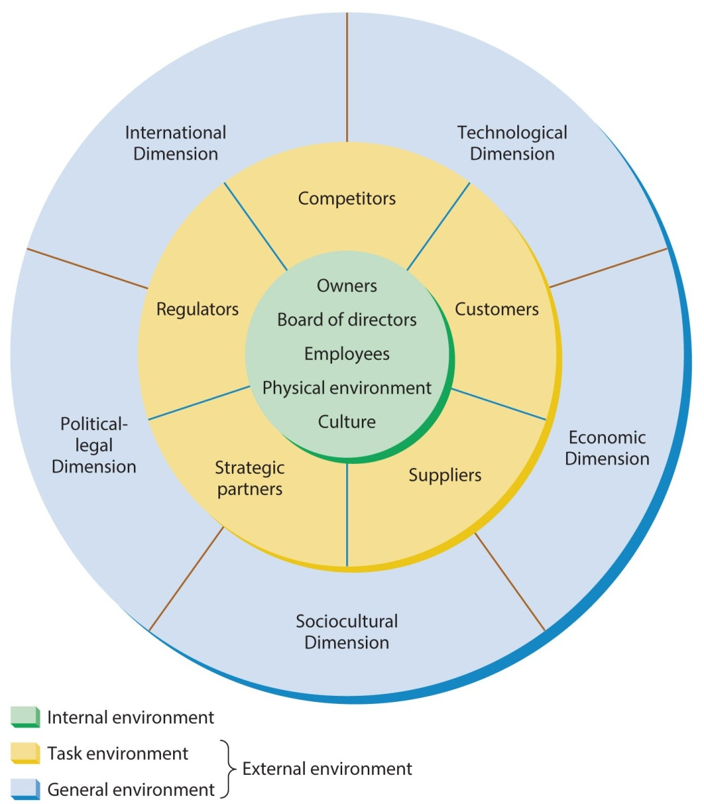
Figure 3.1
The Organization and Its Environments
There are actually two separate external environments: the general environment and the task environment.

Slide 6
External Environment
General environment
The set of broad dimensions and forces in an organization’s surroundings that create its overall context.
Task environment
Specific organizations or groups that influence an organization.

Slide 7
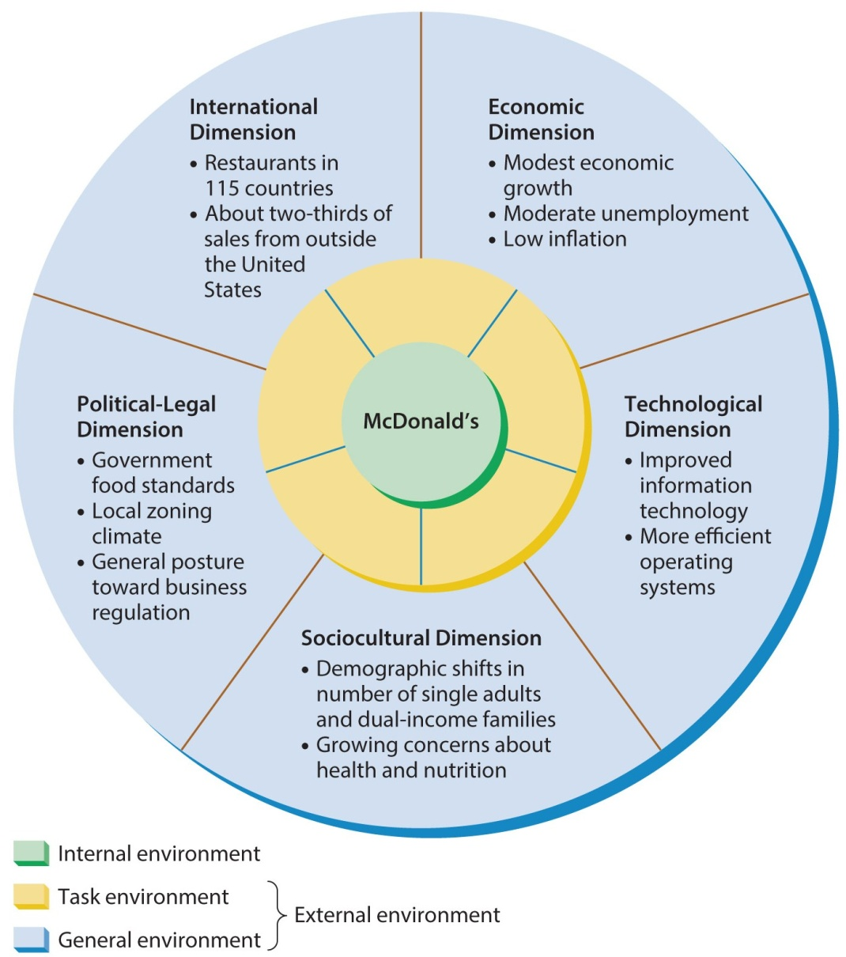
Figure 3.2
McDonald’s General Environment
The general environment of an organization consists of economic, technological, sociocultural, political-legal, and international dimensions.

Slide 8
The General Environment
Economic dimension
The overall health and vitality of the economic system in which the organization operates.
Technological dimension
The methods available for converting resources into products or services.
Sociocultural dimension
The customs, mores, values, and demographic characteristics of society.
Political-legal dimension
The government regulation of business and the relationship between business and government.
International dimension
The extent to which an organization is involved in or affected by business in other countries.

Slide 9
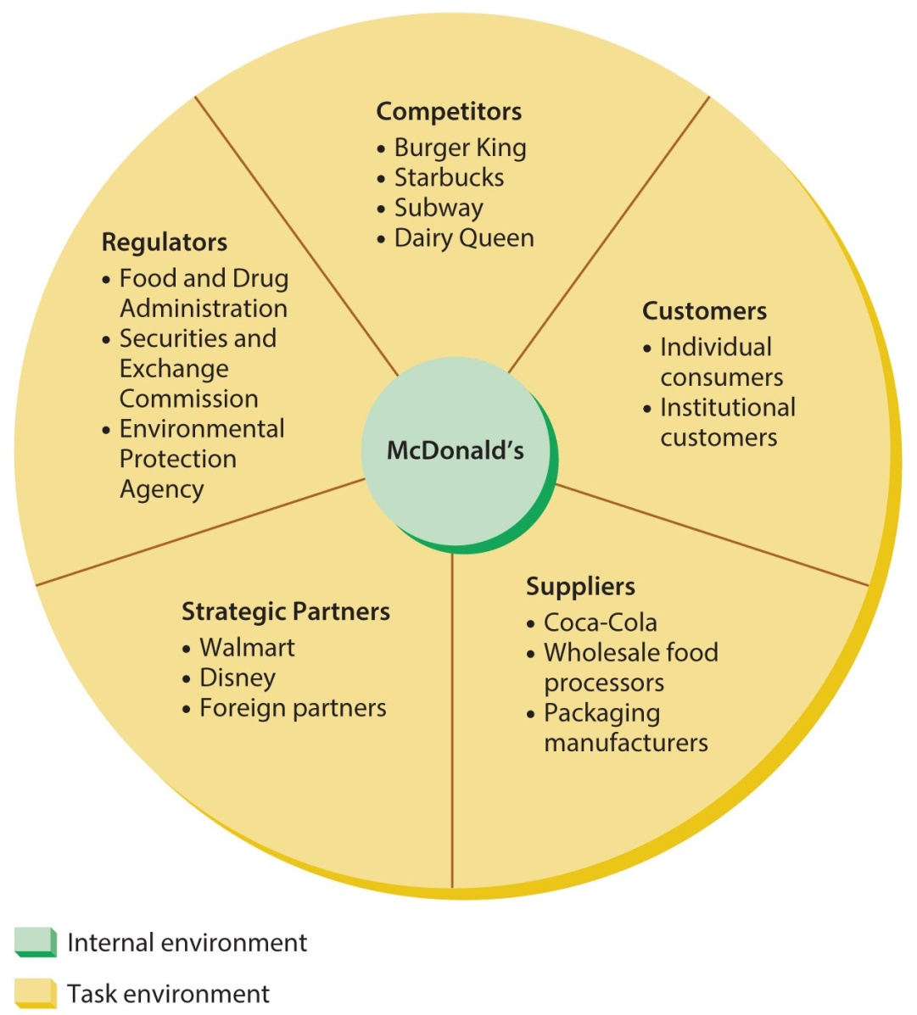
Figure 3.3
McDonald’s Task Environment
The task environment includes competitors, customers, suppliers, strategic partners, and regulators.

Slide 10
The Task Environment
Competitors
An organization that competes with other organizations for resources.
Customers
Whoever pays money to acquire an organization’s products/services.
Suppliers
An organization that provides resources for other organizations.
Strategic partners (strategic allies)
An organization working together with one or more other organizations in a joint venture or similar arrangement.

Slide 11
The Task Environment
Regulators
A unit that has the potential to control, legislate, or otherwise influence the organization’s policies and practices.
Regulatory agencies
An agency created by the government to regulate business activities.
Interest group
A group organized by its members to attempt to influence business.

Slide 12
Figure 3.1
The Organization and Its Environment
An organization’s internal environments consist of their owners, boards of directors, employees, physical work environments, and cultures.

Slide 13
The Internal Environment
Owners
Whoever can claim property rights to an organization.
Board of directors
Governing body elected by a corporation’s stockholders and charged with overseeing the general management of the firm to ensure that it is being run in a way that best serves the stockholders’ interests.

Slide 14
The Internal Environment
Employee issues include
A workforce becoming increasingly diverse in
gender, ethnicity, age, and other dimensions.
Increased reliance on “temp” workers.
Labor unions add a complex layer.
Physical work environment issues include
location, design, and layout.

Slide 15
The Organization’s Culture
Culture defies objective measurement or observation yet is the foundation of the internal environment.
Organization culture
The set of values, beliefs, behaviors, customs, and attitudes that helps the members of the organization understand what it stands for, how it does things, and what it considers important.

Slide 16
The Organization’s Culture
Importance of organizational culture
It can shape the firm’s effectiveness and long-term success, and increase productivity.
Determinants of organizational culture
Develops over a long period of time.
Often starts with the founder.
Includes such things as corporate success and shared experiences.

Slide 17
Managing Organization Culture
Managers must understand current culture.
If it is in the best interests of the firm,
managers should reward behavior consistent with the culture.
If current culture needs changing,
mangers must identify the culture they prefer,
bring in outsiders, adopt new slogans, and tell new stories to support the new culture.

Slide 18
The Multicultural Environment
Multiculturalism
The broad issues associated with differences in values, beliefs, behaviors, customs, and attitudes held by people in different cultures.
Diversity
Exists in a group or organization when its members differ from one another along one or more important dimensions, such as age, gender, or ethnicity.
Organization culture, multiculturalism, and diversity are closely related concepts.

Slide 19
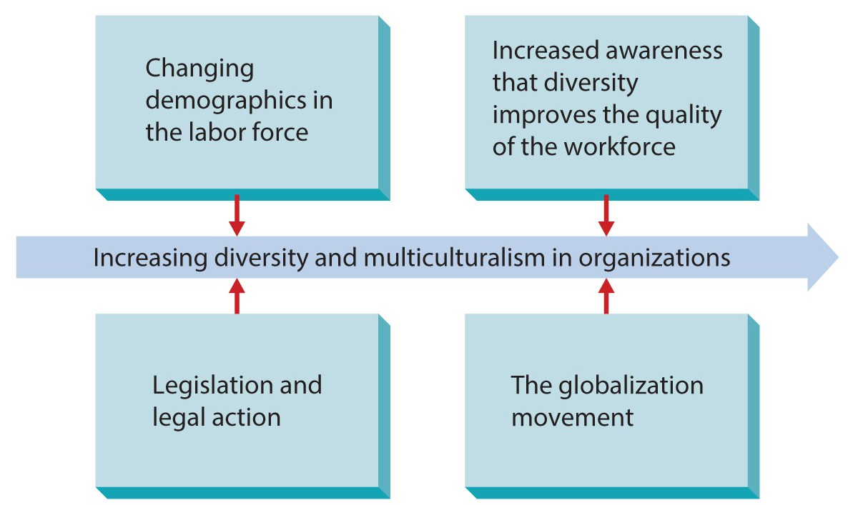
Figure 3.4
Reasons For Increasing Diversity and Multiculturalism
The most fundamental trend is that all organizations are becoming more diverse and multicultural.

Slide 20
Dimensions of Diversity and Multiculturalism
Average age is increasing.
Increasing numbers of females in workforce.
Glass ceiling is a perceived barrier that keeps women from advancing to top management.
Ethnicity
the ethnic composition of a group or organization, continues increasing.

Slide 21
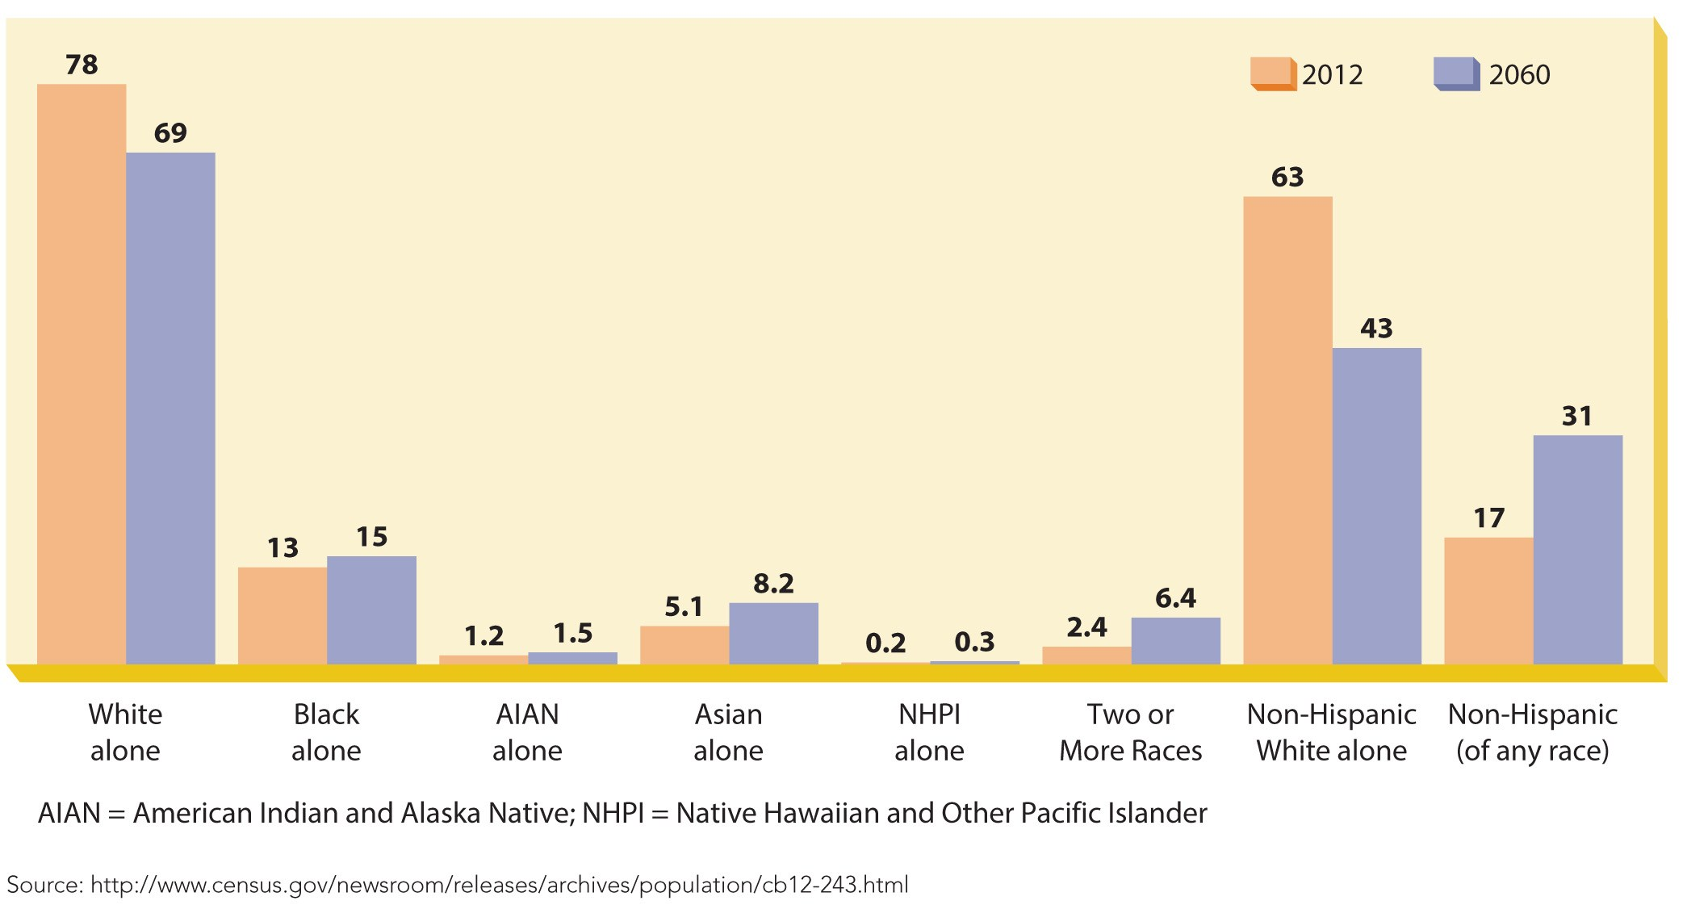
Figure 3.5
Ethnicity Distribution Trends in the U.S.
The greatest increase in expected growth is within the Hispanic population.

Slide 22
Trends in Diversity and Multiculturalism
Other Diversity Dimensions
Multicultural Differences
Physical mobility.
Religion.
Single parents.
Dual-career marriages.
Alternative lifestyles.
Vegetarianism.
Political ideologies.
Some organizations
actively enhance their multiculturalism.
Soon, all companies may become multicultural,
due to changes in the external labor market.
U.S. immigration is at its highest rate since 1910.

Slide 23
Organization-Environment Relationships
Organizations are open systems and interact with various dimensions in many different ways.
First:
how environments affect organizations.
Second:
how organizations adapt to their environments.

Slide 24
How Environments Affect Organizations
Three basic perspectives:
environmental change and complexity,
competitive forces, and
environmental turbulence.

Slide 25
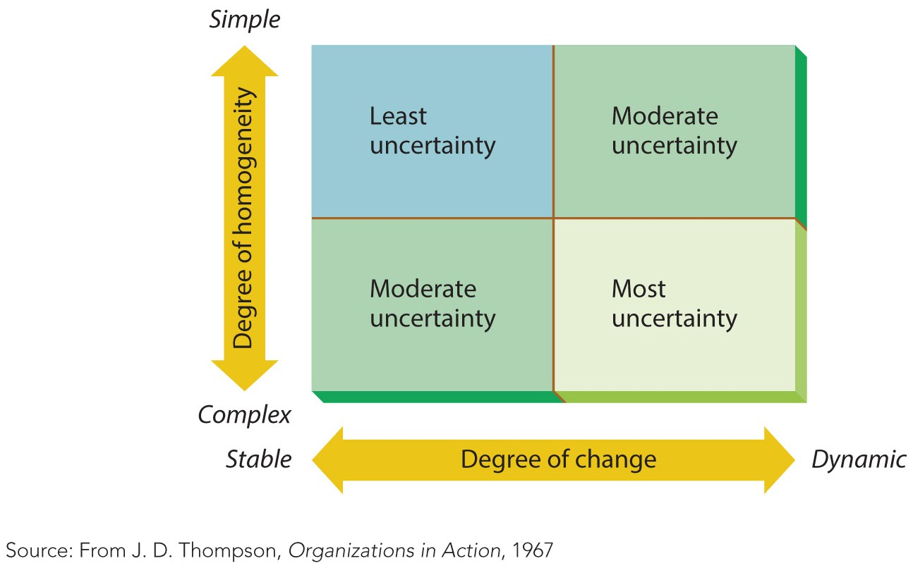
Figure 3.6
Environmental Change, Complexity, and Uncertainty
Degrees of homogeneity and change combine to create uncertainty.

Slide 26
Competitive Forces
Michael Porter defined the Five Competitive Forces.
Threat of new entrants
Ease of entering the market.
Competitive rivalry
Rivalry between firms in the same industry.
Threat of substitute products
Can other products work just as well?
Power of buyers
Power of suppliers
Extent buyer’s influence suppliers.
Extent suppliers influence buyers.

Slide 27
Environmental Turbulence
Consists of changes in the environment which may or may not be expected.
Crisis is the most common form of turbulence.
Some organizations have developed a crisis team and/or plan.

Slide 28
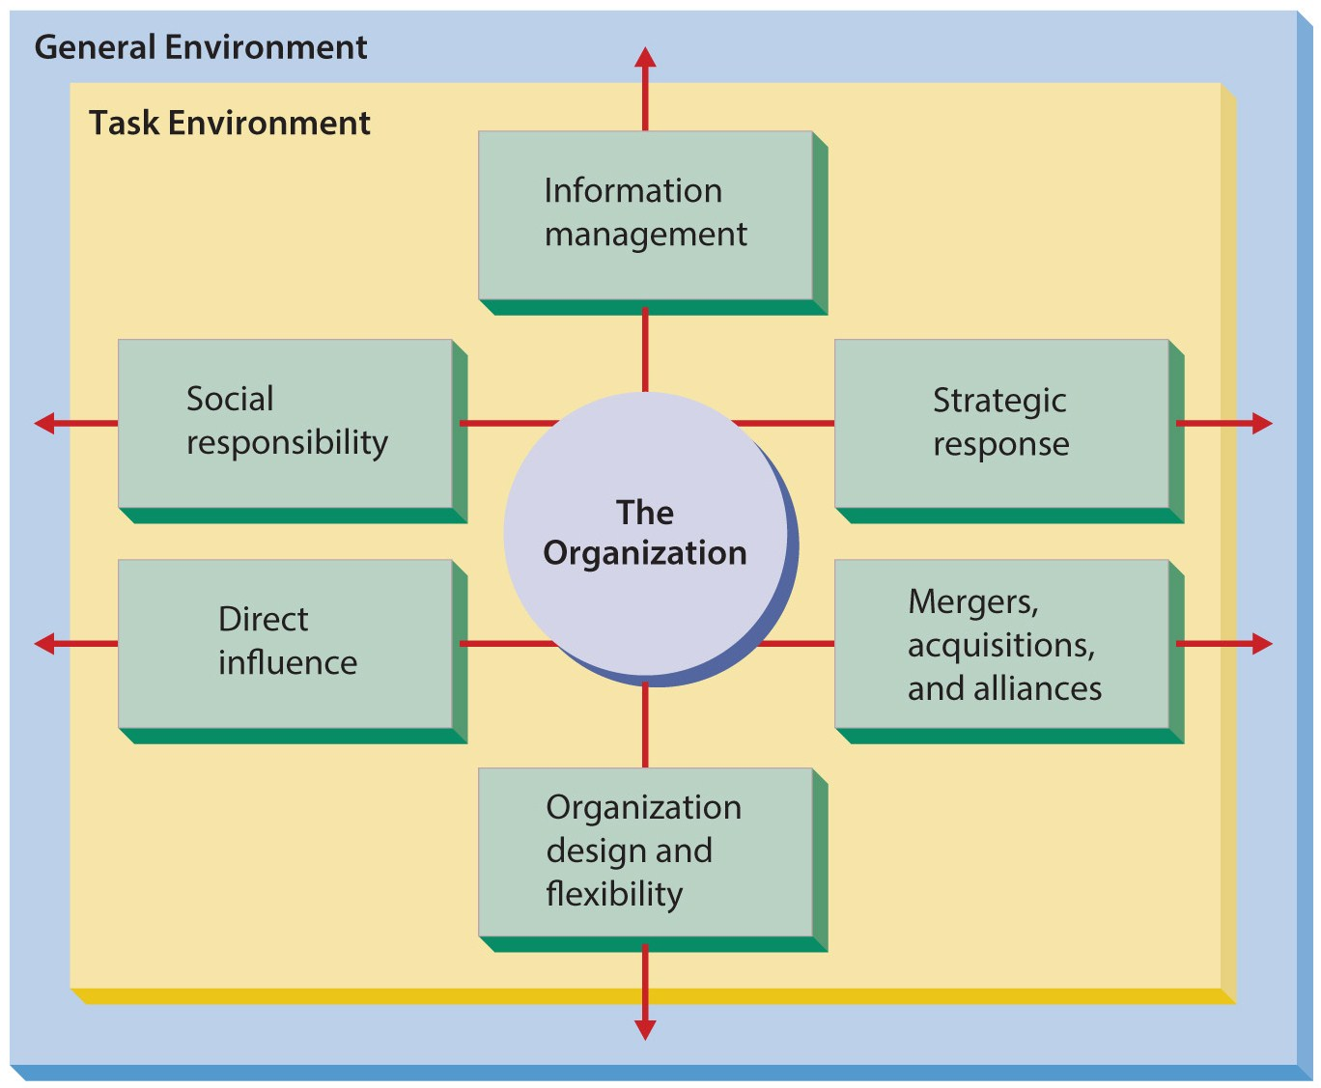
Figure 3.7
How Organizations Adapt to Their Environments
These are the six basic mechanisms through which organizations adapt to their environments.

Slide 29
How Organizations Adapt to Their Environment
Information management
Boundary spanner – someone who spends much of their time with others outside the organization.
Environmental scanning – monitoring the environment through observation and reading.
Information systems – electronic systems which gather, organize and summarize information.
Strategic response
Realizing something has changed and determining what action, if any, is needed.

Slide 30
How Organizations Adapt to Their Environment
Mergers, acquisitions, and alliances
A merger occurs when two or more firms combine to form a new firm.
An acquisition occurs when on firm buys another. Most are friendly.
A hostile takeover occurs when one firm buys another against its will.
In an alliance (partnership), the firm undertakes a new venture with another firm.

Slide 31
How Organizations Adapt to Their Environment
Organization design and flexibility
involves how an organization designs its structure.
Directly influence the environment by:
Signing long-term contracts.
Vertically integrating.
Lowering price, affecting competitors.
Creating new products.
Lobbying and bargaining.

Slide 32
Summary
Chapter three defined the environments organizations face including:
external, both general and task, and
internal, including organization culture.
Multiculturalism and diversity followed.
The chapter closed with how organizations affect and adapt to their environments.
Includes the five competitive forces.

