Slide 1
MANAGEMENT
TWELFTH EDITION
Ricky W. Griffin
Part Two: Understanding the Environmental Context of Management
Chapter Four: Responding to the Ethical and Social Environment

Slide 2
Learning Outcomes
Discuss the managerial ethics, three areas of special ethical concern for managers, and how organizations manage ethical behavior.
Identify and summarize key emerging ethical issues in organizations today.
Discuss the concept of social responsibility, specify to whom or what an organization might be considered responsible, and describe four types of organizational approaches to social responsibility.
Explain the relationship between the government and organizations regarding social responsibility.
Describe some of the activities that organizations may engage in to manage social responsibility.

Slide 3
Individual Ethics in Organizations
Ethics
An individual’s personal beliefs about whether a behavior, action, or decision is right or wrong.
Ethical behavior
Behavior that conforms to generally accepted social norms.
Unethical behavior
Behavior that does not conform to generally accepted social norms.

Slide 4
Individual Ethics in Organizations
A combination of factors contribute to form an individual’s ethics.
Individual Ethics
Values Morals
Peers
Events
Family

Slide 5
Managerial Ethics
Managerial ethics are standards of behavior that guide individual managers in their work.
How an organization treats its employees.
Hiring, firing, wages, work conditions, privacy and respect.
How employees treat the organization.
Conflicts of interest, secrecy, confidentiality, and honesty.
How employees and the organizations treat other economic agents.
Customers, competitors, stockholders, suppliers, dealers, and unions.

Slide 6
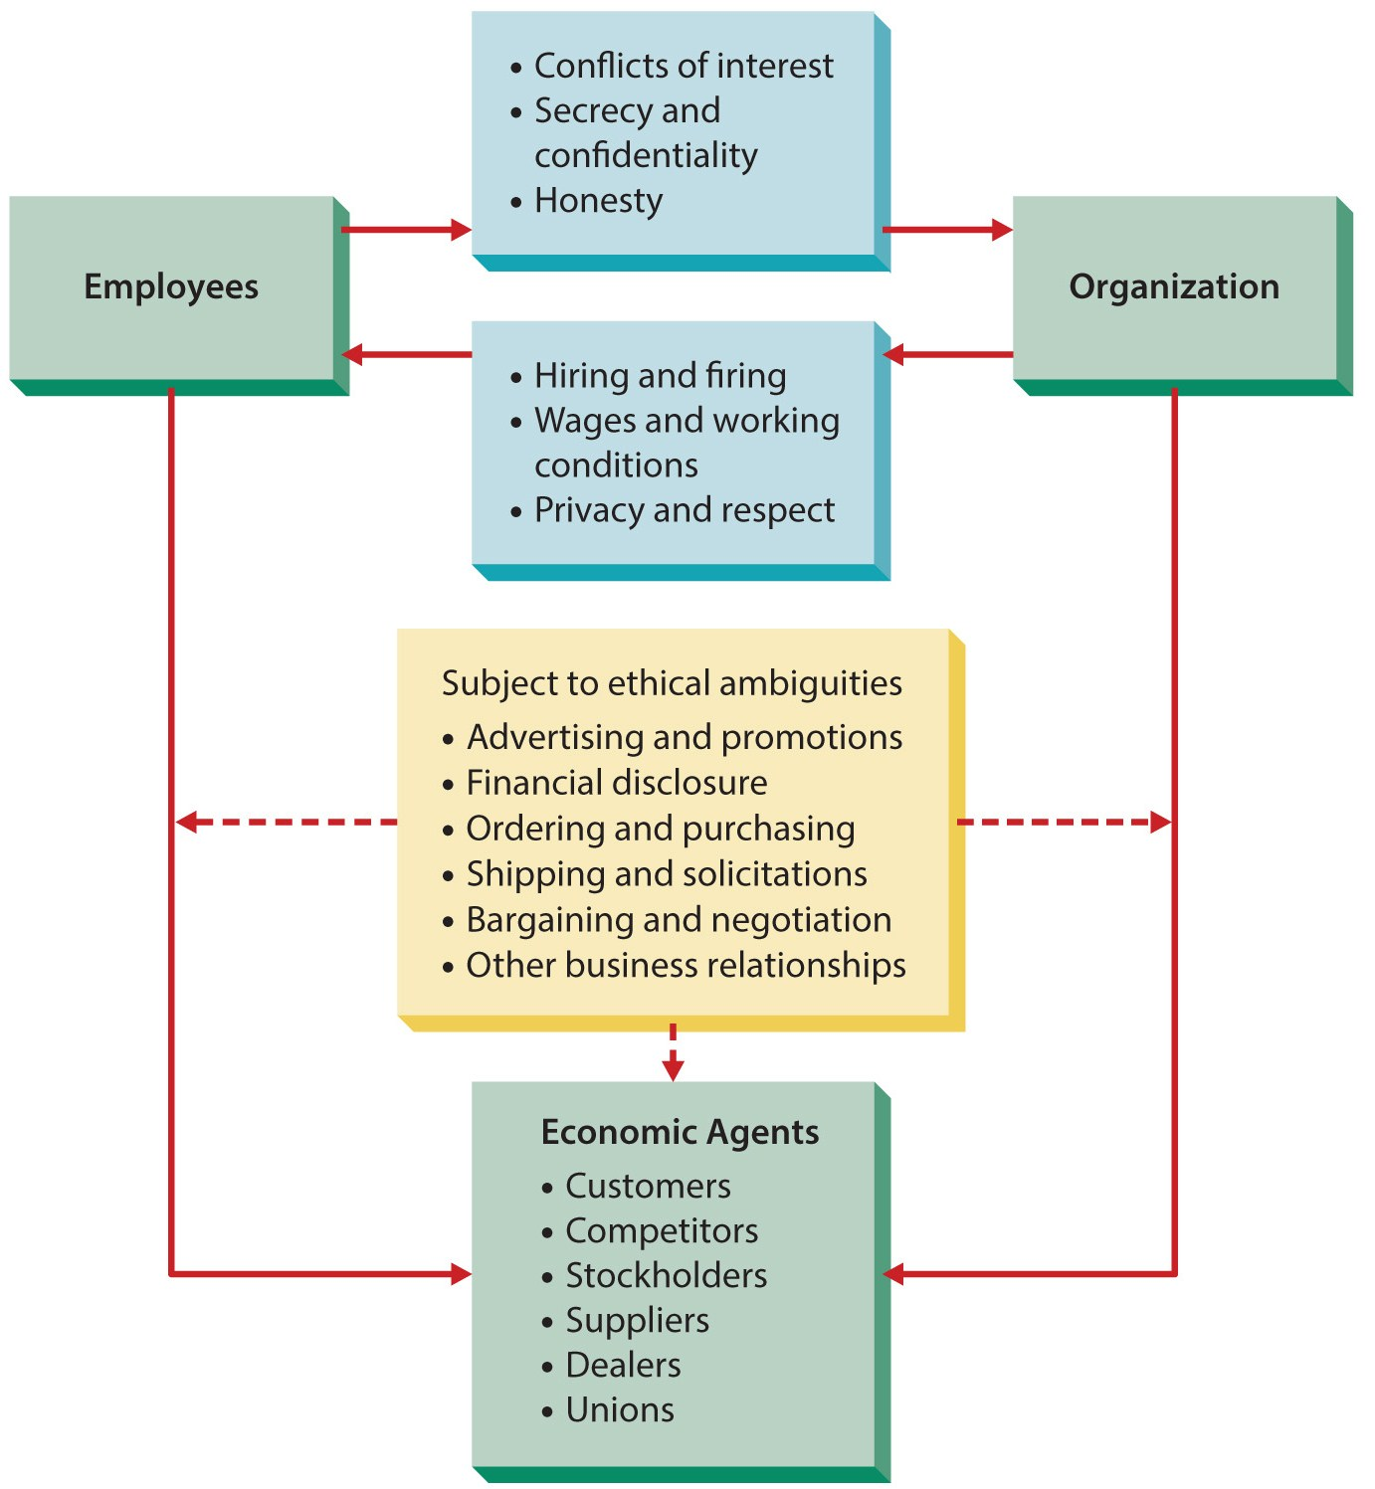
Figure 4.1
Managerial Ethics
Managers need to approach each set of relationships from an ethical and moral perspective.

Slide 7
Ethics in an Organizational Context
Unethical behavior most often occurs in a conducive organizational context.
Peers, top managers, and culture contribute to the ethical context.
Managers may find themselves under pressure and consider unethical actions.

Slide 8
Managing Ethical Behavior
Emphasizing ethical behavior takes many forms but starts with top management.
Committees and training are options.
The text looks at three common options.
Creating ethics codes.
Applying moral judgment.
Maintaining organizational justice.

Slide 9
Managing Ethical Behavior
Firms must adhere to such codes if they are to be of value.
Code of Ethics
A formal, written statement of the values and ethical standards that guide a firm’s actions.

Slide 10
Managing Ethical Behavior
Applying Moral Judgment
Other principles
Gather the relevant factual information.
Determine the most appropriate moral values.
Make an ethical judgment based on the rightness or wrongness of the proposed activity or policy.
Ethical norms, including
Utility – does the act optimize outcomes?
Rights – does the act respect the rights of all involved?
Justice – is it consistent and fair?
Caring – is the act consistent with people’s responsibilities to each other?

Slide 11
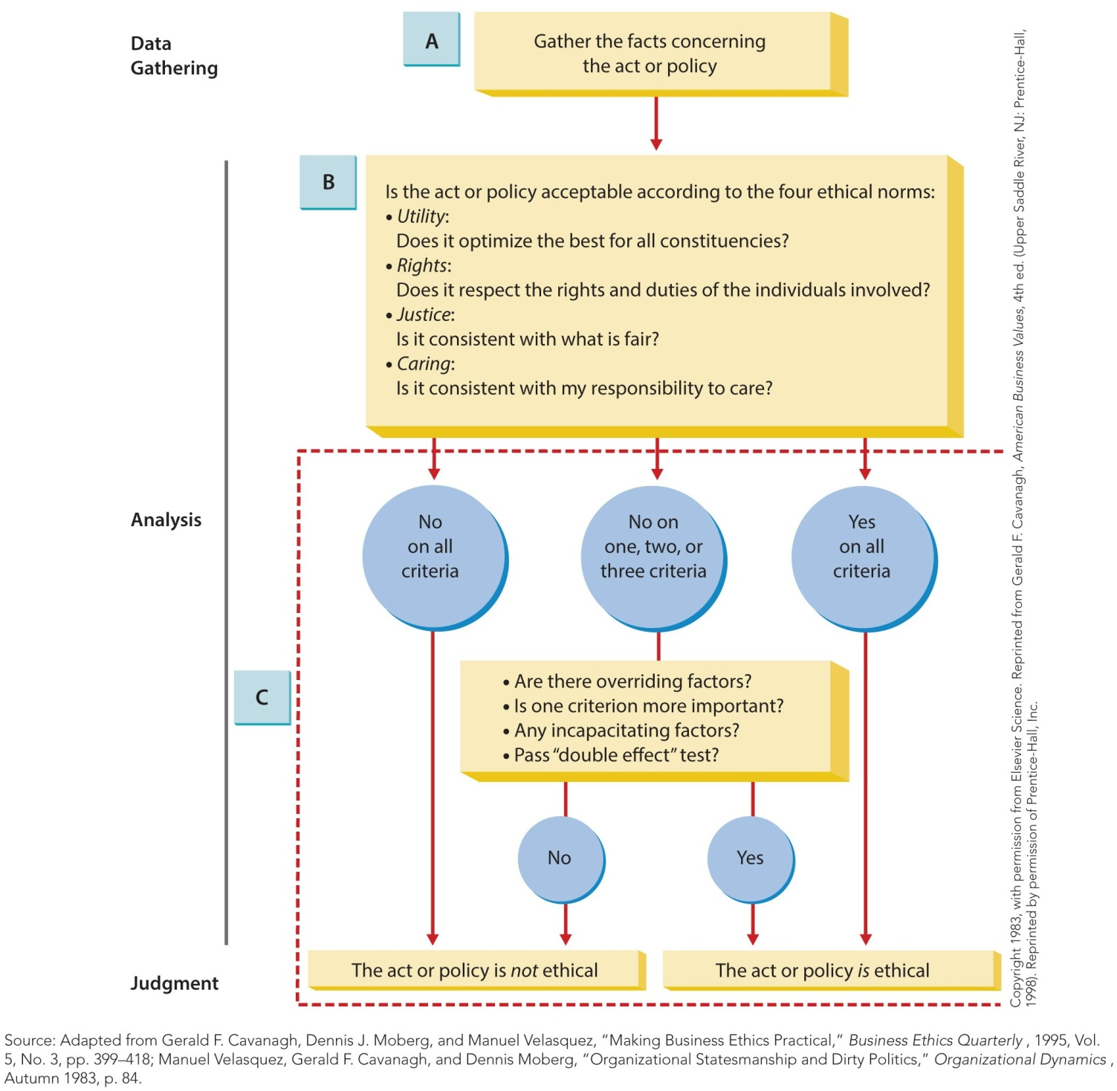
Figure 4.2
A Guide for Ethical
Decision Making
The resulting analysis allows a manager to make a clear assessment of whether a decision or policy is ethical.

Slide 12
Managing Ethical Behavior
Organizational justice
The perceptions of people in an organization regarding fairness.
The four types of organizational justice are: distributive, procedural, interpersonal, and informational.

Slide 13
Organizational Justice
Distributive justice is people’s perceptions of the fairness with distribution of rewards.
Procedural justice is individual’s perceptions of the fairness used to determine outcomes.
Interpersonal justice is the fairness people see in how they are treated by others.
Informational justice is the perceived fairness of information used for decisions.

Slide 14
Emerging Ethical Issues
Ethical leadership
The Sarbanes-Oxley Act of 2002 requires CEOs and CFOs to vouch for the truthfulness of their firm’s financial disclosures.
Corporate governance
Boards of directors must be independent.
Information technology
Online privacy is an important ethical concern.

Slide 15
Social Responsibility and Organizations
Social responsibility
The set of obligations an organization has to protect and enhance the societal context in which it functions.

Slide 16
Areas of Social Responsibility
Organizations may exercise social responsibility toward
their stakeholders,
the natural environment, and
the general social welfare.

Slide 17
Areas of Social Responsibility
Organizational stakeholders
Person or organization who is directly affected by the practices of an organization and has a stake in its performance.
Organizational stakeholders is another way to describe the task environment.

Slide 18
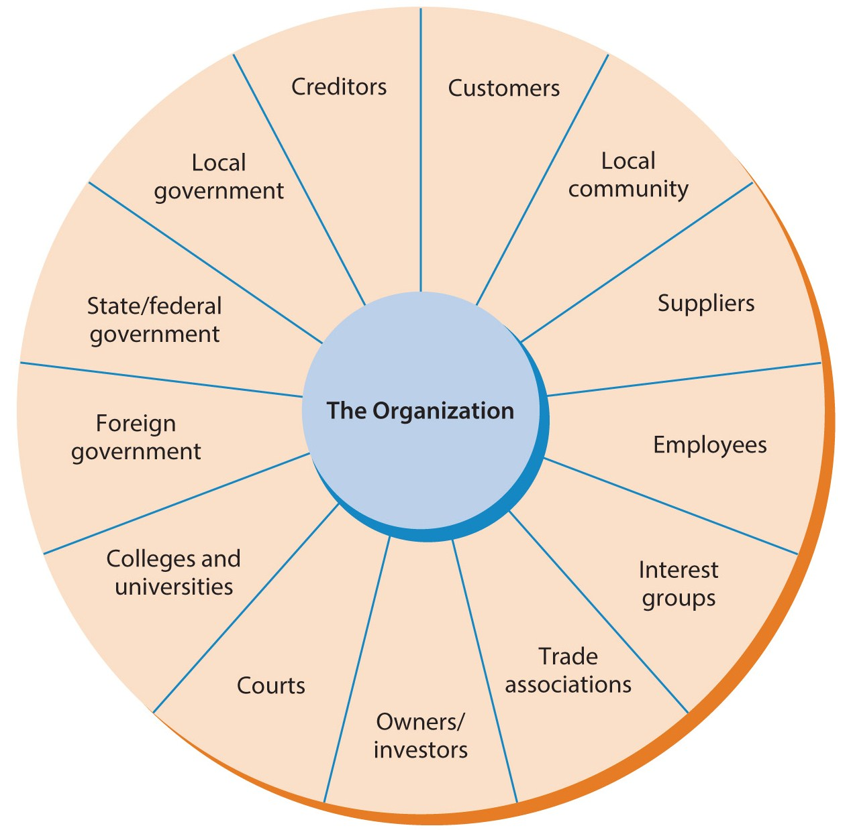
Figure 4.3
Organizational Stakeholders
Most companies focus on three main groups: customers, employees, and investors.

Slide 19
Areas of Social Responsibility
The natural environment
Laws now regulate how business treat the natural environment.
Much remains to be done.
General social welfare
Organizations contribute to charities, philanthropic organizations, and not-for-profit foundations, among other ways.

Slide 20
Arguments For/Against Social Responsibility
Arguments For Social Responsibility
Arguments Against Social Responsibility
Business creates problems and should solve them.
Corporations are citizens.
Businesses have the resources to help.
Businesses can profit from social responsibility.
Businesses should simply focus on making a profit.
Involvement gives businesses too much power.
There is potential for conflict of interest.
Organizations lack the expertise.

Slide 21
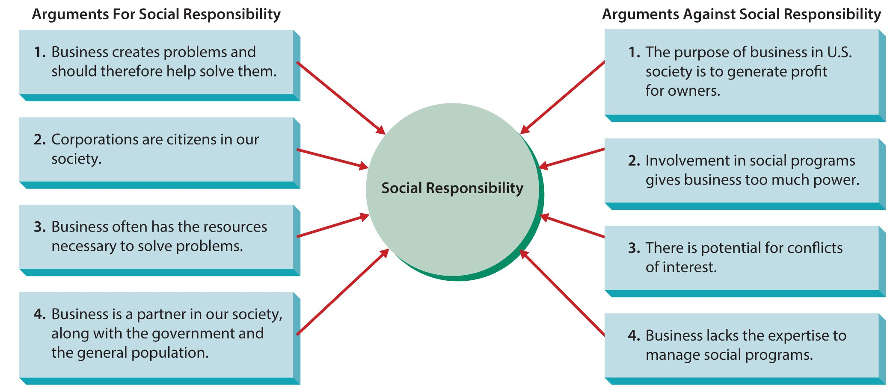
Figure 4.4
Arguments For and Against Social Responsibility
Managers should assess their own values, beliefs, and priorities when deciding which stance and approach to take regarding social responsibility.

Slide 22
Figure 4.5
Approaches to Social Responsibility
The four stances an organization can take falls along a continuum.

Slide 23
Organizational Approaches to Social Responsibility
Obstructionist stance
firm does as little as possible.
Defensive stance
does only what is legally required, nothing more.
Accommodative stance
meets legal requirements and goes beyond sometimes.
Proactive stance
views itself as a citizen and seeks opportunities to contribute.

Slide 24
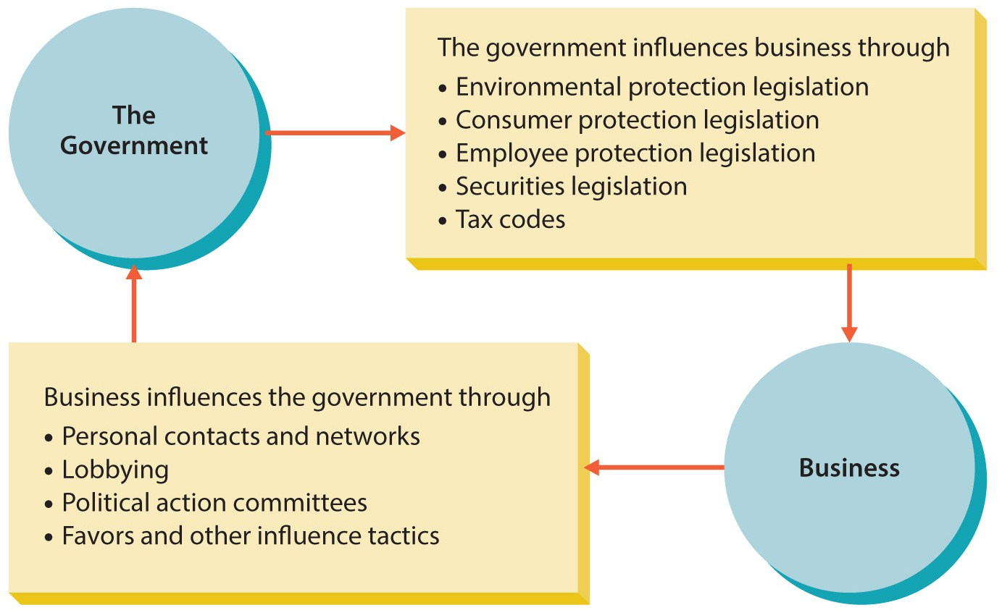
Figure 4.6
How Business and the Government Influence Each Other

Slide 25
How Government Influences Organizations
Through regulation
Establishment of laws and rules that dictate what organizations can and cannot do.
Through indirect regulation
For example, providing tax incentives for companies who opened new training centers.

Slide 26
How Organizations Influence Government
Personal contacts
Lobbying
uses persons or groups to formally represent an organization before political bodies.
A political action committee (PAC)
is created to solicit and distribute money to political candidates.
Favors and other influence tactics

Slide 27
Managing Social Responsibility
Legal compliance
The extent to which the organization complies with local, state, federal, and international laws.
Ethical compliance
The extent to which the firm and its members follow basic ethical standards of behavior.
Philanthropic giving
The awarding of funds or other gifts to charities or other social programs.
Formal organizational actions.

Slide 28
Managing Social Responsibility
Organizational leadership and culture
Can define the social responsibility stance adopted by an organization.
Whistle blowing
Occurs when an employee discloses illegal or unethical conduct by others within an organization.
Informal organizational actions

Slide 29
Evaluating Social Responsibility
Many organizations require employees to read guidelines or codes of ethics and sign an agreement of compliance.
Evaluate response time for instances of questionable legal or ethical conduct.
A corporate social audit
is a formal and thorough analysis of the effectiveness of a firm’s social performance.

Slide 30
Summary
Chapter four first looked at individual ethics, their organizational context and noted several emerging ethical issues.
Next, the subject of social responsibility.
The relationships between businesses and government regarding social responsibility.
The activities undertaken by organizations to be more socially responsible.

