Slide 1
MANAGEMENT
TWELFTH EDITION
Ricky W. Griffin
Part Three: Planning and Decision Making
Chapter Six: Basic Elements of Planning and Decision Making

Slide 2
Learning Outcomes
Summarize the essential functions of decision making and the planning process.
Discuss the purpose of organizational goals, identify different kinds of goals, discuss who sets goals, and describe how to manage multiple goals.
Identify different kinds of organizational plans, note the time frames for planning, discuss who plans, and describe contingency planning.

Slide 3
Learning Outcomes
Discuss how tactical plans are developed and executed.
Describe the basic types of operational plans used by organizations.
Identify the major barriers to goal setting and planning, how organizations overcome those barriers, and how to use goals to implement plans.

Slide 4
Decision Making and the Planning Process
Decision making
Is the cornerstone of planning.
Is the catalyst that drives the planning process.
Underlies the formulation and implementation of all plans.
Planning
Occurs within an environmental context.

Slide 5
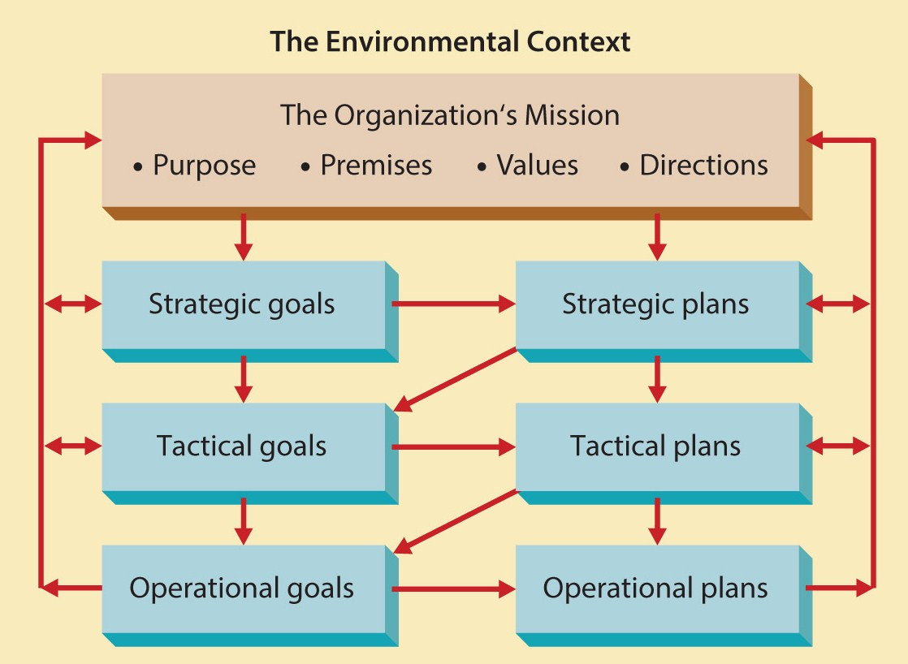
Figure 6.1
The Planning Process

Slide 6
Organizational Goals
Goals serve four important purposes:
They provide guidance and a unified direction.
Goal-setting affects other aspects of planning.
Effective goal setting promotes good planning.
Good planning facilitates future goal setting.
Specific and moderately difficult goals can motivate employees.
Goals provide an effective mechanism for evaluation and control.

Slide 7
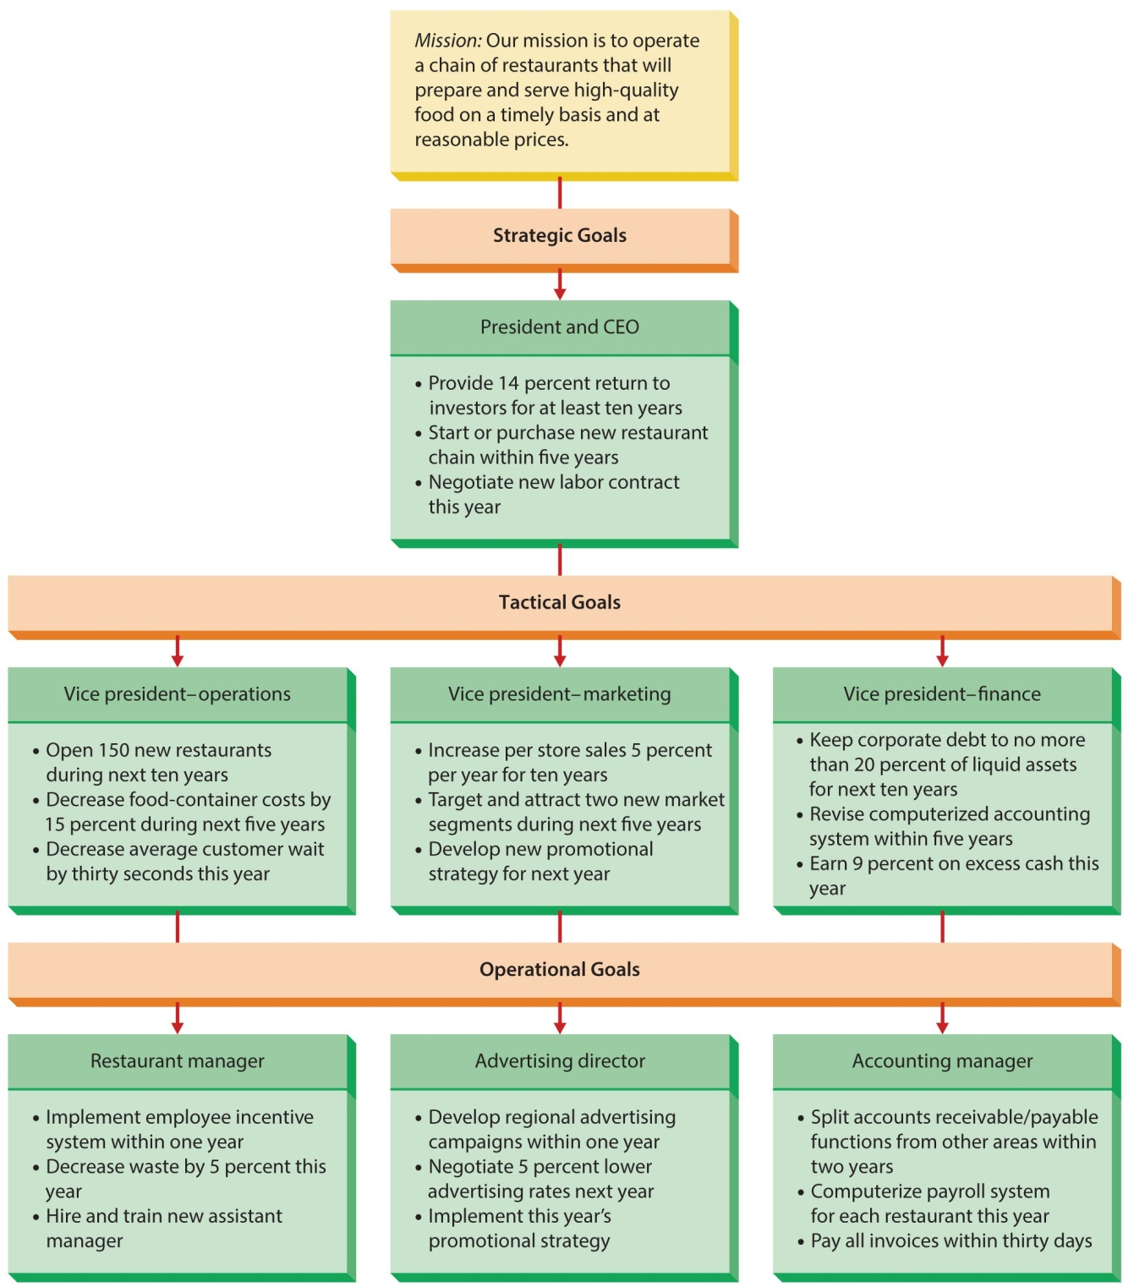
Figure 6.2
Kinds of Organizational Goals for a Regional Fast-Food Chain
Goals vary by level, area, and time frame.

Slide 8
Kinds of Goals - Level
Goals are set for and by different levels.
A mission statement states an organization’s fundamental purpose.
A strategic goal is set by/for top management.
Focus is on broad, general goals.
A tactical goal is set by/for middle managers.
Focus is on actions necessary to achieve strategic goals.
An operational goal is set by/for lower-level managers.
Focus is on short-term issues associated with tactical goals.

Slide 9
Kinds of Goals Area and Time Frames
Area
Organizations set goals for different areas.
Operations, marketing, finance, quality control, productivity, human resources.
Time frame
Organizations set goals across different time frames.
Long-term, intermediate-term, and short-term goals.

Slide 10
Organizational Goals
Responsibilities for setting goals
Who sets goals?
All managers.
Managers are responsible for setting goals that correspond to their level in the organization.
Managing multiple goals
Sometimes goals conflict.
Optimizing involves balancing and reconciling possible conflicts among goals.

Slide 11
Organizational Planning
This section identifies:
Kinds of plans
Time frames for planning
Who is responsible for planning
Contingency planning

Slide 12
Kinds of Organizational Plans
Strategic plan
A general plan outlining decisions of resource allocation, priorities, and action steps necessary to reach strategic goals.
Tactical plan
A plan aimed at achieving tactical goals, developed to implement parts of a strategic plan.
Operational plan
Focuses on carrying out tactical plans to achieve operational goals.

Slide 13
Time Frames for Planning
Long-range plan
Covers many years, perhaps decades, commonly five years or more.
Intermediate plan
Generally covers from one to five years.
Short-range plan
Covers a span of one year or less.
An action plan operationalizes any other plan.
A reaction plan reacts to unforeseen events.

Slide 14
Responsibilities for Planning
Planning staff
Coordinates planning and provides tools; takes a broad view and crosses departments.
Planning task force
Line managers grouped for a specific task.
Board of directors
Establishes mission and strategy.

Slide 15
Responsibilities for Planning
Chief Executive Officer
Major roles in planning and implementation.
Executive committee
Top management provide input to the CEO and reviews strategic plans.
Line management
Provide valuable inside information and execute the plans developed by top management.

Slide 16
Contingency Planning and Crisis Management
Contingency planning
The determination of alternative courses of action to be taken if an intended plan is unexpectedly disrupted or rendered inappropriate.
Crisis management
The set of procedures the organization uses in the event of a disaster or other unexpected calamity.
Because it is impossible to forecast the future, no organization is perfectly prepared for all crises.

Slide 17
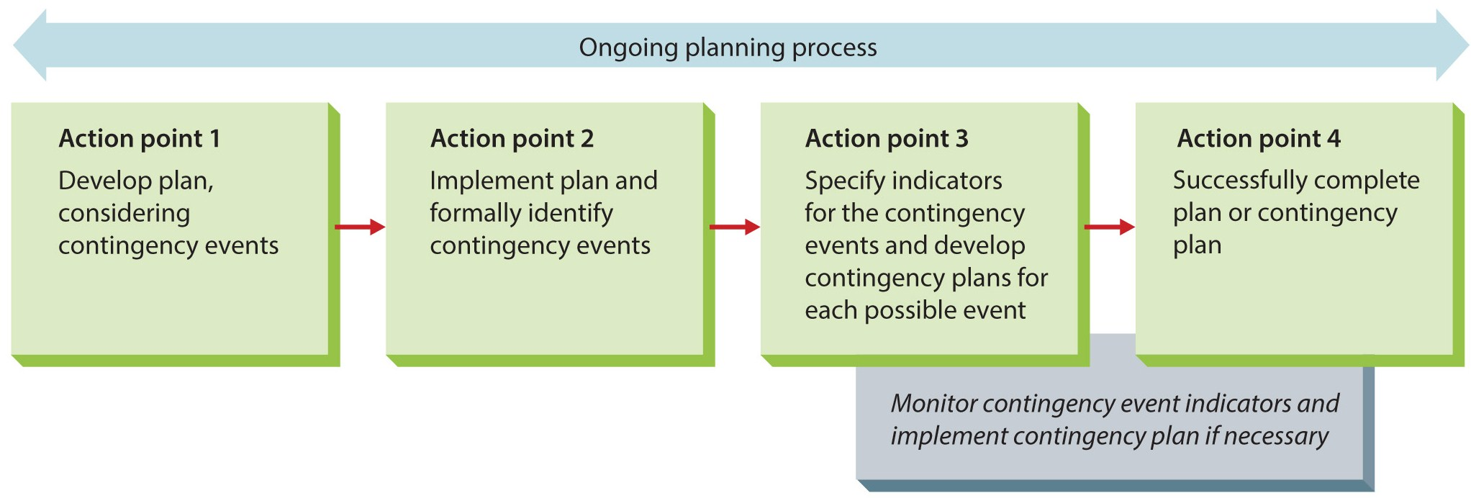
Figure 6.3
Contingency Planning
Action points determine which plan managers should use.

Slide 18
Tactical Planning
Tactical plan
A plan aimed at achieving tactical goals, developed to implement specific parts of a strategic plan.
Tactical plans are to battle as strategy is to war.

Slide 19
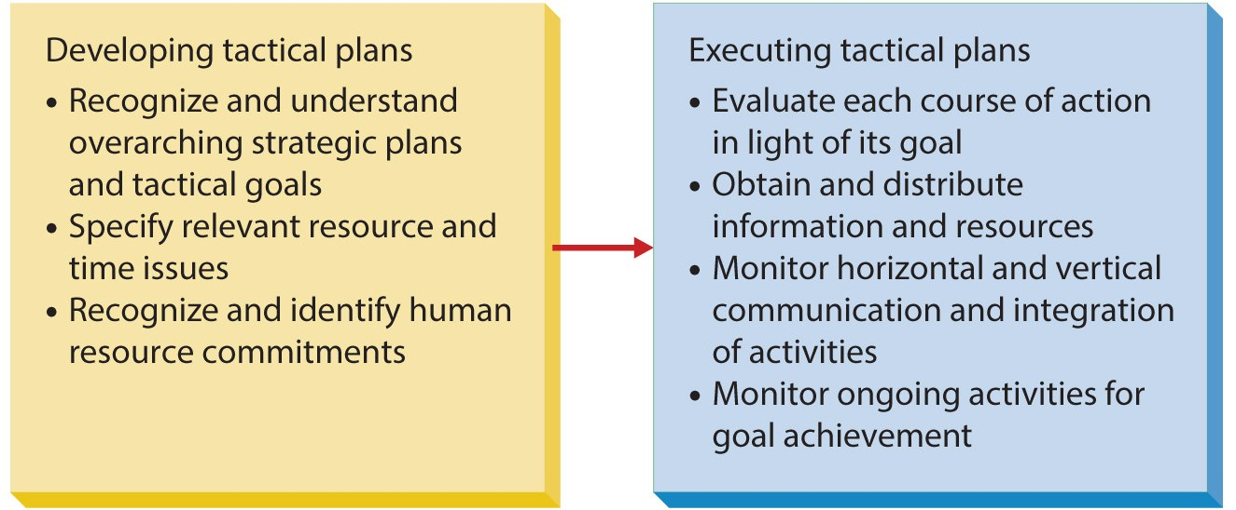
Figure 6.4
Developing and Executing Tactical Plans

Slide 20
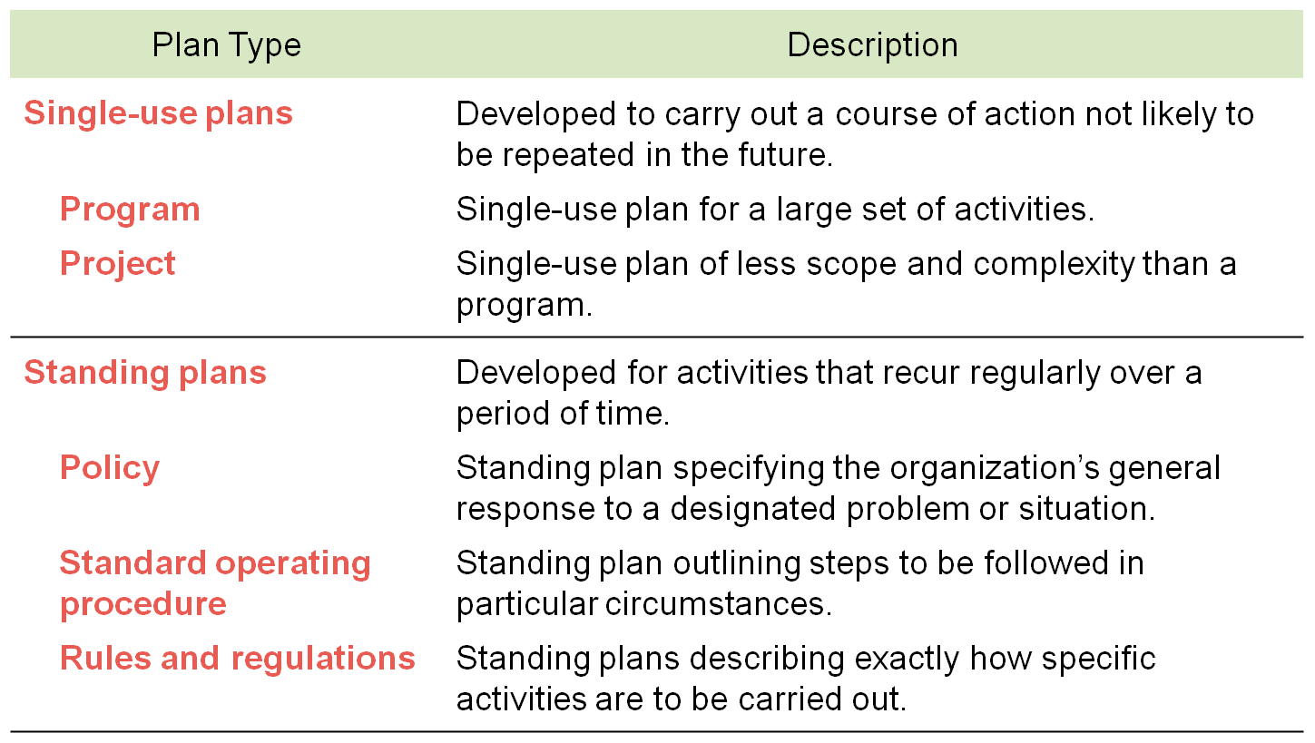
Table 6.1
Types of Operational Plans

Slide 21
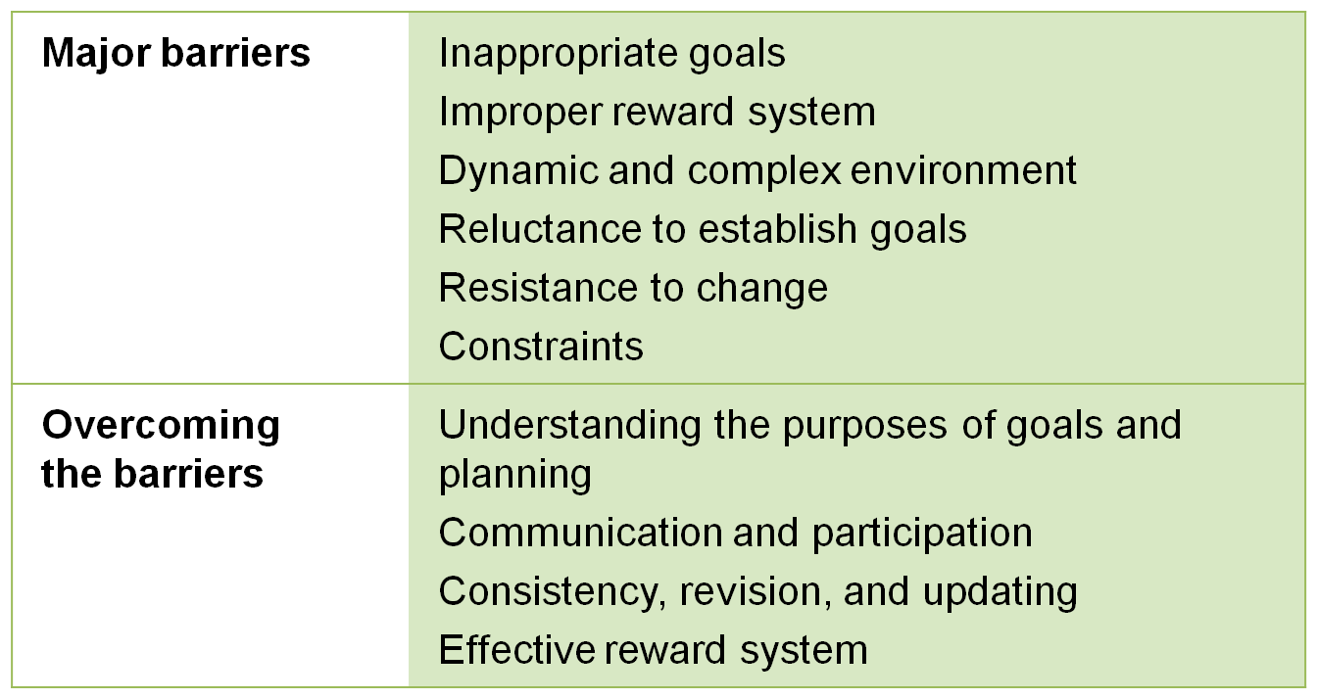
Table 6.2
Barriers to Goal Setting and Planning

Slide 22
Managing Goal-Setting and Planning Processes
Using goals to implement plans.
Management by objectives (MBO)
A formal goal-setting process involving collaboration between managers and subordinates.
The extent to which goals are accomplished is a major factor in evaluating and rewarding subordinates’ performance.

Slide 23
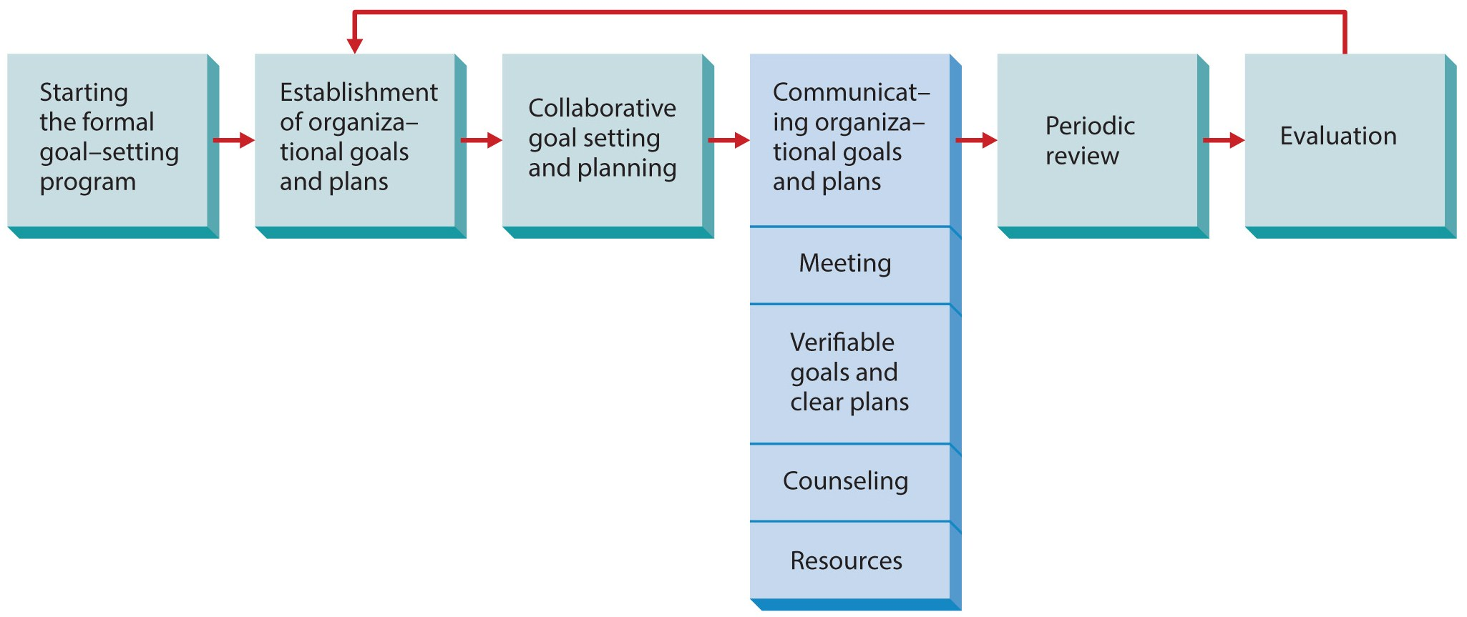
Figure 6.5
The Formal Goal-Setting Process
The purpose of formal goal setting is to give subordinates a voice in the goal-setting and planning processes
and to clarify what they are to accomplish in a given time span.

Slide 24
Effectiveness of Formal Goal Setting
Strengths (Success)
Weaknesses (Failure)
Improved motivation.
Enhanced communication.
Allows for objective performance appraisals.
Focuses on appropriate goals and plans.
Identifies managerial talent.
Facilitates control.
Poor implementation.
Lack of top management support.
Overemphasizing quantitative goals.
Assigned goals lead to resentment and lack of commitment.

Slide 25
Summary
This chapter briefly related decision making and planning, then explained the most common planning process.
Discussion turned to organizational goals and the basic concepts of planning.
Tactical and operational planning followed.
The chapter ended with how to manage the goal-setting and planning processes.

