Slide 1
MANAGEMENT
TWELFTH EDITION
Ricky W. Griffin
Part Three: Planning and Decision Making
Chapter Seven: Managing Strategy and Strategic Planning

Slide 2
Learning Outcomes
Discuss the components of strategy, types of strategic alternatives, and the distinction between strategy formulation and strategy implementation.
Describe how to use SWOT (Strengths, Weaknesses, Opportunities, and Threats) analysis in formulating strategy.
Identify and describe various alternative approaches to business-level strategy formulation.

Slide 3
Learning Outcomes
Describe how business-level strategies are implemented.
Identify and describe various alternative approaches to corporate-level strategy formulation.
Describe how corporate-level strategies are implemented.
Discuss international and global strategies.

Slide 4
Nature of Strategic Management
Strategy
A comprehensive plan for accomplishing an organization’s goals.
Strategic management
A comprehensive and ongoing management process aimed at formulating and implementing effective strategies; a way of approaching business opportunities and challenges.
Effective strategy
A strategy that promotes a superior alignment between the organization and its environment and the achievement of strategic goals.

Slide 5
Components of Strategy
Strategy
Distinctive competence
An organizational strength possessed by only a small number of competing firms.
Scope
Specifies the range of markets in which an organization will compete.
Resource deployment
How a firm distributes its resources across the areas in which it competes.

Slide 6
Levels of Strategy
Business-level strategy
The set of strategic alternatives from which an organization chooses as it conducts business in a particular industry or market.
Corporate-level strategy
The set of strategic alternatives from which an organization chooses as it manages its operations simultaneously across several industries and several markets.

Slide 7
Strategy Formulation and Implementation
Strategy formulation
is the set of processes involved in creating or determining the strategies of the organization
it focuses on the content of strategies.
Strategy implementation
is the methods by which strategies are executed within the organization
it focuses on the processes which achieve strategies.

Slide 8
Strategy Formulation and Implementation
Deliberate strategy
is a chosen plan of action implemented to support specific goals.
Emergent strategy
is a developed pattern of actions in the absence of mission and goals or despite mission and goals.

Slide 9
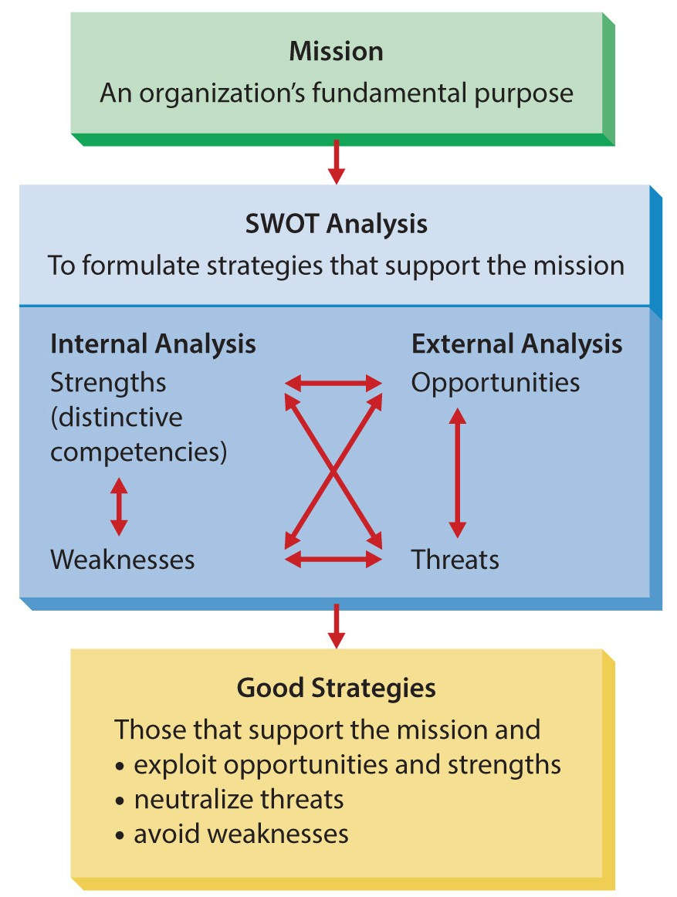
Figure 7.1
SWOT Analysis
SWOT is an acronym standing for Strengths, Weaknesses, Opportunities, and Threats.

Slide 10
Using SWOT Analysis to Formulate Strategy
Evaluating an organization’s strengths
Organizational strengths
are skills or capabilities enabling an organization to conceive of and implement its strategies.
SWOT analysis divides strengths into common strengths and distinctive competencies.
A common strength is a skill or capability held by numerous competing firms.
Competitive parity exists when large numbers of competing firms can implement the same strategy.

Slide 11
Using SWOT Analysis to Formulate Strategy
Evaluating an organization’s strengths
A distinctive competence is a strength possessed by a small number of firms.
Organizations that exploit these competencies often obtain a competitive advantage.
Strategic imitation is duplicating another’s competence into a valuable strategy.
Sustained competitive advantage exists after all attempts at strategic imitation have ceased.

Slide 12
Using SWOT Analysis to Formulate Strategy
Evaluating an organization’s weaknesses
Organizational weaknesses
are skills and capabilities that do not enable (and may limit) an organization to choose and implement strategies that support its mission.
Two ways to address weaknesses
invest to obtain strengths or modify mission.
A competitive disadvantage exists when a firm is not implementing valuable strategies implemented in competing firms.

Slide 13
Using SWOT Analysis to Formulate Strategy
Evaluating opportunities and threats requires analyzing the environment.
Organizational opportunities
are areas in the environment that, if exploited, may generate higher performance.
Organizational threats
areas in the environment that increase the difficulty of an organization’s achieving high performance.

Slide 14
Formulating Business-Level Strategies
Porter’s Generic Strategies
The Miles and Snow Typology
Product Life Cycle Strategies
There are three approaches to formulating business-level strategy.

Slide 15
Formulating Business-Level Strategies Porter’s Generic Strategies
Differentiation strategy
seeks to distinguish itself from competitors through the quality of its products and services.
Overall cost leadership strategy
seeks to gain a competitive advantage by reducing its costs below competing firms.
Focus strategy
concentrates on a specific regional market, product line, or group of buyers.

Slide 16
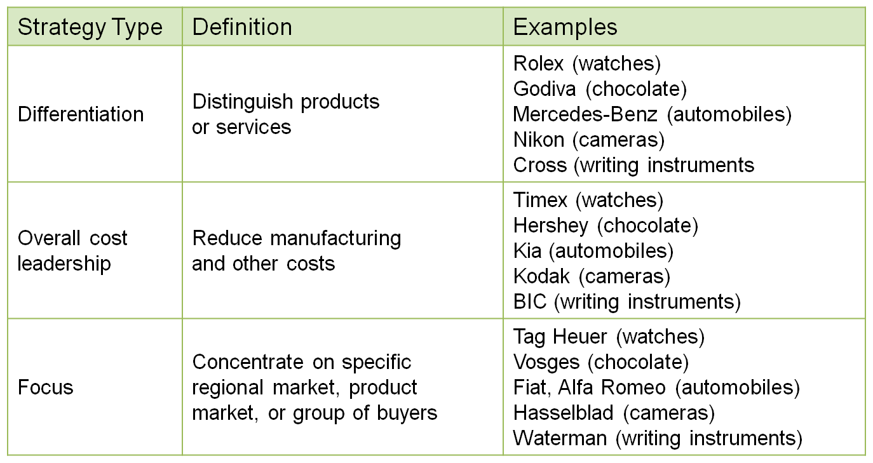
Table 7.1
Porter’s Generic Strategies

Slide 17
Formulating Business-Level Strategies The Miles and Snow Typology
Prospector strategy
encourages creativity and flexibility and is often decentralized.
Defender strategy
focuses on lowering costs and improving performance of current products.
Analyzer strategy
maintains current businesses and is somewhat innovative in new businesses.
Reactor strategy
has no consistent approach to strategy.

Slide 18
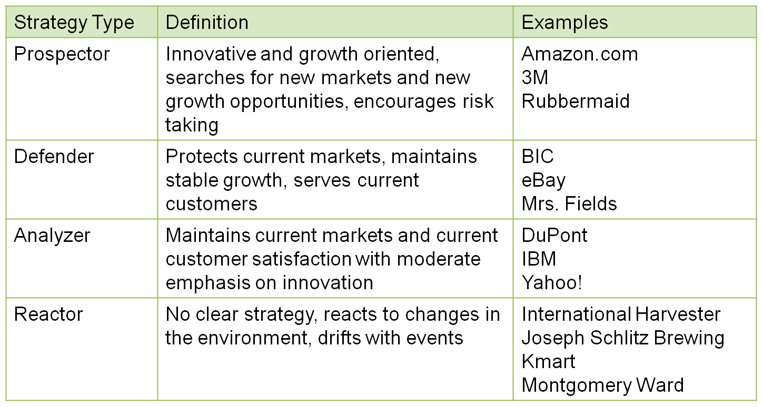
Table 7.2
The Miles and Snow Typology

Slide 19
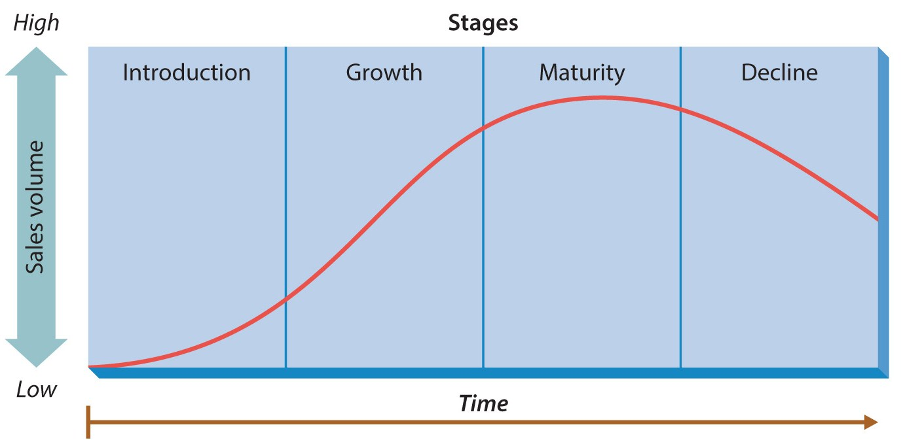
Figure 7.2
The Product Life Cycle

Slide 20
Formulating Business-Level Strategies
Product life cycle
is a model portraying how sales volume for products change over the life of the product.
Different stages call for different strategies.
Introduction stage
Demand may be very high.
Focus on increasing production, keeping quality high, and managing inventories and cash flow.

Slide 21
Formulating Business-Level Strategies
Product life cycle
Growth stage
Sales continue to grow.
Focus on quality/delivery and begin to differentiate.
Maturity stage
Demand begins to slow.
Focus on low costs and search for new products.
Decline stage
Total sales decline.
Firms may close, or differentiate and cut costs.

Slide 22
Implementing Business-Level Strategies Porter’s Generic Strategies
Differentiation strategy
Marketing and sales emphasizes high-quality, high-value image of products or services.
Accounting controls the flow of funds without discouraging creativity.
Manufacturing emphasizes quality and meeting customer needs.
The culture must emphasize creativity, innovation, and response to customer needs.

Slide 23
Implementing Business-Level Strategies Porter’s Generic Strategies
Overall cost leadership strategy
Marketing focuses on product attributes meeting customer needs in a low-cost, effective manner.
Accounting reduces costs through tight controls.
Manufacturing reduces per unit costs by increasing volume of production.
Culture focuses on improving efficiencies.

Slide 24
Implementing Business-Level Strategies The Miles and Snow’s Strategies
Decentralization facilitates prospectors.
Encourages creativity and flexibility.
Prospectors often switch to defenders.
Defenders downplay creativity, focusing on costs and improving performance.
Analyzers maintain current business and must be somewhat innovative.
Tight financial controls and high flexibility, efficient production and customized products.

Slide 25
Formulating Corporate-Level Strategies
Most large businesses are engaged in several businesses, industries, and markets.
Each business within such a firm is frequently called a strategic business unit, or SBU.
Diversification is the number of different businesses an organization engages in and the extent to which these businesses are related to each other.

Slide 26
Formulating Corporate-Level Strategies
Single-product strategy
an organization manufactures one product or service and sells in a single geographic market.
Related diversification
an organization operates in several businesses that are somehow linked with one another.
Bases of relatedness include common:
technology, distribution network, marketing skills, brand names and reputation, and customers.

Slide 27
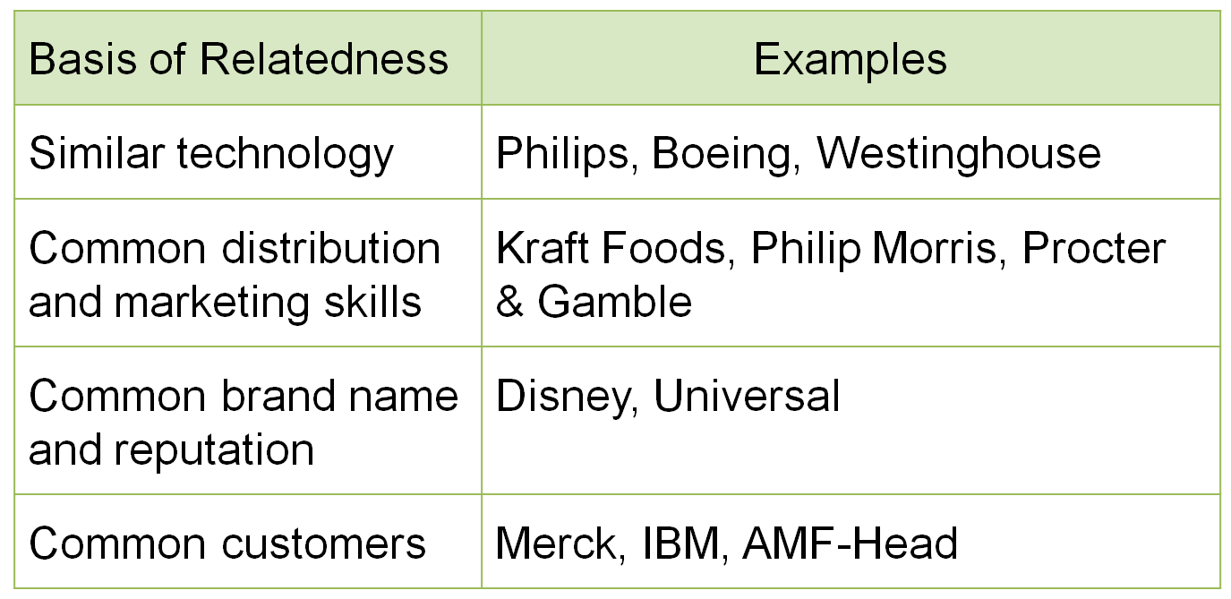
Table 7.3
Bases of Relatedness in Implementing Related Diversification

Slide 28
Formulating Corporate-Level Strategies
Advantages of related diversification
Reduces economic risk.
Reduces overhead costs.
Allows an organization to create synergy.
Synergy exists among a set of businesses when the businesses’ economic value together is greater than their economic value separately.

Slide 29
Formulating Corporate-Level Strategy
Unrelated diversification
An organization operates multiple businesses not logically associated with one another.
Presumed benefits:
Businesses should have stable performance over time and resource allocation advantages.
Actual disadvantages:
Lack of knowledge at the corporate level about unrelated businesses.
Fails to exploit important synergies used by competitors.

Slide 30
Implementing Corporate-Level Strategies
When implementing a diversification strategy, organizations face two important questions.
How will they move from a single-product strategy to some form of diversification?
Once diversified, how will they manage diversification effectively?

Slide 31
Becoming a Diversified Firm
Diversifying
New Products
Replace suppliers or customers
Mergers and acquisitions
Most organizations do not start out completely diversified.

Slide 32
Becoming a Diversified Firm
Some firms diversify by developing new products and services.
Firms can also diversify by replacing former suppliers and customers.
Backward vertical integration
an organization conducts activities formerly conducts by its suppliers.
Forward vertical integration
an organization begins activities formerly conducted by its customers.

Slide 33
Becoming a Diversified Firm
Another common way to diversify is through mergers and acquisitions.
A merger is the purchase of one firm by another firm of approximately the same size.
An acquisition is the purchase of a firm by a firm that is considerably larger.

Slide 34
Becoming a Diversified Firm
The two major tools for managing diversification are organization structure and portfolio management techniques.
Portfolio management techniques
methods of determining which businesses to engage in and how to manage these businesses to maximize corporate performance.

Slide 35
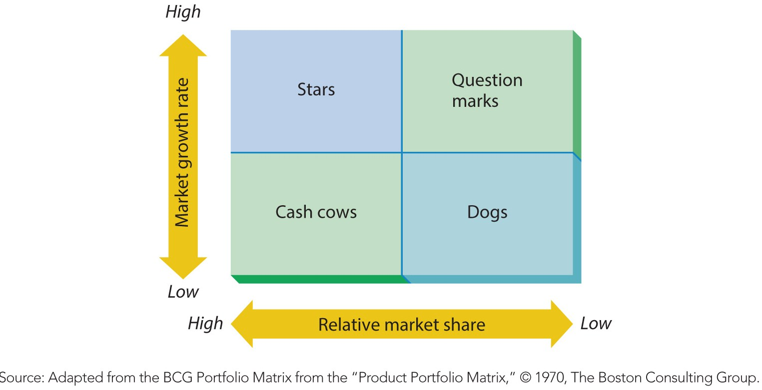
Figure 7.3
BCG Matrix
The BCG matrix is a method of evaluating businesses relative to the growth rate of their market and the organization’s share of the market.

Slide 36
Managing Diversification
GE Business Screen
a method of evaluating businesses along two dimensions: (1) industry attractiveness and (2) competitive position;
in general, the more attractive the industry and the more competitive the position, the more an organization should invest in a business.

Slide 37
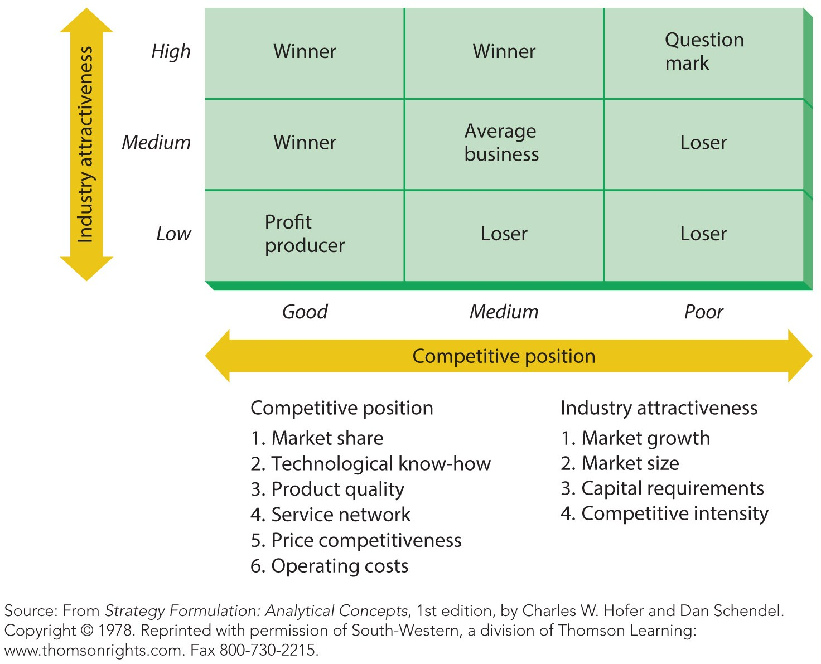
Figure 7.4
The G.E. Business Screen

Slide 38
International and Global Strategies
Managers of international firms face more complexity and uncertainty when formulating strategies.
However, they may exploit three sources of competitive advantage.
Global efficiencies.
Multimarket flexibility.
Worldwide learning.

Slide 39
International and Global Strategies
Global efficiencies include:
Location efficiencies allows firms to locate wherever they can obtain cost advantage.
Economies of scale lowers the per unit cost of production due to large quantities.
Economies of scope lowers cost per unit by sharing expenses across product lines.

Slide 40
International and Global Strategies
Multimarket flexibility
gives firms the ability to respond to change in one region by making changes in other regions.
Worldwide learning
gives firms the advantage of adopting best practices from wherever they originate.
Firms are not usually able to exploit all three advantages simultaneously.

Slide 41
International and Global Strategies
Strategic alternatives
Home replication strategy
A company uses the core competency it developed at home as its main competitive weapon.
Multidomestic strategy
A company manages itself as a collection of subsidiaries, each with a domestic market.
Global strategy
A company views the world as a single marketplace, standardizing products to address the needs of customers worldwide.

Slide 42
Summary
This chapter examined the nature of strategic management, including its components and alternatives.
The text then described the kinds of analysis needed for firms to formulate their strategies.
Next, the text examined how organizations formulate and then implement business-level strategies.
Followed by a parallel discussion at the corporate strategy level.
Concluding with a discussion of international and global strategies.

