Slide 1
MANAGEMENT
TWELFTH EDITION
Ricky W. Griffin
Part Three: Planning and Decision Making
Chapter Nine: Managing Start-Ups and New Ventures

Slide 2
Learning Outcomes
Discuss the nature of entrepreneurship.
Describe the role of entrepreneurship in society.
Understand the major issues involved in choosing strategies for small firms and the role of international management in entrepreneurship.
Discuss the structural challenges unique to entrepreneurial firms.
Understand the determinants of the performance of small firms.

Slide 3
Meaning of Entrepreneurship
Entrepreneurship
The process of planning, organizing, operating, and assuming the risk of a start-up or new venture.
Entrepreneur
Someone who engages in entrepreneurship.
Small business
Privately owned by one individual or a small group, does not have revenues or assets large enough to influence its environment.
Start-up or new venture
A relatively new small business.

Slide 4
Role of Entrepreneurs, Start-Ups and New Ventures in Society
Some entrepreneurs have success.
Think Bill Gates.
Research shows the majority of new businesses fail within the first few years.
Measure start-up contributions in terms of their effects on
job creation, innovation and their importance to big business.

Slide 5
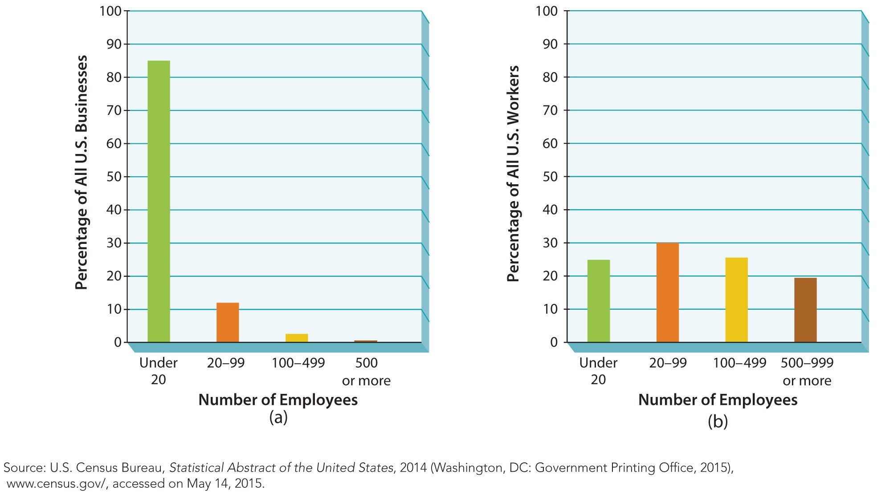
Figure 9.1
Importance of Small Business in the U.S.

Slide 6
Role of Entrepreneurs, Start-Ups and New Ventures on Society
Job creation
They are an important source of new jobs in the U.S. – especially in certain industries.
Innovation
The SBA says start-ups consistently supply over half of all “innovations” each year.
Importance to big business
Start-ups sell the products of big business.
They also supply raw materials to big business.

Slide 7
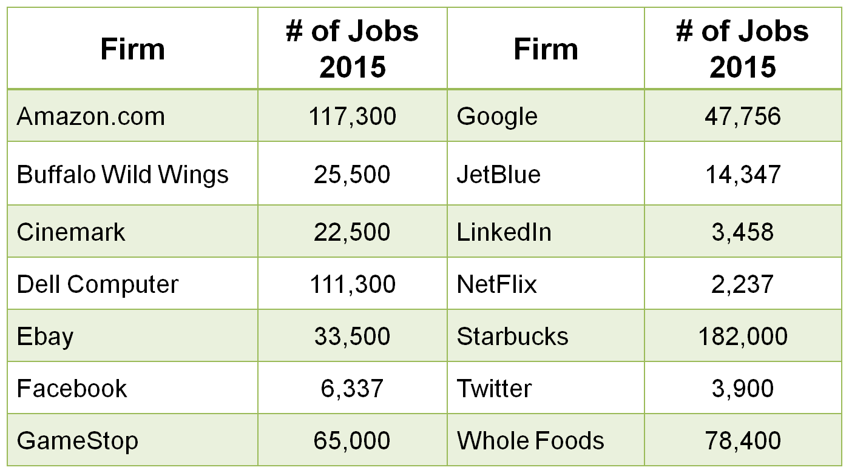
Table 9.1
Job Creation by Recent Successful Start-Ups and New Ventures

Slide 8
Strategy for Start-Ups and New Ventures
Three strategic challenges facing small firms.
Choosing an industry
Emphasizing distinctive competencies
Writing a business plan

Slide 9
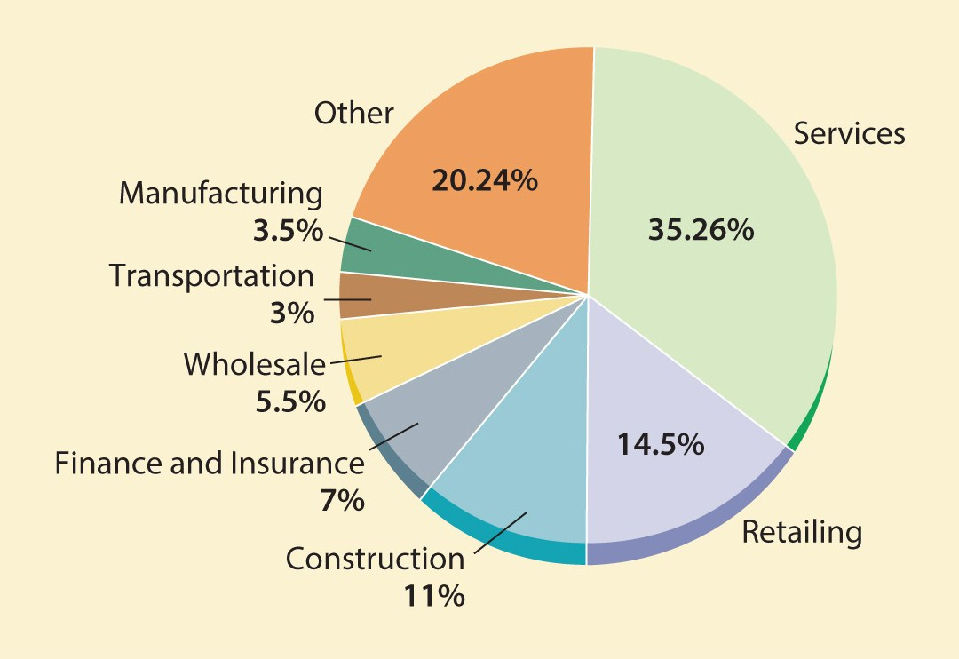
Figure 9.2
Small Businesses* By Industry
*Fewer Than 20 Employees
Source: U.S. Census Bureau, Statistical Abstract of the United States, 2014.

Slide 10
Choosing an Industry
Services
need few resources, offer high return on time invested, and appeal to innovative entrepreneurs.
Retailing
start-ups usually focus limited resources on narrow market segments.
Construction
is constrained by location, so small, local firms are ideal contractors.

Slide 11
Choosing an Industry
Finance and insurance
businesses are either affiliates of or sell products provided by larger national firms.
Wholesaling
requires fewer employees than other industries.
Transportation
includes local taxi and limousine, charter airplane service, tour operation, and maintenance workers.

Slide 12
Choosing an Industry
Manufacturing
more than any other industry, lends itself more to big businesses.
Economy of scale shows the relationship of falling costs as production increases.
When technology in an industry changes, it often shifts the economies of scale curve, creating opportunities for smaller organizations.
Some small manufacturers prosper by serving as suppliers to large manufacturers.

Slide 13
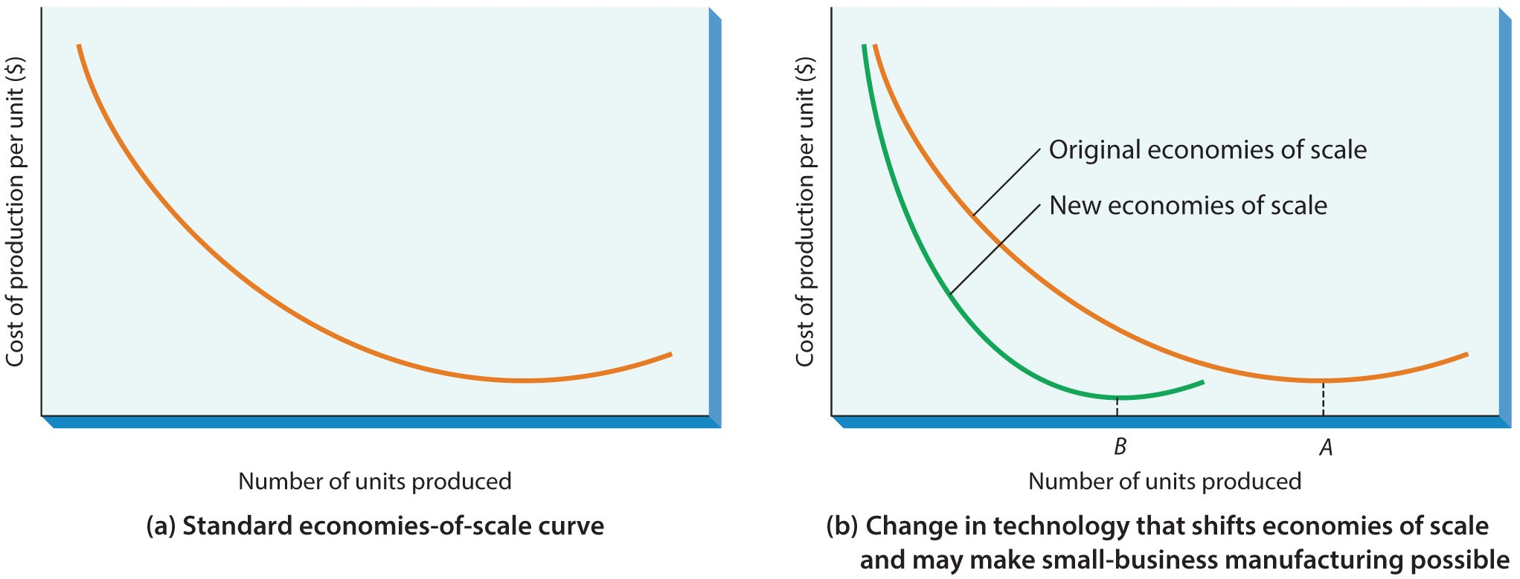
Figure 9.3
Economies of Scale in Small-Business Organizations
Small organizations usually cannot compete effectively on the basis of economies of scale.

Slide 14
Emphasizing Distinctive Competencies
Identify new niches in established markets.
Identify new markets.
Quickly taking advantage of new opportunities.

Slide 15
Emphasizing Distinctive Competencies
Identify a niche in an established market.
A niche is a segment of a market not currently being exploited.
An established market is one in which several large firms compete according to relatively well-defined criteria.

Slide 16
Emphasizing Distinctive Competencies
Identify a new market in two ways.
Transfer a product or service established in one geographic market to a second market.
Create entire industries.
Quickly taking advantage of new opportunities.
A first-mover advantage comes to a firm that exploits an opportunity before any other firm does.

Slide 17
Strategy for Start-Ups and New Ventures
Writing a business plan
a document summarizing the business strategy and structure.
The plan should include:
goals, strategies and implementation, forecasts and financial statements.
Most important of these statements is the cash budget.
International markets
Either location or sales may prove successful.

Slide 18
Structure of Start-Ups and New Ventures
Entrepreneurs must decide:
How to get into business
How to finance the business
When and how to seek expert advice

Slide 19
Starting the New Business
Buy an existing business
Entrepreneurs can examine the history and better understand the risks involved.
Starting from scratch
Allows the entrepreneur to avoid inheriting the mistakes of the past owner.
The risks are greater when starting from scratch.

Slide 20
Financing the New Business
Personal resources
account for over two-thirds of all money invested.
Strategic alliances
are popular with dot.com companies who subcontract functions to wholesalers or shippers.
Traditional lenders
include banks, investors, and government loans.

Slide 21
Financing the New Business
Venture capital companies
are small groups of investors seeking to make profits on companies with rapid growth potential.
They invest capital in return for stock.
Small-business investment companies (SBICs)
borrow from Small Business Association (SBA) and invest in start-ups and new ventures.
SBA financial programs work for the eligible.
Crowdfunding emerged as a source of funds.

Slide 22
Sources of Management Advice
Advisory boards
provide experience, advice, and assistance.
Consultants
may be expensive but offer an objective, trained eye for problems.
The SBA offers programs such as
SCORE, advice from retired business persons,
volunteer (college students) consultants, and
training through the SBA Development Center.
Networking
is important for sharing ideas and advice.

Slide 23
Structure of Start-Ups and New Ventures
Franchising agreement
A contract between an entrepreneur (the franchisee) and a parent company (the franchiser); the entrepreneur pays the parent company for the use of its trademarks, products, formulas, and business plans.
The franchiser provides managerial and financial help, marketing expertise, and a national image.

Slide 24
Franchising
Franchisers benefit from rapid growth.
The franchisee does not have to start from scratch and has a better success rate.
The franchisee does face potentially high start-up costs and continued obligations.
Less tangible is the loss of independence.
Although franchises minimize risk, they do not guarantee success.

Slide 25
Performance of Start-Ups and New Ventures
Trends in start-ups and new ventures
Emergence of e-commerce has led to growth.
Individuals are crossing over from the corporate world, some from layoffs.
Women- and minority-owned small businesses show high growth.
Failure rate is declining and the success rate is the best in the past 50 years.

Slide 26
Performance of Start-Ups and New Ventures
Reasons for Failure
Reasons for Success
Managerial incompetence or inexperience.
Neglect of time.
Weak control systems fail to identify problems.
Insufficient capital.
Hard work, drive, and dedication.
Market demand.
Managerial competence.
Luck.

Slide 27
Summary
The chapter began by exploring the nature of start-ups and new ventures.
The text then examined the role of start-ups and new ventures and discussed strategies for start-ups and new ventures.
The chapter continued by describing the structure of start-ups and new ventures.
The conclusion examined the performance of start-ups and new ventures.

