Slide 1
MANAGEMENT
TWELFTH EDITION
Ricky W. Griffin
Part Four: The Organizing Process
Chapter Ten: Basic Elements of Organizing

Slide 2
Learning Outcomes
Identify the basic elements of organizations.
Describe the basic alternative approaches to designing jobs.
Discuss the rationale and the most common bases for grouping jobs into departments.
Describe the basic elements involved in establishing reporting relationships.
Discuss how authority is distributed in organizations.
Discuss the basic coordinating activities undertaken by organizations.
Describe basic ways in which positions within an organization can be differentiated.

Slide 3
Elements of Organizing
Organizing
Deciding how best to group organizational activities and resources.
Organization structure
The set of elements that can be used to configure an organization.

Slide 4
Elements of Organizing
Designing jobs
Grouping jobs
Establishing reporting relationships
Distributing authority
Coordinating activities
Differentiating among positions
There are six basic building blocks managers use in constructing an organization.

Slide 5
Designing Jobs
Job design
is the determination of an individual’s work-related responsibilities.
Job specialization
is the degree to which the overall task of the organization is broken down and divided into smaller component parts.

Slide 6
Designing Jobs
Benefits of specialization
Limitations of specialization
Workers become proficient at task.
Transfer time between tasks decreases.
The narrow job definition allows for specialized equipment.
Training costs are relatively low.
Worker boredom and dissatisfaction.
Can lead to higher absenteeism and lower quality of work.
Anticipated benefits do not always occur.
Managers should avoid extreme specialization.

Slide 7
Designing Jobs
Alternatives to Specialization
Job characteristics approach
Job rotation
Job enlargement
Work teams
Job enrichment
Due to drawbacks of specialization, many firms sought alternative approaches to job design.

Slide 8
Alternatives to Specialization
Job rotation
involves systematically moving employees from one job to another.
Can increase flexibility and lower costs but jobs are still boring and satisfaction quickly wanes.
Job enlargement
increases the total number of tasks workers perform.
Though positive consequences happen, training costs increase, unions argue for more pay, and work remains boring.

Slide 9
Alternatives to Specialization
Job enrichment
increases both the number of tasks and the control the worker has over the job.
Needed changes not usually made for successful implementation.
Work teams
allows an entire group to design the work system it will use to perform an interrelated set of tasks.

Slide 10
Alternatives to Specialization
The job characteristics approach
suggests jobs be diagnosed and improved along five core dimensions.
Skill variety, number of things a person does in a job.
Task identity, the extent to which the worker does a complete or identifiable portion of the total job.
Task significance, the perceived importance of the task.
Autonomy, the degree of control the worker has over how the work is performed.
Feedback, the extent to which the worker knows how well the job is being performed.
Growth-need strength affects how the model works.

Slide 11
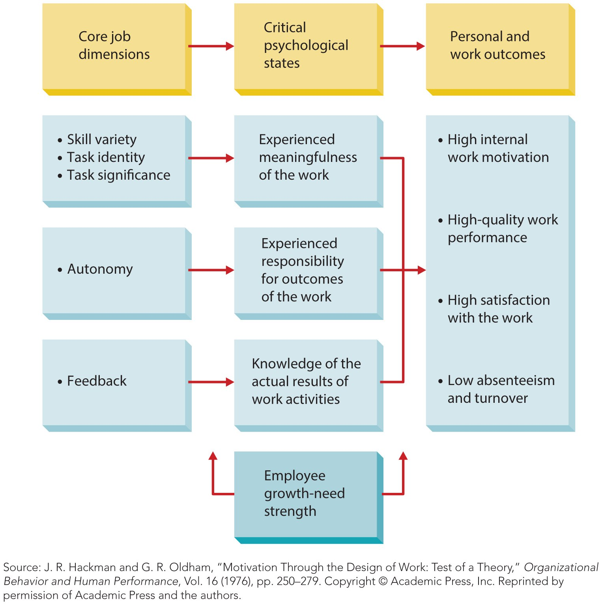
Figure 10.1
Job Characteristics Approach
People with high growth-need respond strongly to this alternative.

Slide 12
Grouping Jobs
Departmentalization
is the process of grouping jobs according to some logical arrangement.
The rationale is linked to size.
As growth occurs, the owner-manager can no longer oversee all workers.
New managerial positions oversee workers grouped according to some plan.
The logic in such a plan is the basis for all departmentalization.

Slide 13
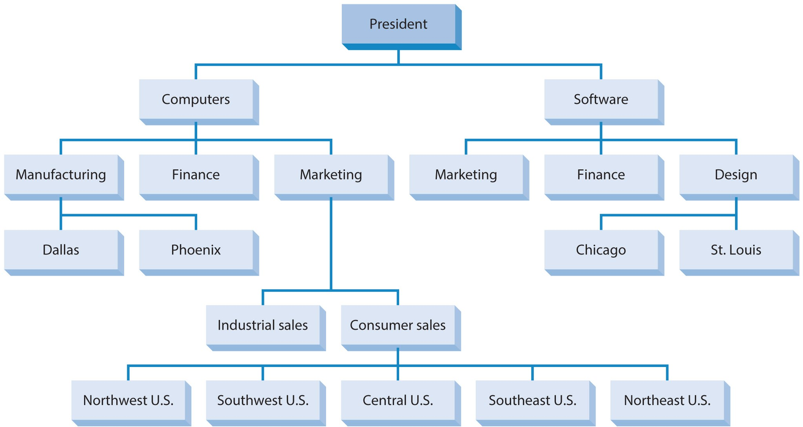
Figure 10.2
Bases for Departmentalization
Product
Function
Customer
Location
The four most common bases are; function, product, customer, and location.

Slide 14
Common Bases for Departmentalization
Functional departmentalization
groups jobs by the same or similar activities.
Most common in smaller organizations.
Advantages include:
Each department is staffed by experts.
Facilitates supervision – narrow set of skills.
Ease of coordinating activities inside departments.
With growth, disadvantages emerge.
Decision making slows and becomes bureaucratic.
Employees lose sight of the organization as a system.
Accountability and performance are difficult to monitor.

Slide 15
Common Bases for Departmentalization
Product departmentalization
groups activities by products or product groups.
Larger businesses adopt this form.
Three major advantages
Activities across products are integrated and coordinated.
Enhances speed and effectiveness of decision making.
Improves department accountability.
Two major disadvantages
Managers may lose focus of the organization as a whole.
Raises administrative costs.

Slide 16
Common Bases for Departmentalization
Customer departmentalization
groups activities to respond to and interact with specific customers or customer groups.
The basic advantage is the organization’s ability to use skilled specialists to deal with unique customers.
One set of skills evaluates business loans, another evaluates car loans.
A fairly large administrative staff is required to integrate activities of various departments.

Slide 17
Common Bases for Departmentalization
Location departmentalization
groups jobs based on geography.
Primary advantage
An organization’s can easily respond to unique customer and environmental characteristics in various regions.
Primary disadvantage
A larger administrative staff is required to keep track of units in scattered locations.
Other forms of departmentalization include time and sequence.

Slide 18
Grouping Jobs
Other considerations about job grouping
Common synonyms for department include:
divisions, units, sections, or bureaus.
Any organization may employ multiple bases of departmentalization, depending on level.
The role of social media is beginning to impact departmentalization.

Slide 19
Establishing Reporting Relationships
The basic issues in establishing reporting relationships:
Clarifying the chain of command
The span of management

Slide 20
Establishing Reporting Relationships
Chain of command
A clear and distinct line of authority among positions in the organization.
Comprised of two components:
Unity of command
Each person has a clear reporting relationship to one boss.
Scalar principle
A clear and unbroken line of authority from lowest to highest position.

Slide 21
Narrow Versus Wide Spans
Span of management (also span of control)
is the number of people who report to a particular manager.
A. V. Graicunas quantified span of management.
Managers deal with three kinds of interactions:
Direct – manager’s one-to-one relationship with workers.
Cross – subordinates relationship among themselves.
Group – relationships between groups of subordinates.
I = N(2^{N}/2 + N – 1)
I is the number of interactions with and among subordinates and N is the number of subordinates.
Each additional subordinate adds more complexity than the previous one.

Slide 22
Narrow Versus Wide Span
Ralph C. Davis described two spans:
An operative span – up to 30 subordinates
For lower-level managers
An executive span, limited to nine
For middle and top managers
Lyndall F. Urwick and General Ian Hamilton
concluded the executive span should never exceed six subordinates.

Slide 23
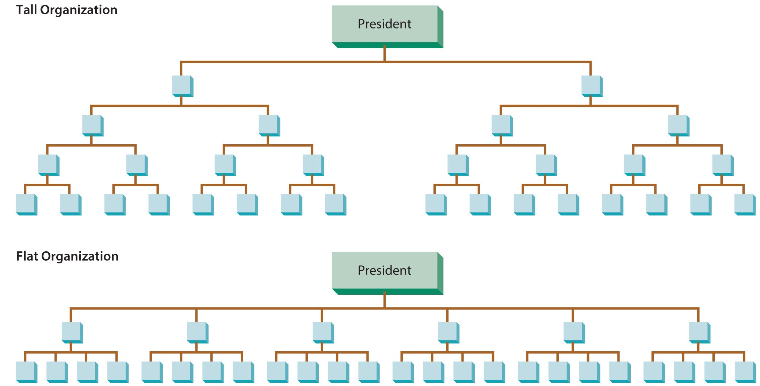
Figure 10.3
Tall versus Flat Organizations

Slide 24
Table 10.1
Factors Influencing the Span of Management
Competence of supervisor and subordinates (the greater the competence, the wider the potential span)
Physical dispersion of subordinates (the greater the dispersion, the narrower the potential span)
Extent of nonsupervisory work in manager’s job (the more nonsupervisory work, the narrower the potential span)
Degree of required interaction (the less required interaction, the wider the potential span)
Extent of standardized procedures (the more procedures, the wider the potential span)
Similarity of tasks being supervised (the more similar the tasks, the wider the potential span)
Frequency of new problems (the higher the frequency, the narrower the potential span)
Preferences of supervisors and subordinates

Slide 25
Distributing Authority
Authority
Power legitimized by the organization.
Delegation
The process by which managers assign work to subordinates.

Slide 26
Distributing Authority
Delegation
The primary reason is to allow the manager to get more work done.
The process involves three steps:
The manager assigns responsibility or tasks.
The manager gives authority needed to do the job.
The manager establishes accountability.
Problems arise when managers are unwilling or unable to delegate.

Slide 27
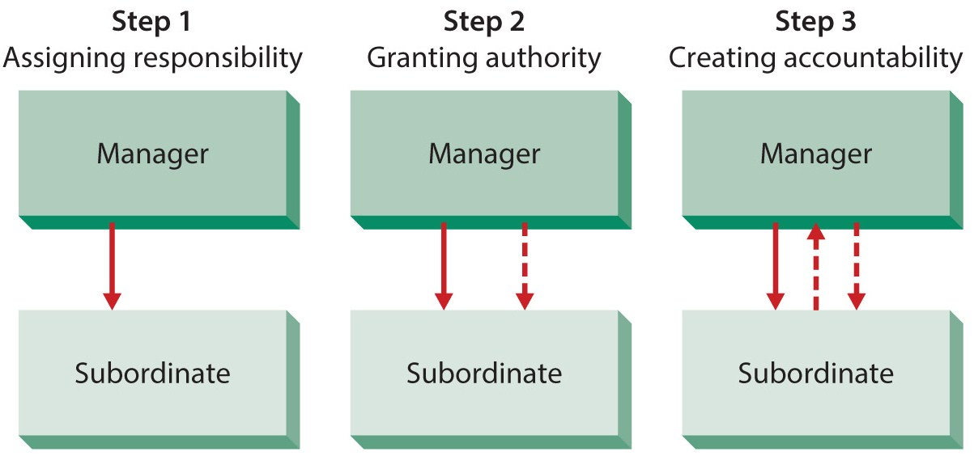
Figure 10.4
Steps in the Delegation Process

Slide 28
Distributing Authority
Decentralization and centralization
Decentralization systematically delegates power and authority to lower-level managers.
Centralization systematically retains power and authority in higher-level managers.
Determinates include:
external environment, complexity and uncertainty, history, riskiness of the decision, and abilities of lower-level managers.

Slide 29
Coordinating Activities
Coordination
The process of linking the activities of the various departments in the organization.
The primary reason for coordination is the interdependence of departments and work groups for information and resources.

Slide 30
Coordinating Activities
Interdependence comes in three forms
Pooled interdependence
occurs when units operate with little interaction, their output is pooled at the corporate level.
The lowest level of interdependence.
Sequential interdependence
occurs when the output of one unit becomes the input for another in a sequential fashion.
Moderate interdependence, usually one way.
Reciprocal interdependence
exists when activities flow both ways between units.

Slide 31
Coordinating Activities
Structural coordination techniques
Use the managerial hierarchy, place one manager in charge of interdependent units.
Rules and procedures for routine activities.
Managers in liaison roles coordinate units.
Task forces for complex interdependence.
Integrating departments is usually permanent.
Technology enables coordination

Slide 32
Differentiating Between Positions
Line position
In the direct chain of command, responsible for achievement of organizational goals.
Staff position
Provides expertise, advice, and support for line positions.
The last building block of organization structure is differentiating between line and staff positions.

Slide 33
Differences Between Line and Staff
Purpose
Line managers work toward organizational goals while staff managers advise and assist.
Authority
Line authority is formal while staff authority may take many forms.
Advise authority – manager chooses to seek input, or not.
Compulsory advice – must consider advice, not heed it.
Functional authority – formal and legitimate authority.

Slide 34
Differentiating Between Positions
Administrative intensity
is the degree to which managerial positions are concentrated in staff positions.
High administrative intensity is an organization with many staff positions relative to line positions.
Low administrative intensity reflects more line positions.

Slide 35
Summary
This chapter discussed the basics of organizing and organizational structure.
The text outlined six building blocks used by organizations and discussed each.
Designing jobs and grouping jobs.
Establishing reporting relationships.
Distributing authority.
Coordinating activities and differentiating among staff and line positions.

