Slide 1
MANAGEMENT
TWELFTH EDITION
Ricky W. Griffin
Part Four: The Organizing Process
Chapter Eleven: Managing Organization Design

Slide 2
Learning Outcomes
Describe the basic nature of organization design.
Identify and explain two basic universal perspectives on organization design.
Identify and explain key situational influences on organization design.
Discuss how an organization’s strategy and its design are interrelated.
Describe the basic forms of organization design.
Describe emerging issues in organization design.

Slide 3
Nature of Organization Design
Organization design
is the overall set of structural elements and the relationships among those elements used to manage the total organization.
Keep two important points in mind.
Organizations are not designed and left intact
most change continuously.
Organization design for larger organizations is extremely complex
no description is complete.

Slide 4
Universal Perspectives on Organization Design
Bureaucratic Model (Max Weber)
A bureaucracy is an organization based on a legitimate and formal system of authority.
Weber’s ideal bureaucracy’s characteristics:
Distinct division of labor.
Consistent rules and uniform task performance.
A chain of command from top to bottom.
Impersonal managers.
Employment based on technical expertise.

Slide 5
Bureaucratic Model
Strengths
Weaknesses
Several elements often improve efficiency.
Helps prevent favoritism.
Makes procedures and practices clear to everyone.
Results in inflexibility and rigidity.
Making exceptions or changing the rules is often difficult.
Often results in neglect of human and social processes.

Slide 6
Behavioral Model
The behavioral model
stresses attention to developing work groups and concern with interpersonal processes.
Eight important processes fall along a continuum:
leadership, motivation, communication, interactions, decision making, goal setting, control, and performance goals.
A System 1 design anchors one end of the continuum; similar to the bureaucratic model.
A System 4 design anchors the other end of the continuum, similar to the behavioral model.

Slide 7
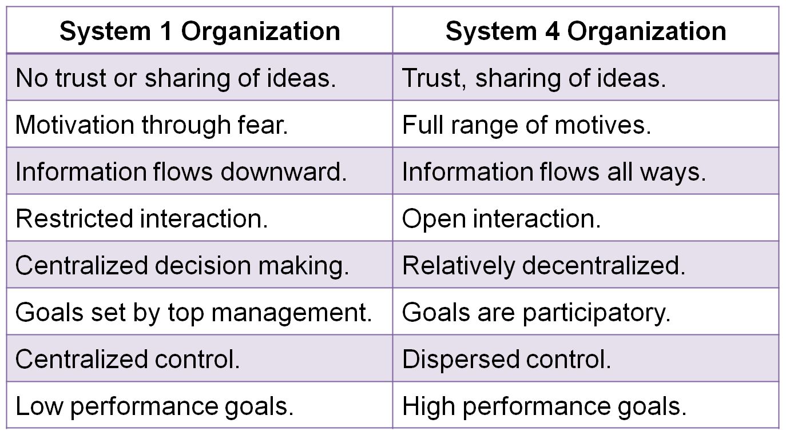
Table 11.1
System 1 and System 4 Organizations
Source: Adapted from Rensis Likert, The Human Organization, 1967. Copyright © 1967 The McGraw-Hill Companies, Inc. Reprinted with permission.

Slide 8
Behavioral Model
Major Strength
Major Weakness
It emphasizes human behavior by stressing the value of an organization’s employees.
This led to a more humanistic approach to designing organizations.
The approach again argues there is one best way to design an organization – as a System 4.
Evidence is strong there is no one best approach.

Slide 9
Situational Influences on Organization Design
Situational view of organization design
assumes the optimal design depends on a set of relevant situational factors.
Four basic factors are discussed here
technology, environment, size, and organization life cycle.
Another factor, strategy, is covered in the next section.

Slide 10
Organization Design and Technology
Technology is the conversion processes used to transform inputs into outputs.
Multiple technologies may be used but the most important one is called the core technology.
Joan Woodward identified three forms of technology.
Unit or small-batch.
Large-batch or mass-production.
Continuous-process.

Slide 11
Organization Design and Technology
Woodward’s findings
Different organization designs associate with each technology.
With increased complexity comes
increased levels of management, executive span of management and relative size of staff.
At a general level.
Extreme technologies similar to System 4s and middle range like System 1s.
The middle range had more specialization.
Success depended on how the organization followed the typical pattern.

Slide 12
Organization Design and Environment
Mechanistic organization
Similar to a System 1 model, most frequently found in stable environments.
Organic organization
A very flexible and informal model, most often found in unstable environments.
Structured in predictable ways.
Constant change dictates a high level of flexibility.
Burns and Stalker studied stable and unstable environments and two design styles emerged.

Slide 13
Organization Design and Environment
Differentiation
The extent to which the organization is broken down into subunits.
Integration
The degree to which the various subunits must work together in a coordinated fashion.
Lawrence and Lorsch believed this influence varies between units of the same organization and characterized two primary dimensions.

Slide 14
Organization Design and Organizational Size
Organizational size
is the total number of full-time or full-time-equivalent employees.
Researchers from the University of Aston used a wider array of organizations than Woodward.
Technology influences structure in small firms but the link breaks down in larger firms.
Larger firms have more job specialization, standard operating procedures, rules and regulations, and a greater degree of decentralization.

Slide 15
Organization Design and Organizational Life Cycle
Organizational life cycle
is a four-phase process through which organizations evolve.
Stages include:
Birth – the start of the business.
Youth – growth.
Midlife – gradual growth into stability.
Maturity – stability into possible decline.
Structure must evolve to cope with challenges in each stage of the process.

Slide 16
Strategy and Organization Design
Corporate-level strategy
Choices will partially determine design.
A single-product strategy – functional departmentalization and mechanistic design.
Related diversification – requires a high level of coordination.
Unrelated diversification – hierarchical reporting system.

Slide 17
Strategy and Organization Design
Business-level strategy
Directly influence organization design.
A defender strategy – tall and centralized.
A prospector strategy – flat and decentralized.
An analyzer strategy – lies in the middle.
Organizational functions
Less obvious and usually covered under corporate or business-level concerns.
Involves marketing, finance, production, HR, etc.

Slide 18
Basic Forms of Organization Design
Functional (U-Form)
Conglomerate (H-Form)
Divisional (M-Form)
Matrix
Hybrid
Most designs fall into one of four basic categories, others are hybrids.

Slide 19
Basic Forms of Organization Design
Functional (U-Form) design
is based on the functional approach to departmentalization. (U for unitary.)
Units are grouped into functional departments.
Considerable coordination is needed.
Shares same advantages/disadvantages as functional departmentalization.
Staffed by experts, facilitates coordination, but promotes a functional focus and centralization.

Slide 20
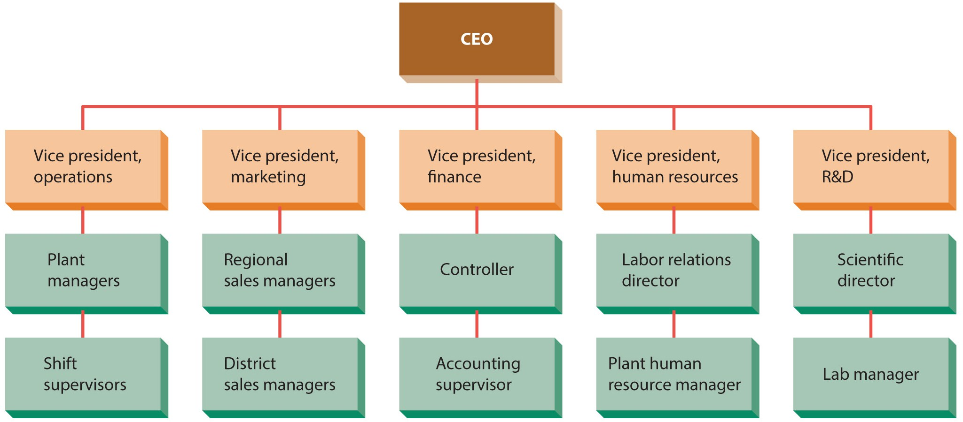
Figure 11.1
Functional or U-Form Design for a Small Manufacturing Company
Note that each functional area is dependent on the others.

Slide 21
Basic Forms of Organization Design
Conglomerate (H-Form) design
used by an organization made up of a set of unrelated businesses.
Essentially a holding company results from unrelated diversification. (H for holding.)
A general manager oversees each business.
Responsible for profit/loss, acts independently.
Corporate staff evaluate, allocate, and decide.
Basic shortcomings are complexity.

Slide 22
Figure 11.2
Conglomerate (H-Form) Design at Samsung
This design results from a strategy of unrelated diversification.

Slide 23
Basic Forms of Organization Design
Divisional (M-Form) design
multiple businesses in related areas operating within a larger organizational framework.
(M-form for multidivisional.)
Some activities are decentralized, some are centralized at the corporate level.
The biggest advantage is the opportunity for coordination and shared resources.
If kept in balance, outperforms U- or H-forms.

Slide 24
Figure 11.3
Multidivisional (M-Form) Design at Hilton Hotels
This design results from a strategy of related diversification.

Slide 25
Basic Forms of Organization Design
Matrix design
is based on two overlapping bases of departmentalization.
Project managers head a project group composed of representatives from functional departments.
A multiple-command structure results when an individual reports to a functional superior and to one or more project managers.

Slide 26
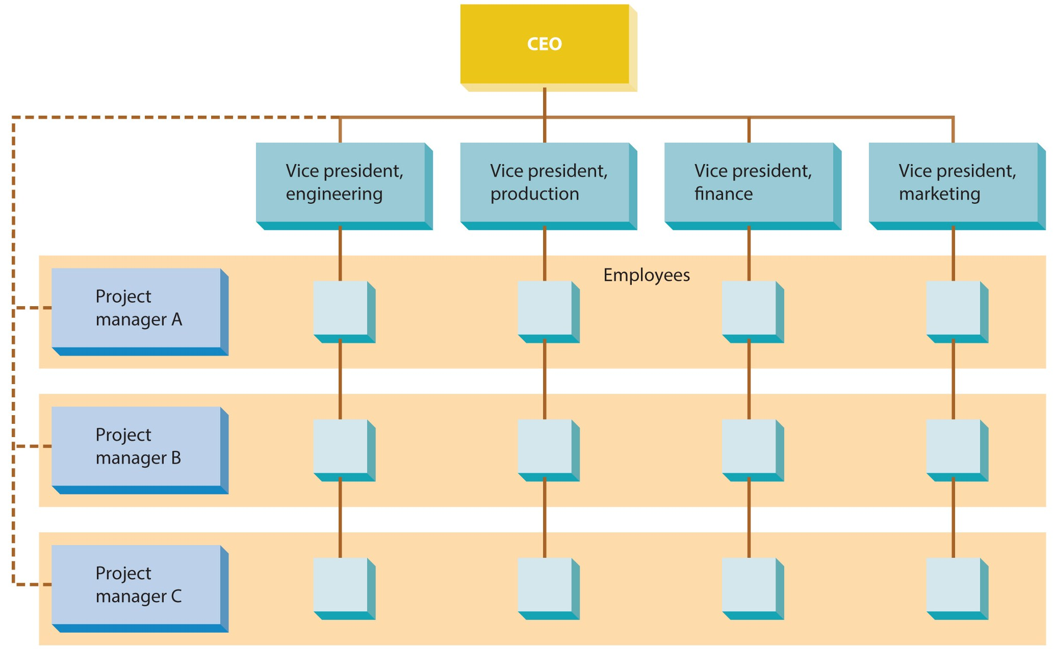
Figure 11.4
A Matrix Organization

Slide 27
Basic Forms of Organization Design
The matrix form is common in one of three situations.
When there is strong pressure from the environment.
When large amounts of information need processing.
When there is pressure for shared resources.

Slide 28
Basic Forms of Organization Design - Matrix
Advantages
Disadvantages
Enhances flexibility.
Team members are motivated and committed.
Employees learn new skills.
Efficient use of human resources.
Enhances cooperation.
Allows decentralization.
Uncertain reporting relationships.
Some take advantage of “unlimited freedom”.
Group dynamics include:
increased decision time,
individual domination,
may compromise too much,
may lose focus.
Coordination time increases.

Slide 29
Basic Forms of Organization Design
Hybrid designs
A hybrid design occurs when two or more of the common forms of design are combined.
Few companies use a design in its pure form.
Most firms have one basic design as a foundation but maintain flexibility needed to facilitate modifications.

Slide 30
Emerging Issues in Organization Design
A team organization
relies on project-type teams, with little or no underlying functional hierarchy.
A virtual organization
is one with little or no formal structure.
A learning organization
facilitates lifelong learning and personal development of all employees while continually transforming itself to respond to changing demands and needs.

Slide 31
Emerging Issues in Organization Design
Issues in international organization design
It is important that a firm’s organization design allows it to deal effectively in global markets.
Managers can reap important advantages when they approach design from a strategic perspective.

Slide 32
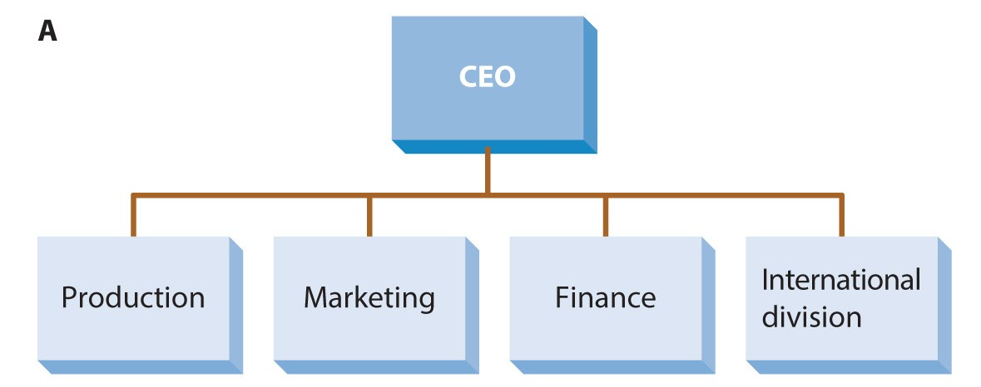
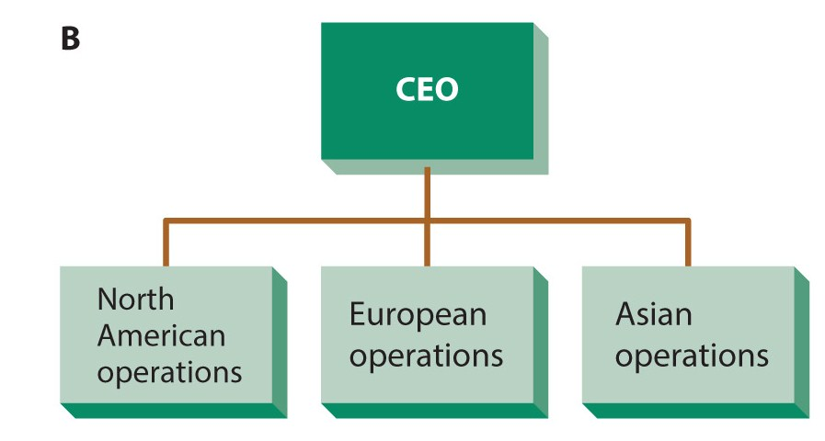
Figure 11.5
Common Organization Designs for International Organizations

Slide 33
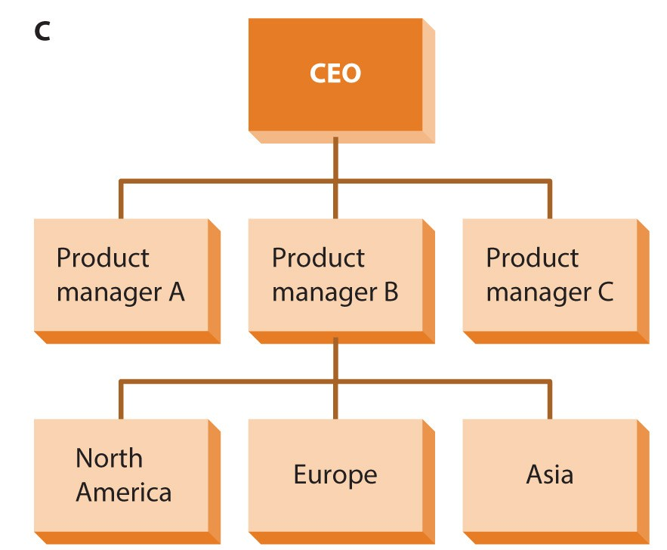
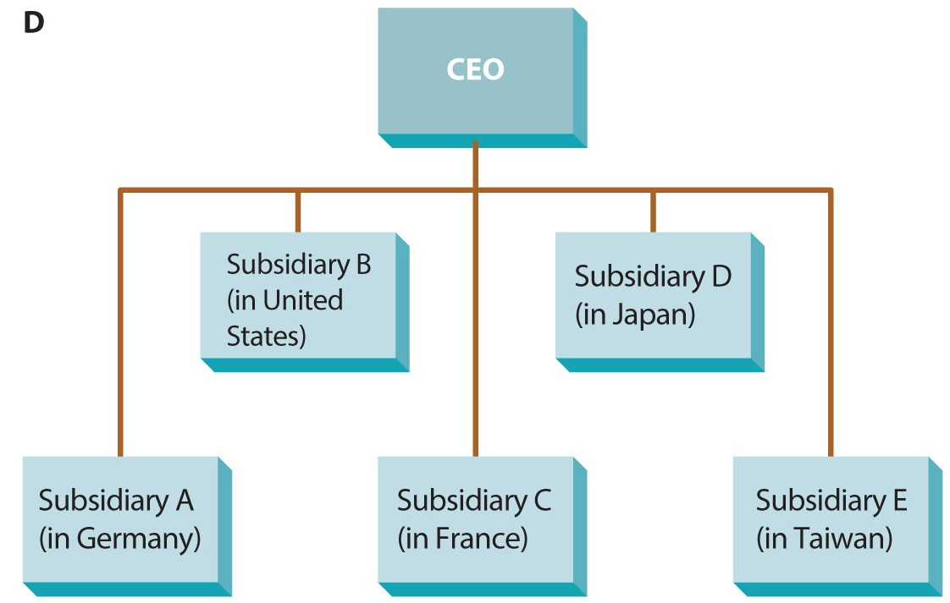
Figure 11.5
Common Organization Designs for International Organizations

Slide 34
Summary
The chapter opened with a discussion on the nature of organization design.
Next, early universal models were introduced and situational factors were discussed.
The relationship between strategy and structure followed.
Basic forms of organization design were described.
The chapter concluded by presenting four emerging issues in organization design.

