Slide 1
MANAGEMENT
TWELFTH EDITION
Ricky W. Griffin
Part Four: The Organizing Process
Chapter Thirteen: Managing Human Resources in Organizations

Slide 2
Learning Outcomes
Describe the environmental context of human resource management, including its strategic importance and its relationship with legal and social factors.
Discuss how organizations attract human resources, including human resource planning, recruiting, and selecting.
Describe how organizations develop human resources, including training and development, performance appraisal, and performance feedback.

Slide 3
Learning Outcomes
Discuss how organizations maintain human resources, including the determination of compensation and benefits and career planning.
Discuss labor relations, including how employees form unions and the mechanics of collective bargaining.
Describe the key issues associated with managing knowledge workers and contingent and temporary workers.

Slide 4
Environmental Context of Human Resource Management
Human resource management (HRM)
The set of organizational activities directed at attracting, developing, and maintaining an effective workforce.
HRM takes place within a complex and ever-changing environmental context.

Slide 5
Environmental Context of Human Resource Management
Three vital components of this context:
HRM Environment
Strategic importance
Legal environment
Social environment

Slide 6
Strategic Importance of HRM
Human resources are critical for both effectiveness and competitiveness.
Many firms develop strategic HR plans and integrate them into other strategic plans.
Human capital
reflects the organization’s investment in attracting, retaining, and motivating an effective workforce.
A tangible indicator of the value of people.

Slide 7
The Legal Environment of HRM
A number of laws regulate employee-employer relations, especially in these areas:
Equal employment opportunity
Compensation and benefits
Labor relations
Occupational safety and health

Slide 8
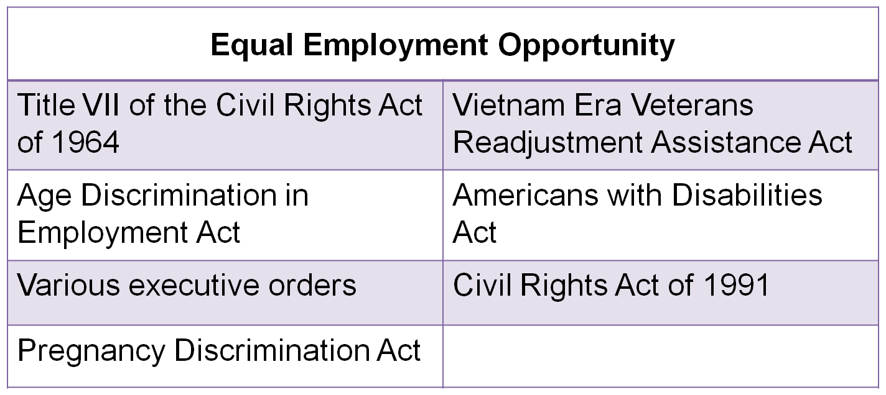
Table 13.1
The Legal Environment of HRM

Slide 9
Equal Employment Opportunity
Title VII of the Civil Rights Act of 1964
forbids discrimination on the basis of sex, race, color, religion, or national origin in all areas of the employment relationship.
Applies to direct and indirect discrimination and requires employment be based on qualifications.
Adverse impact
exists when minority group members pass a selection standard at a rate less than 80 percent of the pass rate of majority group members.

Slide 10
Equal Employment Opportunity
Equal Employment Opportunity Commission (EEOC)
is a federal agency charged with enforcing Title VII and other antidiscrimination laws.
Age Discrimination in Employment Act
outlaws discrimination against people older than 40 years; passed in 1967, amended in ‘78 and ‘86.
Both the Age Discrimination Act and Title VII
require passive nondiscrimination or equal opportunity.

Slide 11
Equal Employment Opportunity
Affirmative action
is intentionally seeking and hiring qualified or qualifiable employees from racial, sexual, and ethnic groups underrepresented in the organization.
Employers holding government contracts require affirmative action.
Must have written action plans and employment goals.
Require affirmative hiring for Vietnam veterans due to the Vietnam Era Veterans Readjustment Assistance Act.
The Pregnancy Discrimination Acts forbids discrimination against women who are pregnant.

Slide 12
Equal Employment Opportunity
Americans with Disabilities Act (ADA)
prohibits discrimination against people with disabilities.
Passed in 1990, requires employers make reasonable accommodations for employees.
Civil Rights Act of 1991
amends the original Civil Rights Act, making it easier to bring discrimination lawsuits while also limiting punitive damages.

Slide 13
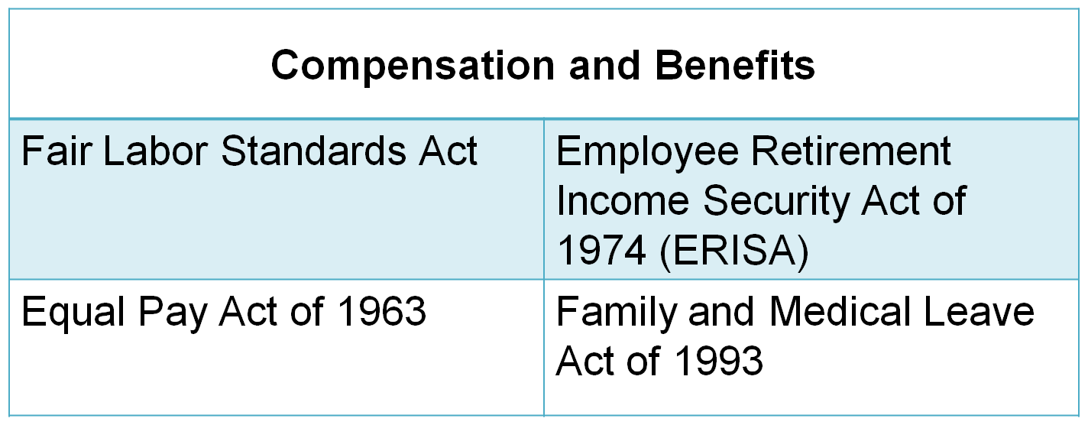
Table 13.1
The Legal Environment of HRM

Slide 14
Compensation and Benefits
Fair Labor Standards Act
sets a minimum wage and requires overtime pay for work in excess of 40 hours per week; passed in 1938 and amended frequently.
Salaried professional, executive, and administrative employees are exempt.
Equal Pay Act of 1963
requires that men and women be paid the same amount for doing the same job.

Slide 15
Compensation and Benefits
Employee Retirement Income Security Act of 1974 (ERISA)
regulates how organizations manage their pension funds.
Family and Medical Leave Act of 1993
requires employers provide up to 12 weeks of unpaid leave for family and medical emergencies.

Slide 16
Table 13.1
The Legal Environment of HRM

Slide 17
Labor Relations
National Labor Relations Act
passed in 1935 to set up procedures for employees to vote on whether to have a union; also known as the Wagner Act.
National Labor Relations Board (NLRB)
was established by the Wagner Act to enforce its provisions.
Labor-Management Relations Act
was passed in 1947 to limit union power; also known as the Taft-Hartley Act.

Slide 18
Table 13.1
The Legal Environment of HRM
OSHA requires that employers
provide a place of employment that is free from hazards that may cause death or serious physical harm and
obey the safety and health standards established by the Department of Labor.

Slide 19
Emerging Legal Issues
Sexual harassment
Forbidden under Title VII, more victims confront the problem in court.
Alcohol and drug abuse
Court rulings define alcoholics and drug addicts as disabled and protected under the same laws.
AIDS victims are covered under disability laws
Employee privacy
Can you refuse to hire due to social media postings?

Slide 20
Social Change and HRM
Many organizations are using more and more temporary workers.
Dual-career families are much more common today.
Employment-at-will
is a traditional view of the workplace that says organizations can fire their employees for whatever reason they want; recent court judgments are limiting employment-at-will.

Slide 21
Human Resource Planning
Job analysis
is a systemized procedure for collecting and recording information about jobs within an organization.
There are two parts of a job analysis:
A job description lists the duties of a job, working conditions, and tools, materials, and equipment used.
A job specification describes the skills, abilities, and credentials required to perform the job.

Slide 22
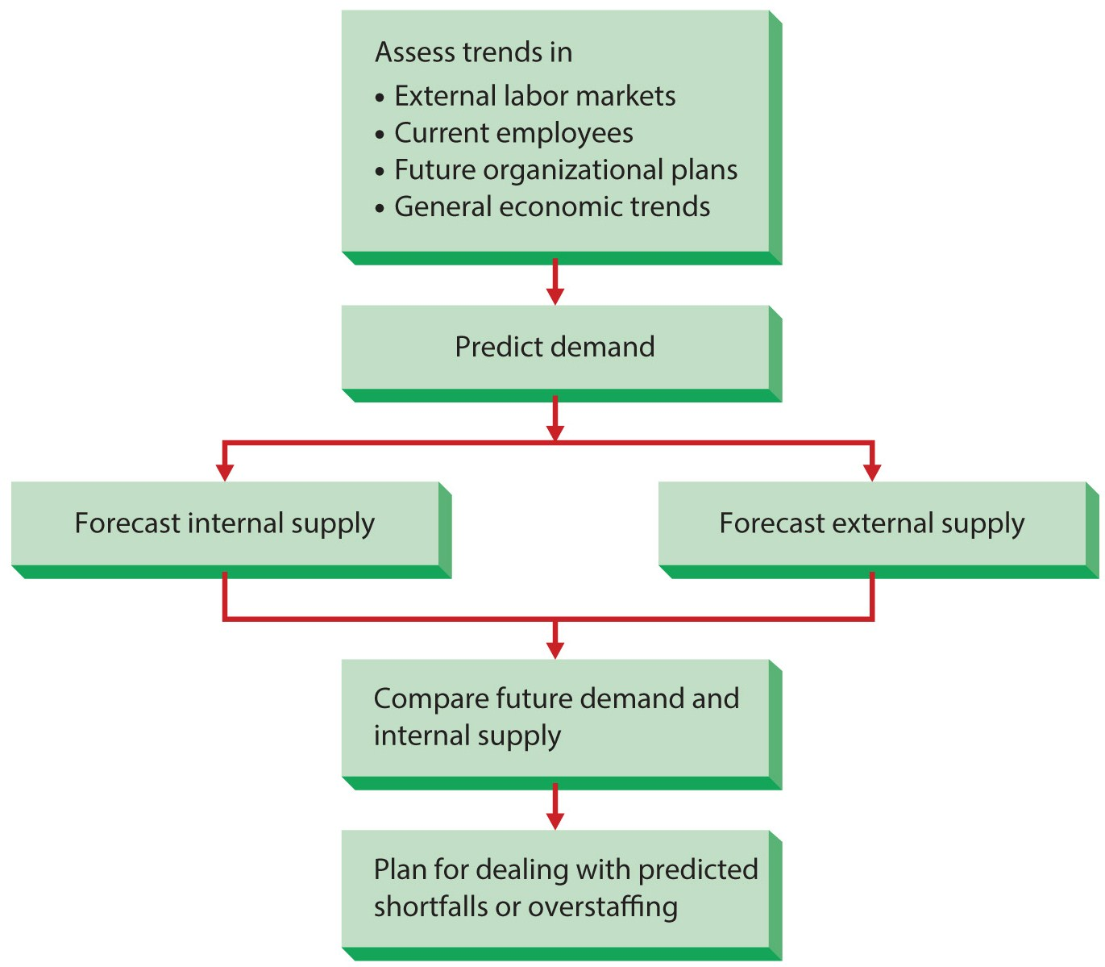
Figure 13.1
Human Resource Planning

Slide 23
Human Resource Planning
Forecasting labor supply involves two tasks:
Forecasting the internal and external supply.
Replacement charts can be used to plan for management positions.
Employee information systems or skills inventory contains information on each employee’s education, skills, experience, and career aspirations.
Forecasting external supply is a different problem.
Planners must rely on information from outside sources.

Slide 24
Human Resource Planning
Matching human resources supply and demand requires managers plan and deal with predicted shortfalls or overstaffing.
If hiring, managers use recruitment and temporary works to gain flexibility.
If overstaffed, managers may transfer workers, not replace those who quit, encourage early retirement, and layoff extra employees.

Slide 25
Recruiting Employees
Recruiting
is the process of attracting qualified individuals to apply for open jobs.
Internal recruiting
considers current employees as applicants for higher-level jobs.
External recruiting
attracts persons outside the organization to apply for jobs.
Realistic job previews
provide applicants with a real picture of what it is like to perform the job.

Slide 26
Selecting Employees
Validation
is determining the extent to which a selection device is predictive of future job performance.
Predictive validation involves collecting the scores of employees or applicants and correlating with actual job performance.
Content validation uses logic and job analysis data to establish that the device measures skills needed for successful job performance

Slide 27
Selecting Employees
Application blanks
Tests
Interviews
Assessment centers
Other techniques
There are many selection methods.

Slide 28
Developing Human Resources
Training
Occurs when the firm teaches operational or technical employees how to do a job for which they were hired.
Development
Occurs when a firm teaches its managers and professionals the skills needed for both present and future jobs.
Evaluation and feedback are also necessary.

Slide 29
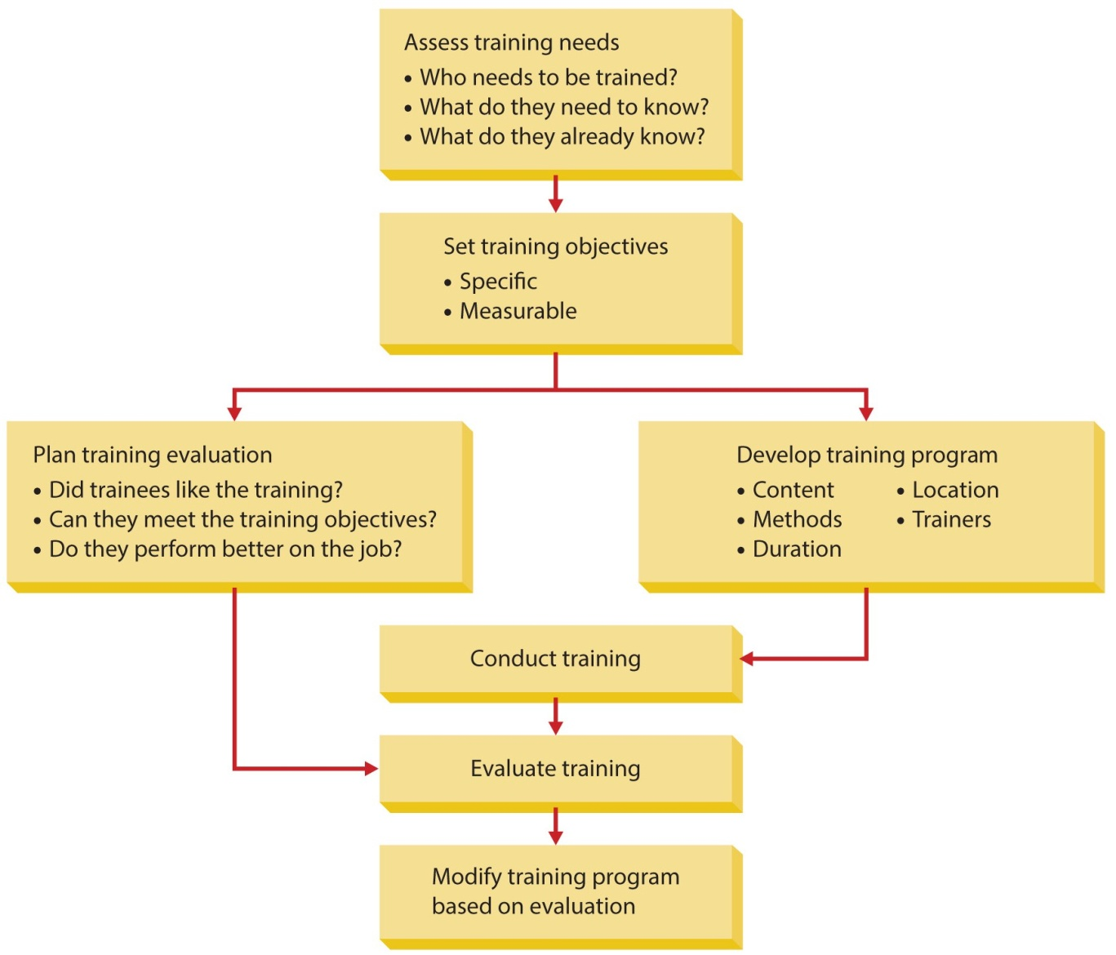
Figure 13.2
The Training Process

Slide 30
Performance Appraisal
Performance appraisal
is a formal assessment of how well employees are doing their jobs.
Can be of two types: objective and judgmental.
Objective measures are concrete measures of performance.
The special performance test reduces “opportunity bias” but should be combined with other methods.
Judgmental methods include rating and ranking.

Slide 31
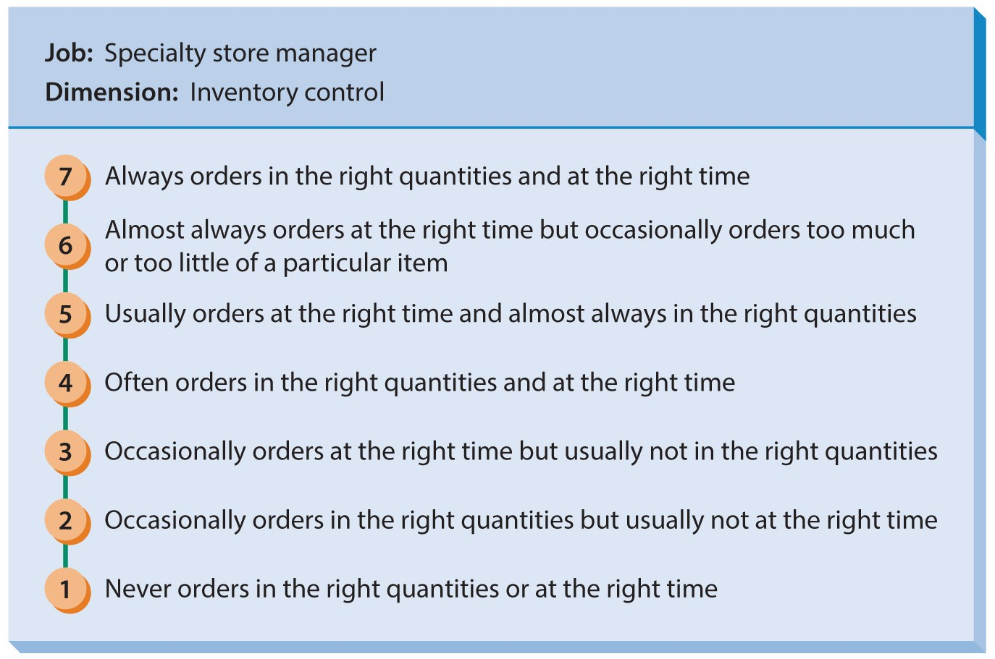
Figure 13.4
Behaviorally Anchored Rating Scale
Behaviorally Anchored Rating Scale (BARS), is a sophisticated rating method in which supervisors construct a rating scale associated with behavioral anchors.

Slide 32
Performance Appraisal
Errors or biases occur in any system.
Recency error occurs when an evaluator makes a judgment based only on the most recent performance.
Halo error occurs when an evaluator allows performance in one dimension of the job to ‘spread’ to all dimensions.
360-degree feedback
is an appraisal system in which managers are evaluated by everyone around them – their boss, peers, and subordinates, giving a complete picture of true performance.
Performance feedback is the final step.

Slide 33
Determining Compensation
Compensation
is financial remuneration given by the organization to its employees in exchange for their work.
There are three basic forms.
Wages are hourly compensation.
Salary is pay for total contribution, not hours worked.
Incentives are pay tied to specific performance.

Slide 34
Determining Compensation
Wage-level decisions involve whether to pay above, at, or below the going rate.
Internal strategy and external unemployment affect wage levels.
Wage structures are jobs grouped by value.
Job evaluation attempts to assess the worth of each job relative to other jobs.
Simplest method ranks jobs from most pay to least.
Systems for setting individual wage rates:
seniority, initial qualifications, or merit.

Slide 35
Determining Benefits
Benefits
are things of value, other than compensation, provided by the organization to its workers.
Sometimes called indirect compensation.
Come in many forms including paid time off, insurance, Social Security, and pension plans.
Some offer choices with a “cafeteria benefit plans”.
Nontraditional benefits include on-site daycare.
Career planning
can benefit the company and the employee.

Slide 36
Managing Labor Relations
Labor relations
is the process of dealing with employees who are represented by a “union”.
Reasons for membership declined after 1955:
increased standards of living,
the decline of the manufacturing sector, and
globalization of business operations.
Managing labor relations is an important part of HRM.

Slide 37
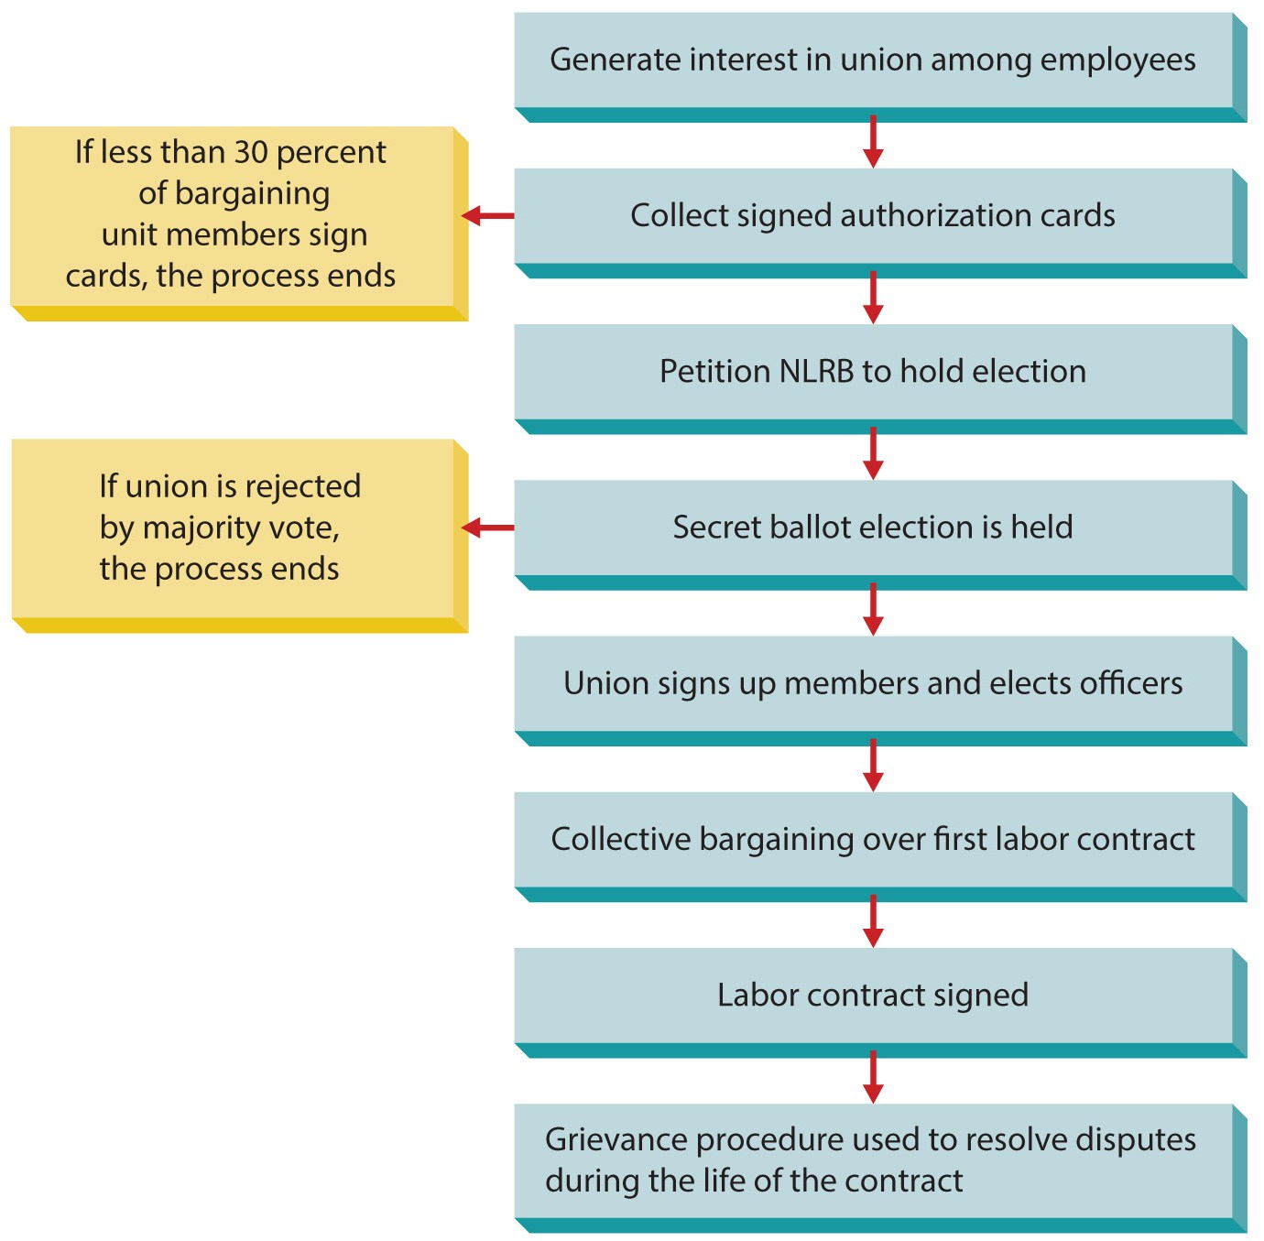
Figure 13.5
The Union-Organizing Process
If employees want to form a union, the law prescribes a specific set of procedures that both employees and the organization must follow.

Slide 38
Managing Labor Relations
Collective bargaining
is the process of agreeing on a satisfactory labor contract between management and a union.
Grievance procedure
is used to enforce the labor contract.
If an employee feels mistreated, they file a grievance, taking it to higher levels of the organization, until the problem is corrected.

Slide 39
New Challenges in the Changing Workplace
Managing knowledge workers
Knowledge workers are employees whose contributions are based on what they know.
They provide special challenges for HR managers.
They are increasingly in demand but expensive.
Organizations must pay them enough to keep them.
Contingent and temporary workers
A contingent worker works less than full-time.
Currently about 13 percent of the U.S. workforce.
Adds flexibility but increases planning time.

Slide 40
Summary
Chapter thirteen began by describing the environmental context of HRM.
Attracting human resources was covered.
Next, the text described how organizations seek to develop their human resources.
The text then examined maintaining high-quality human resources.
The chapter concluded by discussing labor unions.

