Slide 1
MANAGEMENT
TWELFTH EDITION
Ricky W. Griffin
Part Five: The Leading Process
Chapter Fourteen: Basic Elements of Individual Behavior in Organizations

Slide 2
Learning Outcomes
Explain the nature of the individual – organization relationship.
Define personality and describe personality attributes that affect behavior in organizations.
Discuss individual attitudes in organizations and how they affect behavior.
Describe basic perceptual processes and the role of attributions in organizations.
Discuss the causes and consequences of stress and describe how it can be managed.
Describe creativity and its role in organizations.
Explain how workplace behaviors can directly or indirectly influence organizational effectiveness.

Slide 3
Understanding Individuals in Organizations
Psychological contract
is the overall set of expectations held by an individual with respect to their contributions to the organization and what the organization will provide in return.
The individual provides contributions such as effort, skill, ability, time, or loyalty.
The organization provides inducements both tangible (pay) and intangible (status).

Slide 4
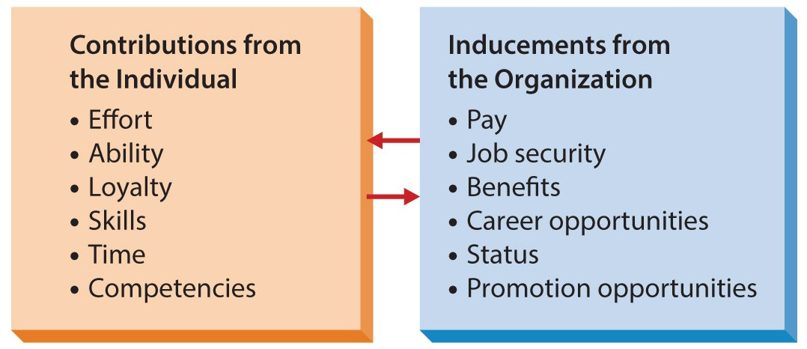
Figure 14.1
The Psychological Contract
The psychological contract is not written on paper nor are the terms negotiated.

Slide 5
Understanding Individuals in Organizations
Person-job fit
is the extent to which the individual contributions match the organizational inducements.
Possible reasons for imperfect person-job fit:
Organizational selection procedures are imperfect.
Both people and organizations change.
Each individual is unique.
Individual differences
are personal attributes that vary from one person to another.

Slide 6
Personality and Individual Behavior
Personality
The relatively permanent set of psychological and behavioral attributes that distinguish one person from another.
Managers should strive to understand basic personality attributes.

Slide 7
“Big Five” Personality Traits
Agreeableness
A person’s ability to get along with others.
Conscientiousness
The number of things a person can effectively work on at one time.
Negative emotionality
Extraversion
Extent to which a person is poised, calm, resilient, and secure.
Openness
A person’s comfort level with relationships.
A person’s rigidity of beliefs and range of interests.

Slide 8
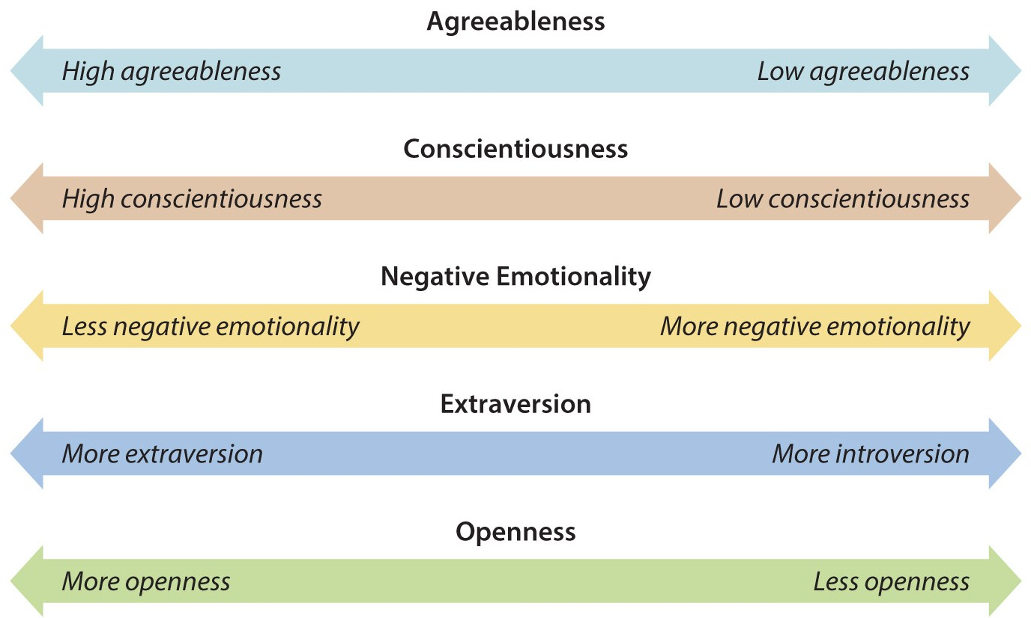
Figure 14.2
The “Big Five” Model of Personality

Slide 9
The Myers-Briggs Framework
Extraversion (E) versus Introversion (I)
Extraverts gather energy from others, introverts need solitude to recharge their energy.
Sensing (S) versus Intuition (N)
Sensing types prefer concrete ideas, intuitive types prefer abstract concepts.
Thinking (T) versus Feeling (F)
Thinkers base decisions on logic, feelers on emotion.
Judging (J) versus Perceiving (P)
Judgers prefer completion, perceivers enjoy the process.

Slide 10
Other Personality Traits at Work
Locus of control
is the degree an individual believes their behavior directly impacts the consequences of that behavior.
Internal locus of control is a belief that success/failure results from one’s own behavior.
External locus of control is a belief that success/failure results from fate, chance, luck, or the behavior of others.
Self-efficacy
is an individual’s beliefs about her or his capabilities to perform a task.

Slide 11
Other Personality Traits at Work
Authoritarianism
is an individual’s belief that power and status differences are appropriate in an organization.
Machiavellianism
is behavior directed at gaining power and controlling behavior of others.
Self-esteem
is the extent to which a person believes they are worthwhile and a deserving individual.
Risk propensity
is the degree to which an individual is willing to take chances and make risky decisions.

Slide 12
Emotional Intelligence
Emotional intelligence or EQ
is the extent to which people are self-aware, manage their emotions, motive themselves, express empathy, and possess social skills.
Research suggest persons with high EQ may perform better than others.
EQ appears to be something not biologically based, it can be developed within a person.

Slide 13
Emotional Intelligence
Self-awareness
Managing emotions
Motivating oneself
Empathy
Social skills
There are five dimensions of EQ.

Slide 14
Attitudes and Individual Behavior
Attitudes
are complexes of beliefs/feelings people have about specific ideas, situations, or other people.
The affective component reflects feelings and emotions an individual has toward a situation.
The cognitive component derives from perceived knowledge an individual has about a situation.
The intentional component reflects how an individual expects to behave toward or in the situation.
Cognitive dissonance occurs when an individual has conflicting attitudes.

Slide 15
Work-Related Attitudes
Job satisfaction or dissatisfaction
reflects the extent an individual is gratified by or fulfilled by their work.
Organizational commitment
reflects an individual’s identification with and attachment to the organization.
Organizational engagement
is the extent an employee sees themselves as part of the organization, actively looks for ways to contribute, and is involved in multiple ways.

Slide 16
Affect and Mood in Organizations
Positive affectivity
is a tendency to be upbeat and optimistic, have an overall sense of well-being, see things in a positive light, and seem to be in a good mood.
Negative affectivity
is a tendency to be generally downbeat and pessimistic, see things in a negative way, and seem to be in a bad mood.

Slide 17
Perception and Individual Behavior
Perception
Is the set of processes by which an individual becomes aware of and interprets information about the environment.
Because perception plays a role in a variety of other workplace behaviors, managers need to have a general understanding of basic perceptual processes.

Slide 18
Basic Perceptual Processes
Selective perception
is the process of screening out information we are uncomfortable with or that contradicts our beliefs.
Helpful only if our basic perception is accurate.
Stereotyping
is the process of categorizing or labeling people on the basis of a single attribute.
Common attributes include race, gender, and age.

Slide 19
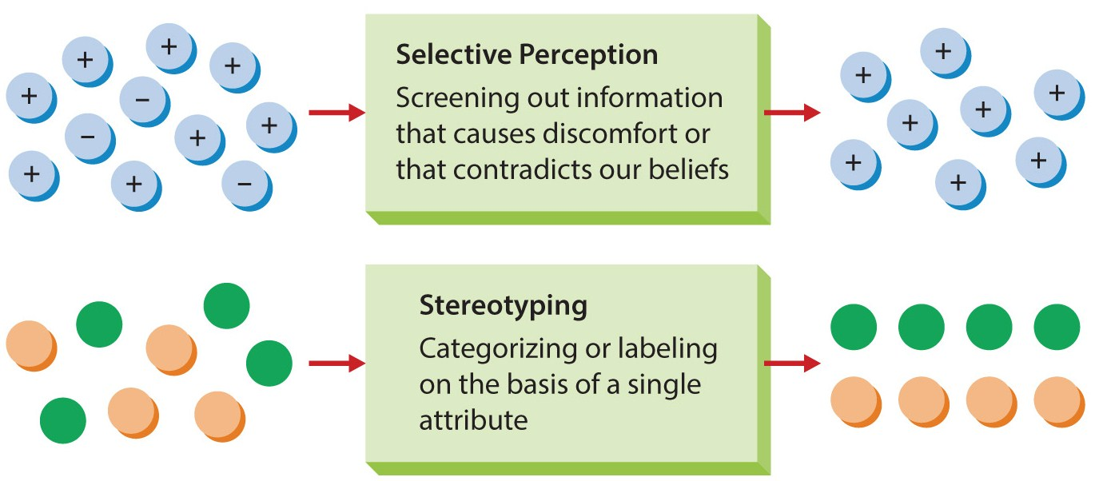
Figure 14.3
Perceptual Processes
Two of the most basic perceptual processes are selective perception and stereotyping.

Slide 20
Perception and Attribution
Attribution
is a mechanism through which we observe behavior and attribute causes to it.
May be our own behavior, or that of others.
Occurs through three forces:
Consensus is the extent other people in the same situation behave the same way.
Consistency is the extent the same person behaves in the same way at different times.
Distinctiveness is the extent the same person behaves in the same way in other situations.

Slide 21
Stress and Individual Behavior
Stress
is an individual’s response to a strong stimulus, called a stressor.
General Adaptation Syndrome (GAS)
is a general cycle of the stress process.
Stage 1 – alarm.
Stage 2 – resistance.
Stage 3 – exhaustion.

Slide 22
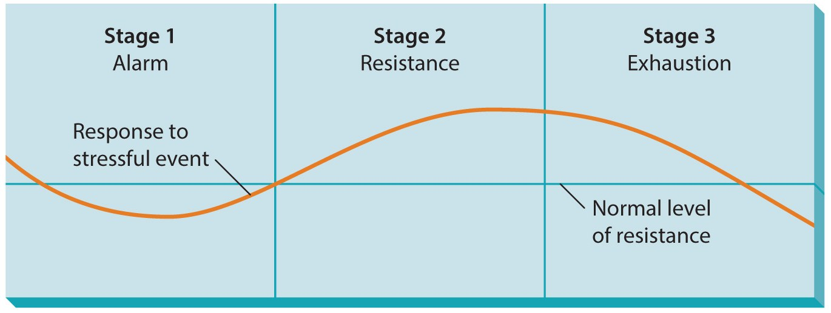
Figure 14.4
The General Adaptation Syndrome
Stress is not all bad. The absence of stress may lead to stagnation.

Slide 23
Stress and Individual Behavior
Type A
Individuals are competitive, devoted to work, and have a strong sense of time urgency.
Type B
Individuals are less competitive, less devoted to work, and have a weaker sense of time urgency.
Type B people are less likely to experience stress.

Slide 24
Causes and Consequences of Stress
Four categories of work-related stressors
Task demands are associated with the task itself.
Physical demands are stressors associated with the job setting.
Role demands are stressors associated with roles within the organization.
Interpersonal demands are associated with relationships that confront people.

Slide 25
Figure 14.5
Causes of Work Stress

Slide 26
Causes and Consequences of Stress
Negative consequences of stress
Behavioral – include detrimental or harmful actions.
Psychological – include sleep disturbances, depression and family problems.
Medical – include heart disease, stroke, etc.
Has direct consequences for businesses.
Burnout
is a feeling of exhaustion that may develop when someone experiences prolonged stress.

Slide 27
Managing Stress
People manage stress through exercise, relaxation, time management, and support.
Organizations help employees cope with stress through:
wellness programs, stress management programs, health promotion programs, and fitness programs.

Slide 28
Creativity in Organizations
Creativity
The ability of an individual to generate new ideas or conceive of new perspectives on existing ideas.

Slide 29
The Creative Individual
Creative attributes fall into three categories:
background experiences, personal traits, and cognitive abilities.
Creative individuals were often raised in an environment that nurtured creativity.
Creative people share traits of openness, high energy, independence and autonomy.
Creative people are intelligent and show divergent (see differences) and convergent thinking skills (see similarities).

Slide 30
Creativity in Organizations
The creative process
Preparation – education and experiences.
Incubation – allow the problem to mature.
Insight – a spontaneous breakthrough.
Verification – determines validity of insight.
Enhancing creativity in organizations
Make it a part of the firm’s culture.
Integrate into the reward system.

Slide 31
Types of Workplace Behavior
Workplace behavior
is a pattern of action by the members of an organization that directly or indirectly influences organizational effectiveness.
Performance behaviors
are the total set of work-related behaviors the organization expects the individual to display.
Withdrawal behavior
Absenteeism – when someone skips work.
Turnover – when someone quits work.

Slide 32
Types of Workplace Behavior
Organizational citizenship
refers to the behavior of individuals that make a positive overall contribution to the organization.
Likely a complex mosaic of individual, social and organizational variables.
Dysfunctional behaviors
are those that detract from, rather than contribute to, organizational performance.
Includes absenteeism and turnover, theft, sabotage, harassment, political behavior, and violence.

Slide 33
Summary
The chapter first investigated the psychological nature of individuals.
The concept of personality, and several attributes, were introduced.
The role of stress was discussed, followed by a discussion on creativity.
The chapter concluded by describing a number of basic individual behaviors important to organizations.

