Slide 1
MANAGEMENT
TWELFTH EDITION
Ricky W. Griffin
Part Five: The Leading Process
Chapter Fifteen: Managing Employee Motivation and Performance

Slide 2
Learning Outcomes
Characterize the nature of motivation, including its importance and historical perspectives.
Identify and describe the major content perspectives on motivation.
Identify and describe the major process perspectives on motivation.
Describe reinforcement perspectives on motivation.
Identify and describe popular motivational strategies.
Describe the role of organizational reward systems in motivation.

Slide 3
The Nature of Motivation
Motivation
is the set of forces that cause people to behave in certain ways.
Importance of motivation in the workplace
Factors determining individual performance:
Motivation – the desire to do the job.
Ability – the capability to do the job.
Work environment – resources to do the job.
Motivation is intangible in character.

Slide 4
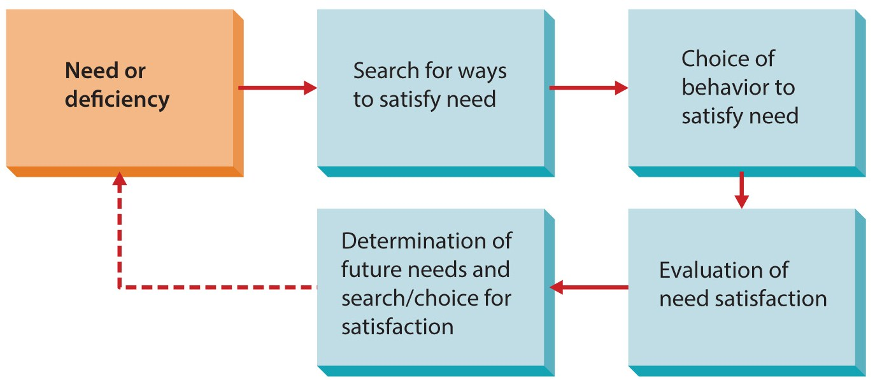
Figure 15.1
The Motivation Framework

Slide 5
Historical Perspectives on Motivation
The traditional approach (Frederick Taylor) advocates incentive pay systems.
This narrow view fails to consider other factors.
The human relations approach emphasizes the role of social processes in the workplace.
Give employees the illusion of involvement.
The human resource approach goes past the illusion, looking for real employee contributions.

Slide 6
Content Perspectives on Motivation
Content perspectives
Are approaches to motivation that address the question: What factor or factors in the workplace motive people?

Slide 7
The Needs Hierarchy Approach
Two needs hierarchy approaches are Maslow’s hierarchy and the ERG theory.
Maslow’s hierarchy of needs
suggests that people must satisfy five groups of needs in order:
physiological,
security,
belongingness,
esteem, and
self-actualization.

Slide 8
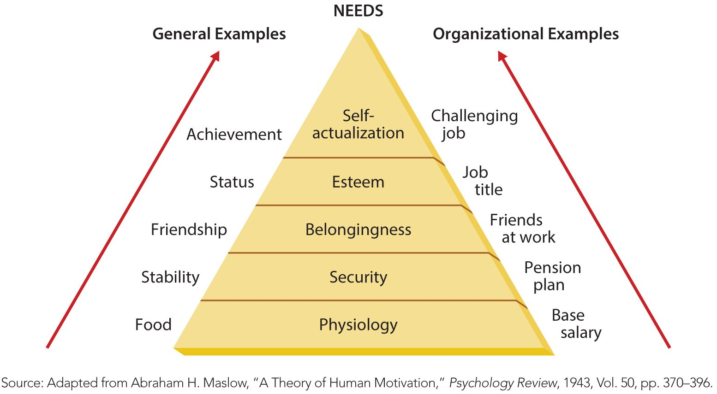
Figure 15.2
Maslow’s Hierarchy of Needs

Slide 9
The Needs Hierarchy Approach
ERG theory of motivation
suggests that people’s needs are grouped into three possibly overlapping categories:
existence, relatedness, and growth.
This theory collapses Maslow into three levels.
Existence – physiological and security needs.
Relatedness – need to belong and earn esteem.
Growth – self-esteem and self-actualization.
A frustration-regression element allows a person to back down the hierarchy when frustrated.

Slide 10
The Two-Factor Theory
Two-factor theory of motivation
people’s satisfaction and dissatisfaction are influenced by two independent set of factors – motivation factors and hygiene factors.
Herzberg concluded satisfaction and dissatisfaction were not at opposite ends of a continuum, but on different continuums.
Motivation factors fell on the satisfaction continuum.
Hygiene factors fell on the dissatisfaction continuum.

Slide 11
Figure 15.3
The Two-Factor Theory of Motivation
Herzberg recommended job enrichment.

Slide 12
Content Perspectives on Motivation
Three important individual human needs
The need for achievement is the desire to accomplish a goal or task more effectively than in the past.
The need for affiliation is the desire for human companionship and acceptance.
The need for power is the desire to be influential in a group and to control one’s environment.
The implications of content perspectives is that they discuss what motivates people, but do not describe how people are motivated.

Slide 13
Process Perspectives on Motivation
Process perspectives
Focus on why people choose certain behavioral options to fulfill their needs and how they evaluate their satisfaction after they have attained these goals.
Process perspectives are concerned with how motivation occurs.

Slide 14
Process Perspectives on Motivation
Expectancy theory
Suggests that motivation depends on two things: how much we want something and how likely we think we are to get it.

Slide 15
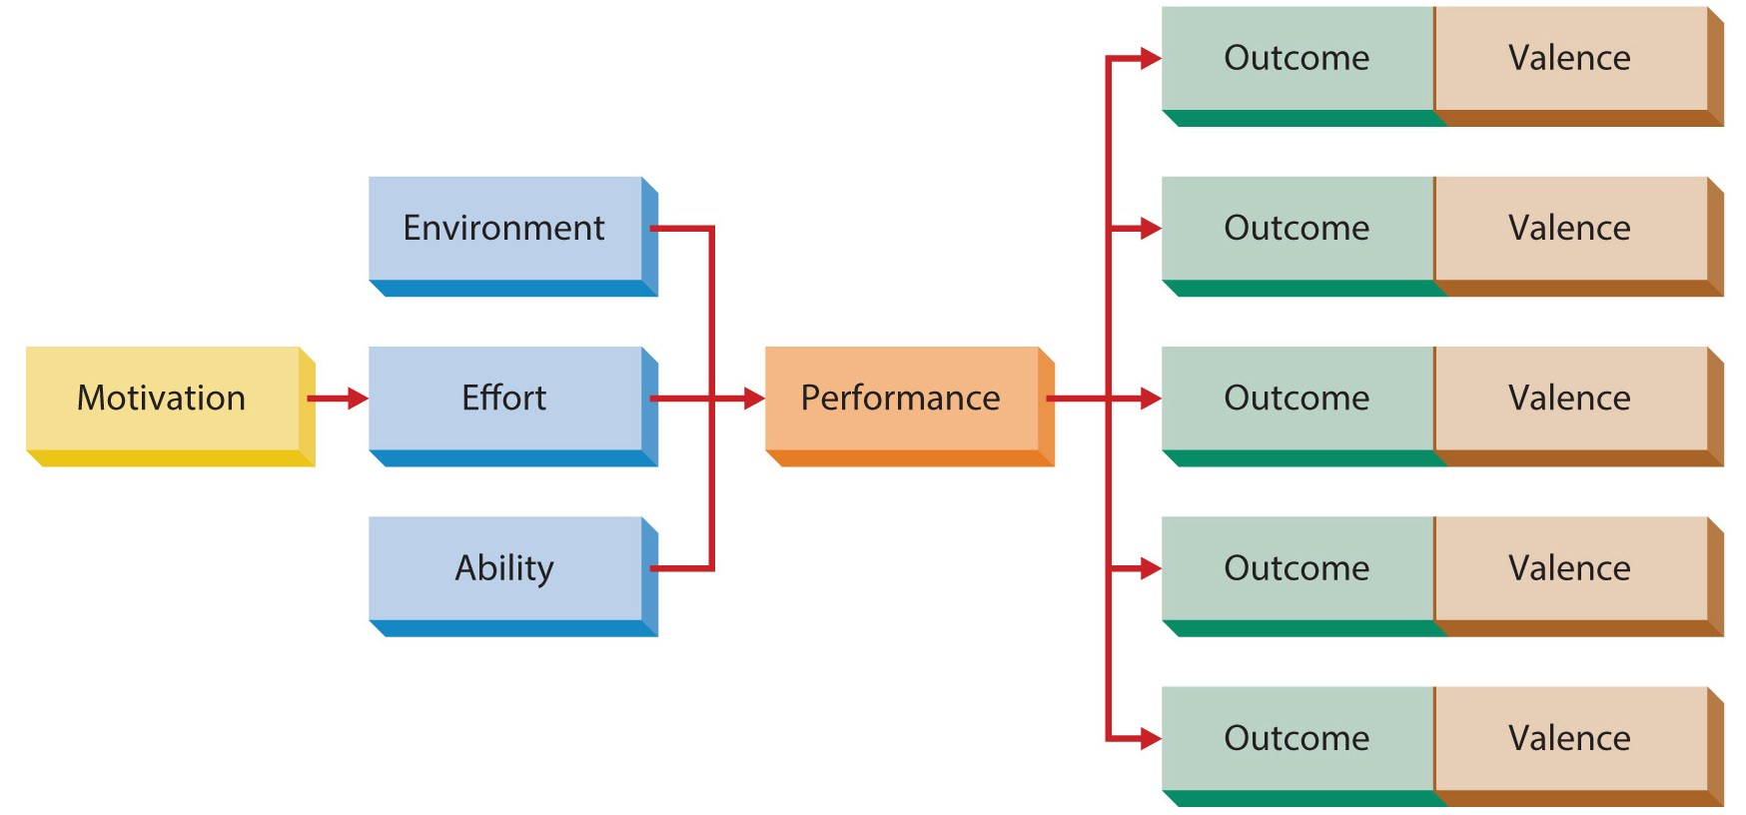
Figure 15.4
The Expectancy Model of Motivation

Slide 16
Expectancy Theory
Expectancy theory has four assumptions
Behavior is determined by a combination of forces in the individual and in the environment.
People make decisions about their own behavior in organizations.
Different people have different types of needs.
People make choices from alternative plans of behavior, based on perceptions of the extent a given behavior will lead to desired outcomes.

Slide 17
Expectancy Theory
Expectations in expectancy model
Effort-to-performance expectancy
is the individual’s perception of the probability that effort will lead to high performance.
Performance-to-outcome expectancy
is the individual’s perception that performance will lead to a specific outcome.
Outcomes
are consequences of behaviors in an organization setting, usually rewards.

Slide 18
Expectancy Theory
Expectations in expectancy model
Each outcome has an associated value or valance.
A valance
is an index of how much an individual desires a particular outcome, the attractiveness of the outcome.
For motivation to occur
all of the following must be greater than 0.
Effort-to-performance, performance-to-outcome, and the sum of the valences for the outcomes.

Slide 19
Expectancy Theory
The Porter-Lawler extension
suggests that high performance may lead to satisfaction that results from the rewards given for high performance.
This reverses the direction of causation
Expectancy theory says motivated workers will have high performance.
Porter-Lawler say that high performing workers will become motivated.

Slide 20
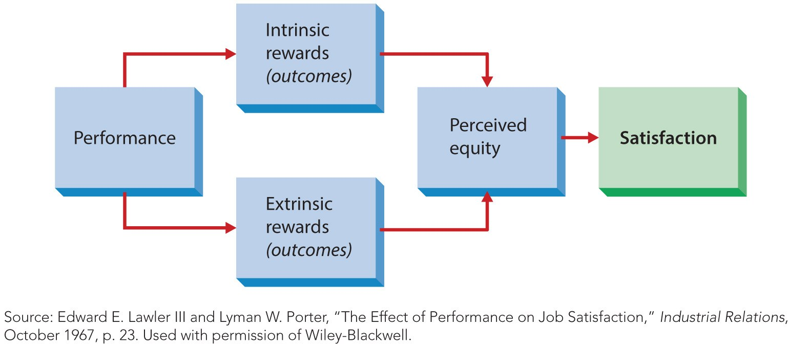
Figure 15.5
The Porter-Lawler Extension of Expectancy Theory

Slide 21
Process Perspectives on Motivation
Equity theory
Suggests that people are motivated to seek social equity in the rewards they receive for performance.

Slide 22
Equity Theory
To determine equity
a person compares their ratio of outcomes to inputs to someone else’s ratio.
Formulation of ratios and comparisons are very subjective, based on perceptions.
May result in feelings of equitable rewards, under-rewarded, or over-rewarded.
If inequality is perceived, employee works to correct the imbalance.

Slide 23
Goal-Setting Theory
Goal setting theory of motivation
assumes behavior is a result of conscious goals and intentions.
Original theory
Goal difficulty – challenging and requires effort.
Goal specificity – clarity and precision of goal.
Expanded theory
Goal acceptance – makes goals their own.
Goal commitment - wants to reach the goal.

Slide 24
Figure 15.6
The Expanded Goal-Setting Theory of Motivation
Because the theory attracted so much interest, an expanded model was proposed.

Slide 25
Process Perspectives on Motivation
Implications of the process perspectives
Managers trying to improve motivation can use steps to achieve the expectancy theory.
Managers need to consider the nature of the ‘other’ employees compare themselves to.
Goal-setting theory can be used to implement both expectancy and equity theory concepts.

Slide 26
Reinforcement Perspectives on Motivation
Reinforcement theory
Is an approach to motivation that argues that behavior that results in rewarding consequences is likely to be repeated, whereas behavior that results in punishing consequences is less likely to be repeated.

Slide 27
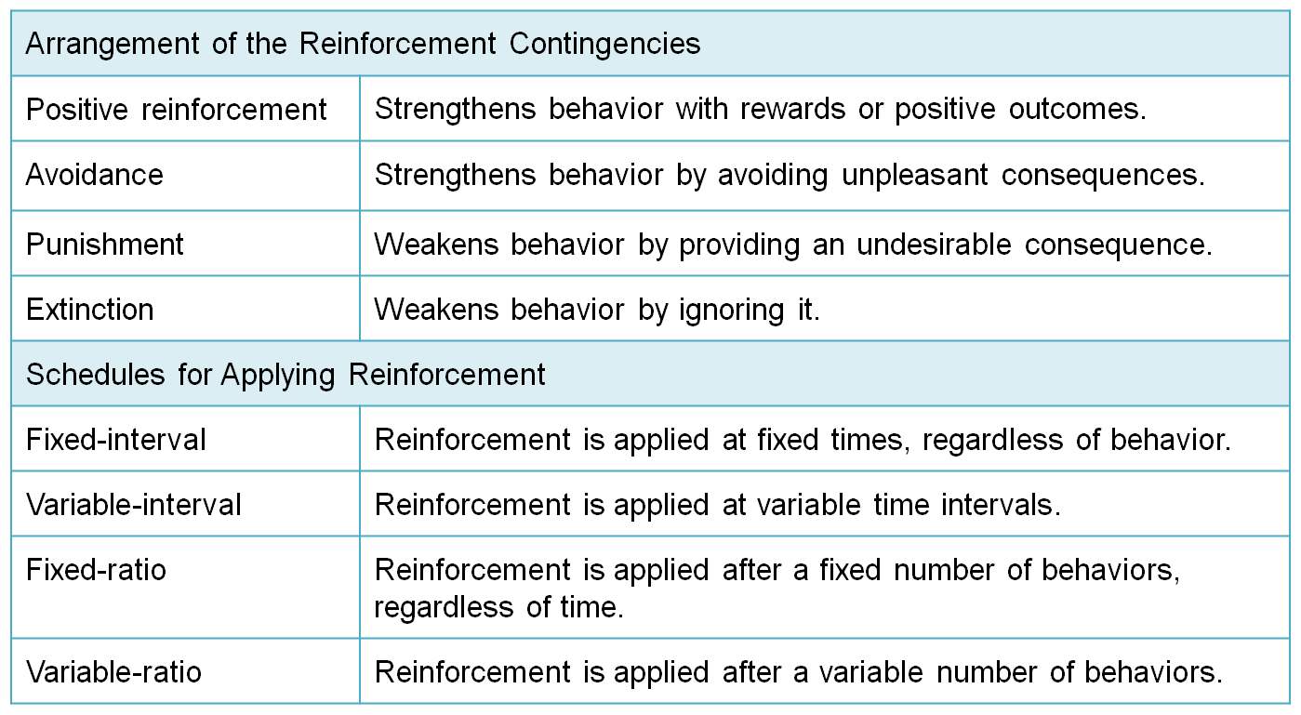
Table 15.1
Elements of Reinforcement Theory

Slide 28
Kinds of Reinforcement
Positive reinforcement
strengthens behavior with rewards or positive outcomes.
Avoidance
strengthens behavior by avoiding unpleasant consequences.
Punishment
weakens undesired behaviors but builds resentment and hostility.
Extinction
weakens undesired behaviors by ignoring or not reinforcing them.

Slide 29
Providing Reinforcement
Fixed-interval schedule
provides reinforcement at fixed times, regardless of behavior.
Variable-interval schedule
provides reinforcement at varied times.
Fixed-ratio schedule
provides reinforcement after a fixed number of behaviors.
Variable-ratio schedule
provides reinforcement after varying numbers of behaviors.

Slide 30
Reinforcement Perspectives on Motivation
Behavior modification, or OB Mod
is a method for applying the basic elements of reinforcement theory.
Implications of reinforcement perspectives
Reinforcement is a powerful force for maintaining employee motivation.
Use the correct manner and schedule.
Managers must avoid motivating undesired or dysfunctional behaviors.

Slide 31
Popular Motivational Strategies
Techniques and strategies to apply theory
Empowerment
is the process of enabling workers to set their own work goals, make decisions, and solve problems within their sphere of responsibility and authority.
Participation
is the process of giving employees a voice in making decisions about their own work.

Slide 32
Popular Motivational Strategies
Areas of participation
Decisions about their own job.
Work schedules.
Product quality.
Techniques and issues in empowerment
Work teams empower workers.
Decentralizing the organization is another method.

Slide 33
Popular Motivational Strategies
Empowerment enhances effectiveness only if certain conditions exist.
Sincere efforts to spread power.
Commitment to maintaining participation.
Workers must believe they are working with managers.
Systematic and patient efforts to empower.
Increased commitment to training.

Slide 34
Popular Motivational Strategies
Alternative working arrangements
A compressed work schedule is working a full 40-hour week in fewer than five days.
Flexible work schedules, (flextime) allows employees some control over the hours they choose to work.
Job sharing occurs when two or more part-time workers share one full-time job.
Telecommuting allows part of work time offsite, usually at home.

Slide 35
Using Reward Systems to Motivate Performance
An organizational reward system
Is the formal and informal mechanisms by which employee performance is defined, evaluated, and rewarded.
Rewards tied to performance have the greatest impact on motivation and performance.

Slide 36
Merit Reward Systems
Merit pay
is pay awarded to employees on the basis of the relative value of their organizational contributions.
Merit pay plans
formally base some meaningful portion of compensation on merit.
Merit is usually determined or defined based on the individual’s performance and overall contributions to the organization.

Slide 37
Incentive Reward Systems
A piece-rate incentive plan occurs when the organization pays a certain amount of money for every unit an employee produces.
Individual incentive plans reward individual performance on a real-time basis.
Sales commissions are a common incentive.
Nonmonetary incentives are also common.
A major advantage is it is a one-shot reward.

Slide 38
Team and Group Incentive Reward Systems
Gainsharing programs
Are designed to share the cost savings from employee productivity improvements. Aligns employee and corporate interests.
The Scanlon plan
Is similar to gainsharing, but the distribution of gains is tilted much more heavily toward employees.

Slide 39
Team and Group Incentive Reward Systems
One-time team rewards may be given either as a proportion of salary or identical amounts.
Nonmonetary rewards often include prizes and awards.
Profit sharing creates a pool of corporate profits distributed to all employees.
Employee stock ownership programs, or ESOPs gradually grant stock ownership as a reward.

Slide 40
Executive Compensation
Standard forms of executive compensation
Base salary is a guaranteed amount of compensation.
Incentive pay includes bonuses based on organizational performance.
May be a pool of diverted profits split between top executives. Or proportionally distributed.

Slide 41
Executive Compensation
Special forms of executive compensation
A stock option plan
is established to give senior managers the option to buy company stock in the future at a fixed price.
If executives are effective, stock price should rise.
Popular because costs are low and they align interests of managers and stockholders.
Executives usually receive many other types of compensation including club memberships, use of company vehicles, low-interest loans, etc.

Slide 42
Executive Compensation
Criticisms of executive compensation
Many feel annual compensation is too high, averaging over $1 million.
There often seems to be little relationship between executive pay and performance.
The gap between CEO earnings and average worker earnings is enormous, and rising.
In 1980 a CEO made 42 times an average worker.
In 1990 the ratio rose to 85 times the earnings.
In 2014 the ratio is 354 times a typical worker.

Slide 43
New Approaches
New
Some organizations allow employees a greater say in how rewards are determined and allocated.
New
Some firms customize rewards to each individual employee’s needs.
New approaches to performance-based rewards.

Slide 44
Summary
The chapter first examined the nature of employee motivation.
The text then explored the major perspectives on motivation.
Newly emerging approaches were then discussed.
The chapter concluded with a description of rewards and their role in motivation.

