Slide 1
MANAGEMENT
TWELFTH EDITION
Ricky W. Griffin
Part Five: The Leading Process
Chapter Sixteen: Managing Leadership and Influence Processes

Slide 2
Learning Outcomes
Describe the nature of leadership and relate leadership to management.
Discuss and evaluate the two generic approaches to leadership.
Identify and describe the major situational approaches to leadership.
Identify and describe three related approaches to leadership.
Describe three emerging approaches to leadership.
Discuss political behavior in organizations and how it can be managed.

Slide 3
The Meaning of Leadership
Leadership
is both a process and a property.
As a process, leadership is the
use of noncoercive influence to shape goals, motivate behavior towards achievement of goals, and help define group or organizational culture
As a property, leadership is the
set of characteristics attributed to individuals who are perceived to be leaders.

Slide 4
The Meaning of Leadership
Leaders
People who can influence the behaviors of others without having to rely on force; those accepted by others as leaders.

Slide 5
Leadership and Management
They are related but not the same.
A person can be a manager, a leader, both, or neither.
Organizations need both good managers and good leaders to be effective.
Leadership is necessary to create change, and management is necessary to achieve orderly results.

Slide 6
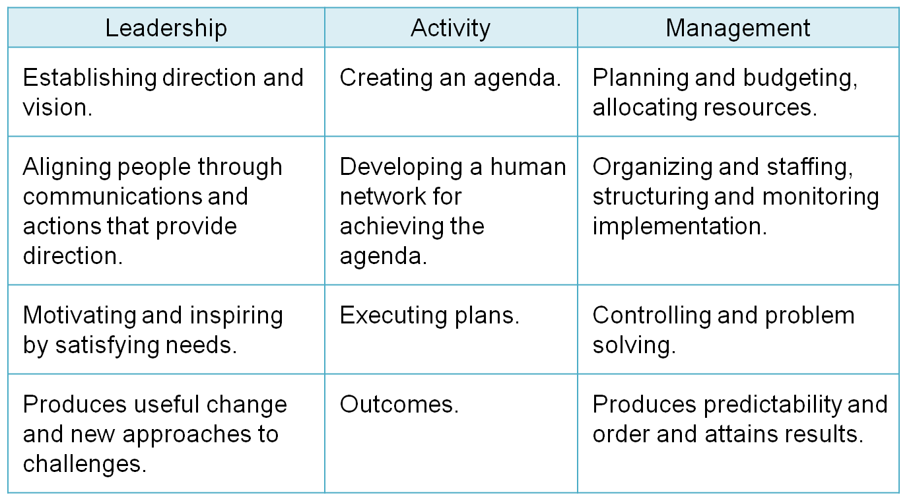
Table 16.1
Distinctions Between Management and Leadership
Source: Reprinted with permission of The Free Press, a division of Simon & Schuster Adult Publishing Group, from A Force for Change How Leadership Differs from Management by John P. Kotter. Copyright © 1990 by John P. Kotter, Inc.

Slide 7
Leadership and Power
Power
Is the ability to affect the behavior of others.
One can have power without using it.

Slide 8
Leadership and Power
Legitimate power
is granted through the organizational hierarchy.
Authority does not make someone a leader.
Reward power
is the power to give or withhold rewards.
Coercive power
is the power to force compliance.
Builds resentment.

Slide 9
Leadership and Power
Referent power
is personal accrued power based on identification, imitation, loyalty, or charisma.
Referent power is abstract but more likely associated with leadership.
Expert power
is personal accrued power based on information or expertise possessed.
People who are both leaders and managers tend to possess expert power.

Slide 10
Methods for Using Power
A legitimate request is based on legitimate power.
Instrumental compliance occurs when a subordinate receives a reward for compliance.
A manager uses coercion when they imply punishment for noncompliance.
Rational persuasion occurs when a manager convinces a subordinate that compliance is in their best interests.

Slide 11
Methods for Using Power
Personal identification occurs when a manager realizes, then exploits, their referent power.
A manager who induces a subordinate to do something consistent with a set of higher ideals or values is using inspirational appeal.
Information distortion is withholding or distorting information to influence behavior.
Can lead to lose of confidence and trust.

Slide 12
Generic Approaches to Leadership
Leadership traits
Researchers assumed some basic set of traits differentiated leaders from nonleaders.
The results found that for every trait identified, there were many exceptions.
Leadership behaviors
Researchers began to look at how effective leaders behaved compared to less effective leaders.

Slide 13
Generic Approaches to Leadership
Job-centered
Employee-centered
The Michigan Studies (Likert)
Managers using employee-centered leader behavior are interested in developing a cohesive work group and ensuring that employees are satisfied with their jobs.
Managers using job-centered leader behavior pay close attention to subordinates’ work, explain work procedures, and are keenly interested in performance.

Slide 14
Generic Leadership Approaches
The Ohio State University studies found two basic leader behavior styles.
Initiating-structure behavior
clearly defines the leader-subordinate role, clarifying expectations,
establishes formal lines of communication, and
determines how tasks will be performed.
Consideration behavior
shows concern for subordinates and attempt to establish a warm, friendly and supportive climate.

Slide 15
Generic Leadership Approaches
The Ohio State studies
Unlike the Michigan studies, each behavior was assumed independent of each other.
Researchers expected to find leaders exhibiting high levels of both behaviors.
Ultimately concluded that situational influences occur making consistent prediction difficult.

Slide 16
Generic Leadership Approaches
The Leadership Grid
provides a means for evaluating leadership styles and training managers to move toward an ideal style of behavior.
The horizontal axis represents concern for production and deals with the job and task aspects of leader behavior.
The vertical axis represents concern for people and deals with the human aspects of leader behavior.

Slide 17
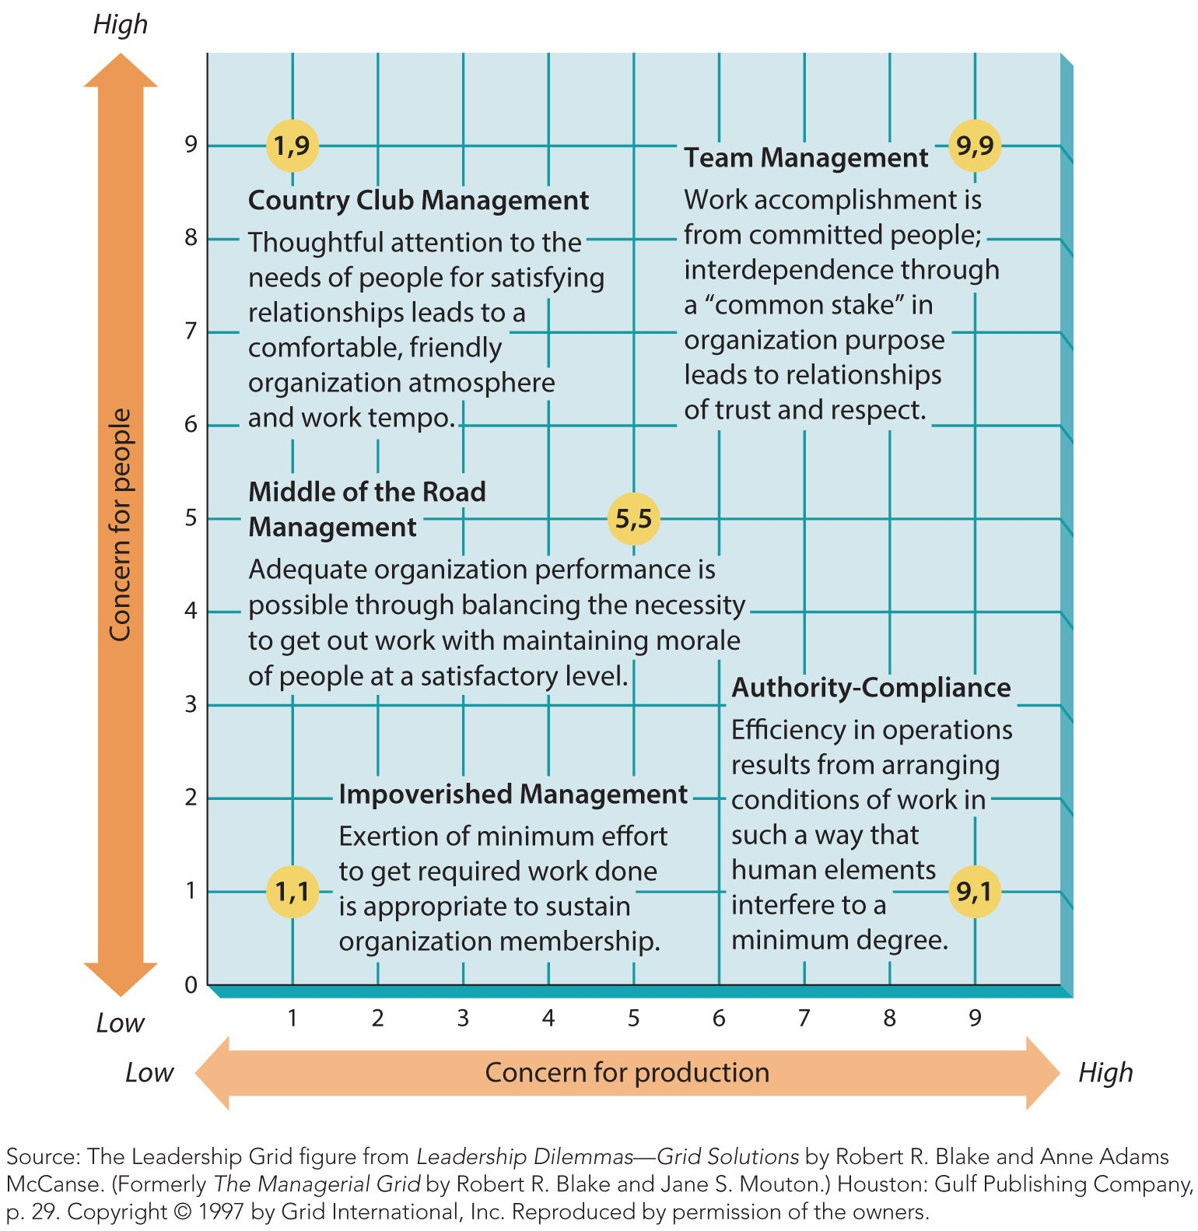
Figure 16.1
The Leadership Grid
Note the five extremes of managerial behavior.

Slide 18
Generic Approaches to Leadership
The leader-behavior theories played an important role in the development of contemporary leadership.
They urge us not to focus on a leader’s traits but on what leaders do, their behaviors.
New approaches were needed.
The next step was the creation of situational models.

Slide 19
Situational Approaches to Leadership
Situational models assume appropriate leader behavior varies with the situation.
The goal is to identify factors and how they interact to determine appropriate behavior.
An important early model laid the foundation for subsequent developments.
Tannenbaum and Schmidt proposed a continuum of leadership behavior.

Slide 20
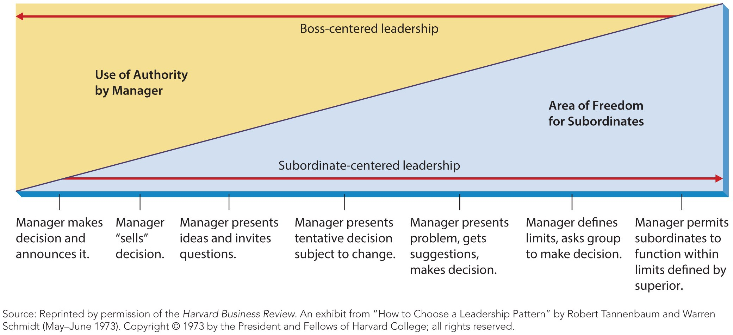
Figure 16.2
Tannenbaum and Schmidt’s Leadership Continuum
Though helpful, this model is only speculative.

Slide 21
LPC Theory
Least-preferred coworker (LPC) theory
The LPC theory
suggests that appropriate styles of leadership vary with situational favorableness.
Developed by Fred Fiedler, this was the first true situational leadership theory.
Fiedler identified two styles of leadership:
task oriented and relationship oriented.

Slide 22
LPC Theory
Fiedler believed the favorableness of the situation depended on three factors.
Leader-member relations – the relationship between the leader and the work group.
Task structure – the degree the group’s task is well defined.
Position power is the power vested in the leader’s position.

Slide 23
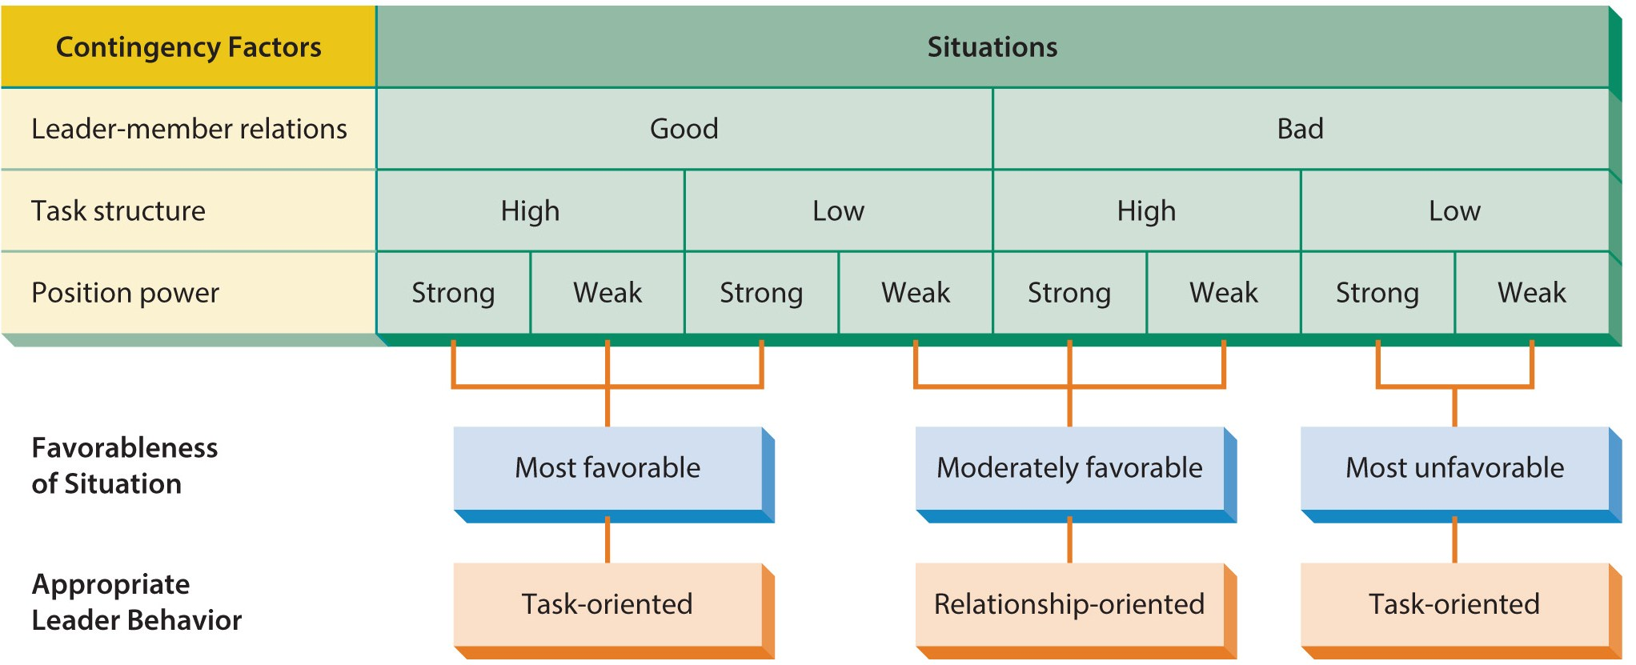
Figure 16.3
The Least-Preferred Coworker Theory of Leadership
Though Fiedler’s theory is often criticized, it was the first to adopt a situational perspective on leadership.

Slide 24
LPC Theory
When the situation is highly favorable or highly unfavorable, task oriented leadership is best.
Relationship oriented leaders are best in situations in the middle range.
Fiedler argues the leader’s style is fixed, the situation must change to match the leader.

Slide 25
Path-Goal Theory
Path-goal theory
says the primary functions of a leader are to make desired rewards available and to clarify the kinds of behavior that will lead to rewards.
Identifies four kinds of leader behavior.
Directive leader behavior.
Supportive leader behavior.
Participative leader behavior.
Achievement-oriented leader behavior.
Assumes leaders can change their style.

Slide 26
Path-Goal Theory
Path-goal theory suggests the appropriate leadership style depends on two factors.
The personal characteristics of subordinates.
Their perceptions of their abilities and their locus of control.
Environmental characteristics of the workplace.
Task structure, the formal authority system or the nature of the work group.

Slide 27
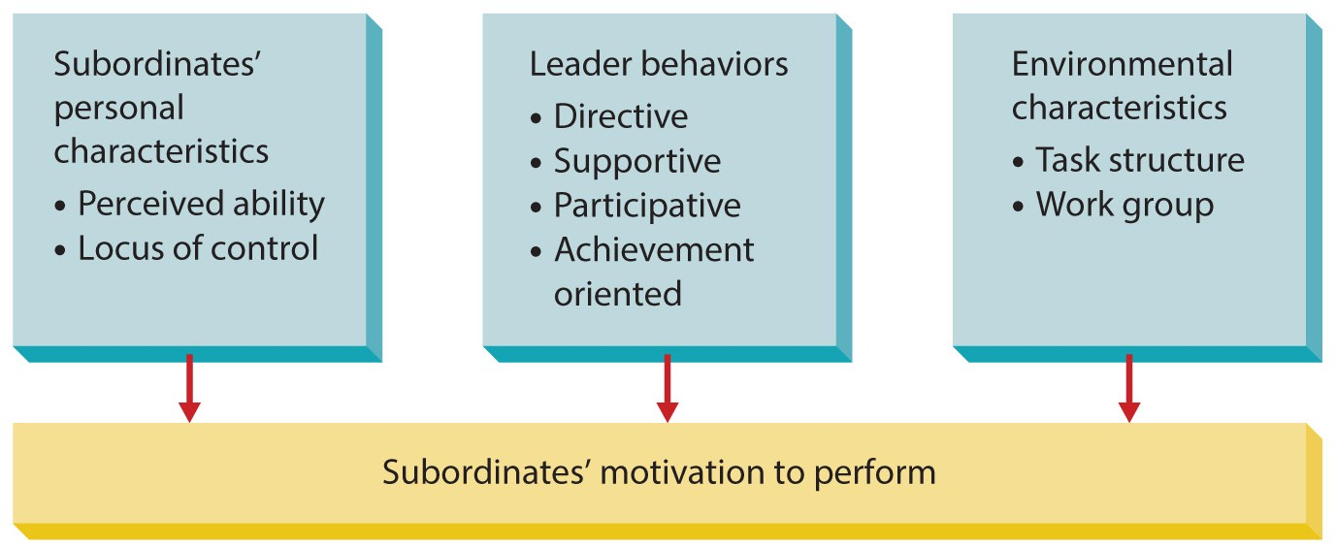
Figure 16.4
The Path-Goal Framework

Slide 28
Vroom’s Decision Tree Approach
Vroom’s decision tree approach
uses a situational model of leader behavior to predict what kinds of situations call for what degrees of group participation.
Suggests managers use one of two different decision trees.
The ends of the tree branches represent different levels or subordinate participation.
Supported by research but complex.

Slide 29
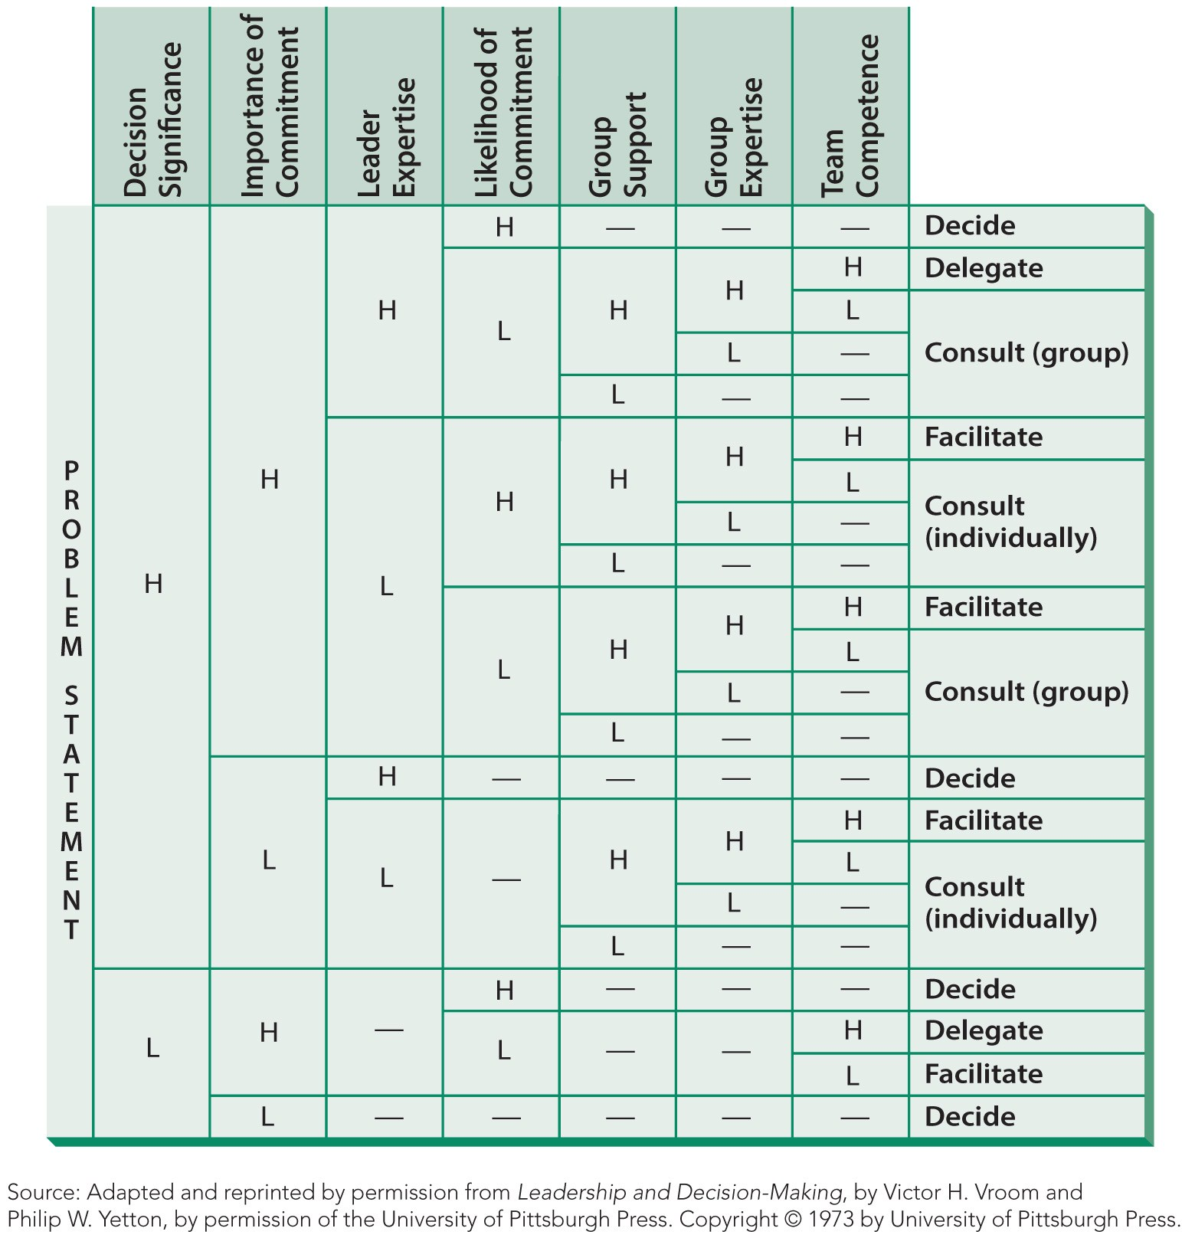
Figure 16.5
Vroom’s Time-Driven Decision Tree

Slide 30
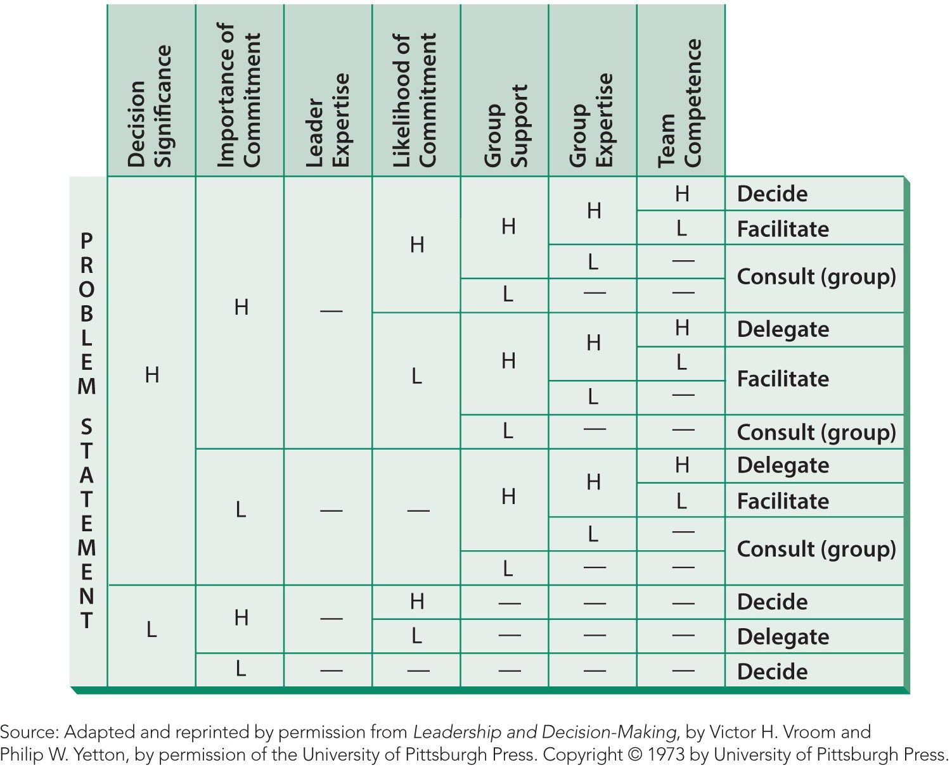
Figure 16.6
Vroom’s Development-Driven Decision Tree
Used when the leader is more interested in developing employees.

Slide 31
The Leader-Member Exchange Approach
Leader-member exchange (LMX) model
stresses that leaders have different kinds of relationships with different subordinates.
Each superior-subordinate pair is a “vertical dyad.”
Those close to the manager are “the in-group” who receive better treatment than “the out-group.”

Slide 32
Related Approaches to Leadership
Substitutes for leadership
identifies situations in which leader behaviors are neutralized or replaced by characteristics of subordinates, the task, and the organization.
Highly experienced employees know what to do.
Simple tasks require little leadership.
Formal and inflexible policies are organizational characteristics that substitute for leadership.

Slide 33
Related Approaches to Leadership
Charismatic leadership
Assumes that charisma is an individual characteristic of the leader.
Charisma
Is a form of interpersonal attraction that inspires support and acceptance.
Charismatic leaders:
Envision the future and have high expectations.
Use enthusiasm and prior success to energize others.
Support and express confidence in others.

Slide 34
Related Approaches to Leadership
Transformational leadership
Goes beyond ordinary expectations by transmitting a sense of mission, stimulating learning experiences, and inspiring new ways of thinking.
Transformation leaders are vital to the success of business due to rapid change and turbulent environments..

Slide 35
Emerging Approaches to Leadership
Strategic leadership
is the capability to understand the complexities of both the organization and its environment
and to lead change in the organization in order to achieve and maintain a superior alignment between the organization and its environment.
This new concept relates leadership to the role of top management.
Effective when leaders deeply understand the business, and its environment.

Slide 36
Emerging Approaches to Leadership
Cross-cultural leadership
Effective cross-cultural leaders understand cultural and national differences.
As organizations become more global and internally diverse, this importance will grow.
Ethical leadership
Managers must demonstrate sound ethical principles and serve as ethical role models.
Businesses must hire ethical leaders and hold them accountable for their actions.

Slide 37
Political Behavior in Organizations
Political behavior
Consists of activities carried out for specific purpose of acquiring, developing, and using power and other resources to obtain one’s preferred outcomes.
May be directed upward, downward, or laterally.
Top levels thought to be more political than lower levels.

Slide 38
Common Political Behaviors
Inducement occurs when something is given in return for support.
Persuasion relies on manipulation of logic and emotions.
Creation of an obligation occurs when a manager does a favor in hopes of receiving one in return.
Coercion is the use of force.

Slide 39
Impression Management
Impression management
A direct and intentional effort by someone to enhance his or her image in the eyes of others.
People engage in impression management for a variety of reasons.

Slide 40
Impression Management
Impression management is used to:
further someone’s career,
receive rewards or promotions,
garner attractive job assignments,
boost someone’s self-esteem, or
gain power and control.
Appearance and association are mechanisms to manage perception.

Slide 41
Managing Political Behavior
Be aware that others may assume your motives are political, even if they are not.
Give subordinates autonomy, responsibility, challenges, and feedback to reduce politics.
Avoid using power if possible.
Get disagreements out in the open.
Avoid covert activities.
Keep performance evaluations transparent, tie rewards directly to performance and minimize competition among managers for resources.

Slide 42
Summary
The chapter began by characterizing the nature of leadership.
The chapter then discussed three major approaches to studying leadership:
traits, behaviors, and situations.
The chapter then examined other perspectives on leadership.
The chapter concluded by describing another approach to influencing others, political behavior in organizations.

