Slide 1
MANAGEMENT
TWELFTH EDITION
Ricky W. Griffin
Part Five: The Leading Process
Chapter Seventeen: Managing Interpersonal Relations and Communication

Slide 2
Learning Outcomes
Describe the interpersonal nature of organizations.
Describe the role and importance of communication in the manager’s job.
Identify the basic forms of communication in organizations.
Discuss informal communication, including its various forms and types.
Describe how the communication process can be managed to recognize and overcome barriers.

Slide 3
Interpersonal Nature of Organizations
Vital managerial activities involve
interpersonal relations, communication, and group processes.
Interpersonal relations fall on two continua
personal and impersonal, and
positive and negative.
Possible outcomes of interpersonal relations
satisfying needs, gaining social support, creating energy, or creating conflict.

Slide 4
Communication and the Manager’s Job
Communication
Is the process of transmitting information from one person to another.
Effective communication
Is the process of sending a message in such a way that the message is as close in meaning as possible to the message intended.
Meaning is the idea the sender of the communication wishes to convey.

Slide 5
The Role of Communication in Management
Managers use communication to fulfill each of the ten basic managerial roles.
Three interpersonal roles, three informational roles, and four decisional roles.
They use communication to carry out the basic management functions.
Planning, organizing, leading and controlling.

Slide 6
The Communication Process
The process begins when the sender wants to transmit a message to the receiver.
The sender encodes the meaning.
The sender transmits the message.
The message is received and decoded back.
If prompted, the cycle begins again.
“Noise”, is anything that disrupts the process.
Can occur anywhere along the path.

Slide 7
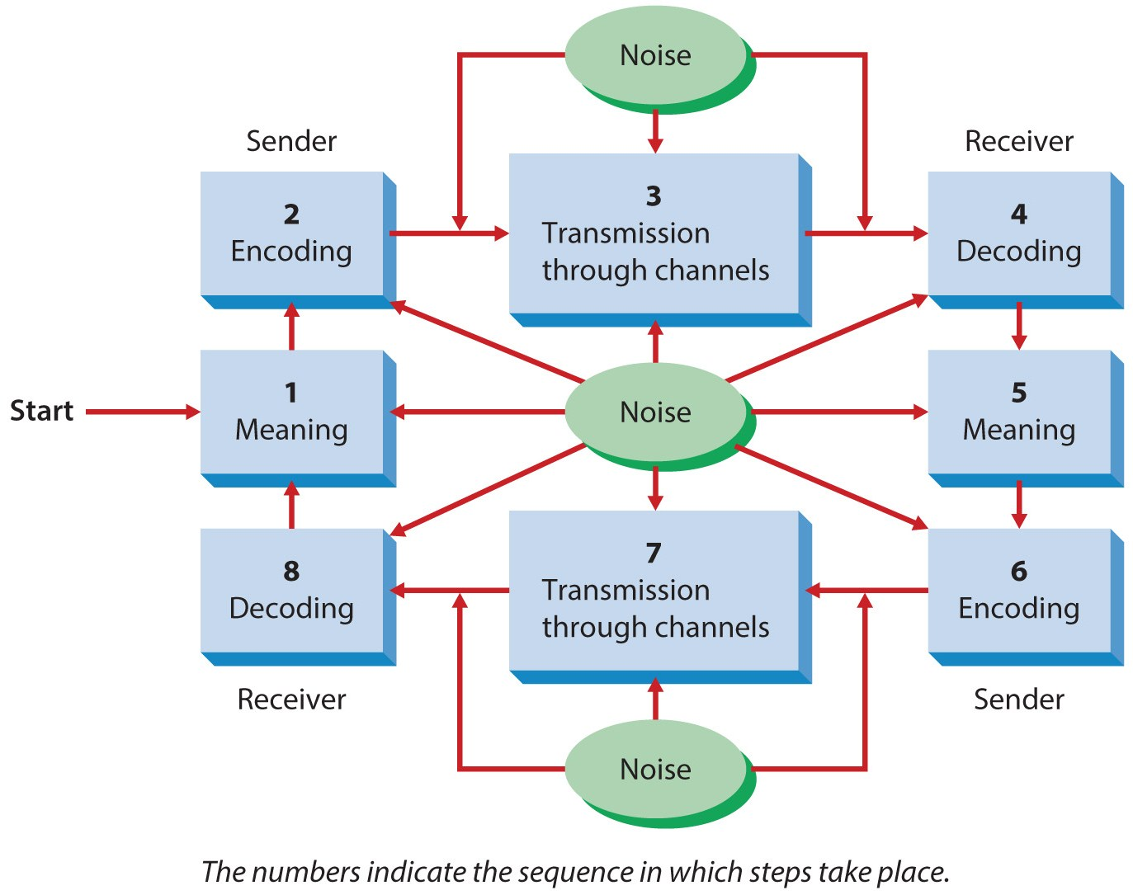
Figure 17.1
The Communication Process

Slide 8
Interpersonal Communication
Oral communication
takes place in face-to-face conversations, group discussion, telephone calls, and other time when the spoken word is used to express meaning.
Provides prompt feedback.
Does not require as much preparation or skill.
May suffer from inaccuracy.
Does not allow for considered responses.
Lacks a permanent record.

Slide 9
Interpersonal Communication
Written communication
is memos, letters, reports, notes, and other times when the written word is used to transmit meaning.
Inhibits feedback and interchange.
More difficult and time consuming.
Usually accurate and allows receiver review.
Provides a permanent record.
Preferable when important details are involved.

Slide 10
Interpersonal Communication
Choosing the right form
The situation determines the best medium.
Oral communication is better when the message is personal, nonroutine, and brief.
Written communication is better when the message is impersonal, routine, and longer.
Managers can combine media to capitalize on the advantages of each.

Slide 11
Communication in Networks and Work Teams
A communication network
is the pattern through which the members of a group communicate.
Various patterns exist.
Centralized networks show the greatest efficiency when tasks are simple and routine.
The wheel is the most centralized form.
Decentralized networks work best for complex and nonroutine tasks.
The all-channel network is the most decentralized.

Slide 12
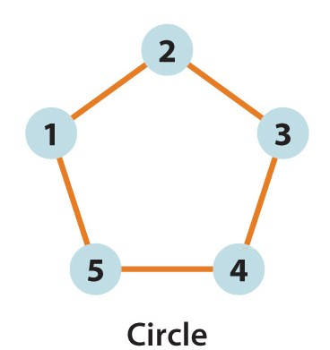
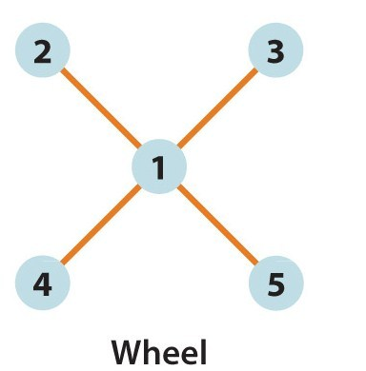
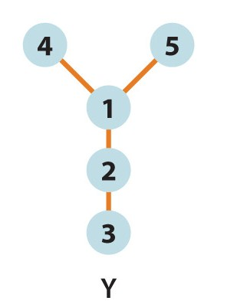
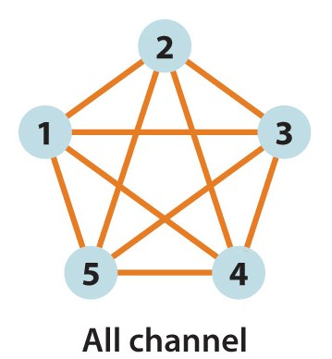
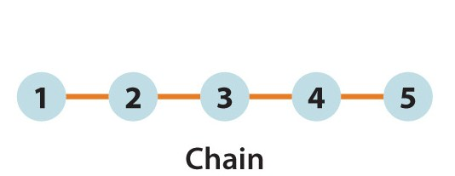
Figure 17.2
Types of Communication Networks

Slide 13
Organizational Communication
Vertical communication
flows up and down the organization, usually along formal reporting lines; may involve several different levels of the organization.
Upward communication consists of messages from subordinates to superiors.
More subject to distortion than downward communication.
Downward communication occurs when information flows down the hierarchy.

Slide 14
Organizational Communication
Horizontal communication
flows laterally within the organization, involves colleagues and peers at the same level and may involve different organizational units.
Probably occurs more among managers than among nonmanagers.
Facilitates coordination, helps problem solving, and plays a major role in cross-departmental work teams.

Slide 15
Digital Communication
Electronic communication has taken on greater importance for managers.
Formal information systems effectively link various areas of the organization by computer.
Personal electronic technology refers primarily to email and cell phones.
While convenient, they can add stress.
Come at the expense of face-to-face meetings.
Makes it more difficult to build a strong culture or develop solid relationships.

Slide 16
Figure 17.3
Formal Communication in Organizations
Many firms place the task of developing a formal information system on the chief information officer (CIO)

Slide 17
Figure 17.4
Informal Communication in Organizations
Informal communication channel …

Slide 18
Informal Communication in Organizations
In some cases communication transcends formal channels and follows any of several informal methods.
Common forms include:
The grapevine.
Management by wandering around.
Nonverbal communication.

Slide 19
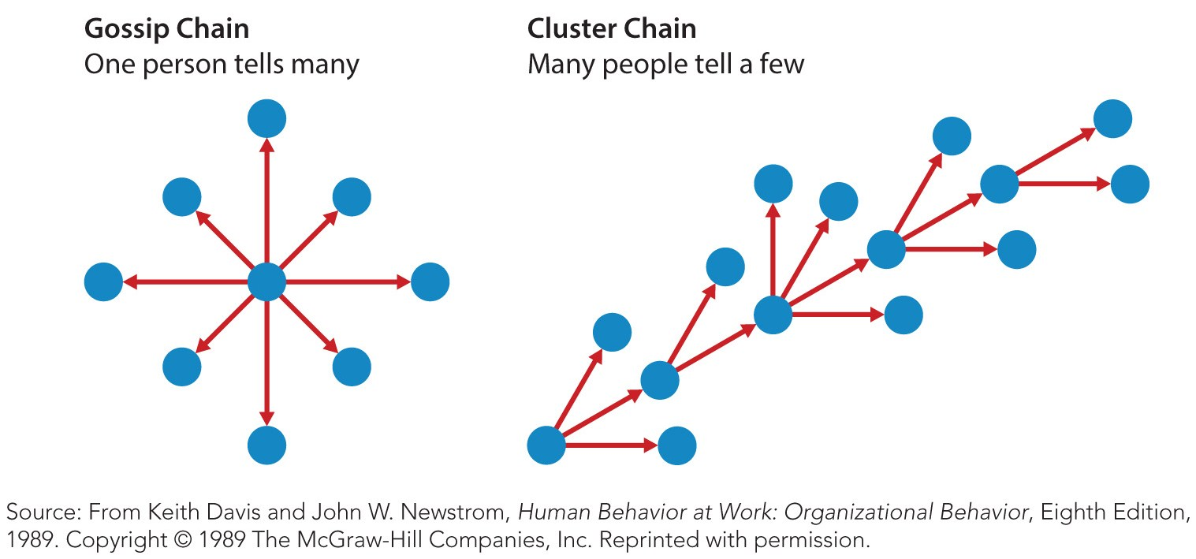
Figure 17.5
Common Grapevine Chains Found in Organizations
The grapevine is an informal communication network among people in an organization.

Slide 20
The Grapevine
The grapevine spreads “gossip” but can be fairly accurate.
Informal communication is increasing.
The grapevine cannot be eliminated.
Manage the grapevine
maintain open channels of communication,
respond vigorously to inaccurate information,
use the grapevine to enhance communication.

Slide 21
Informal Communication in Organizations
Management by wandering around
Is an approach to communication that involves the manager’s literally wandering around and having spontaneous conversations with others.
A related aspect is the informal interchange among employees that takes place outside the workplace.
These meetings promote a strong culture and enhance understanding of how the organization works.

Slide 22
Informal Communication in Organizations
Nonverbal communication
is any communication that does not use words or uses words to carry more meaning than the definition of the words themselves.
Images are created by people’s choice of words.
Settings are where the communication happens.
Body language.
Managers must make sure their body language matches the message they wish to convey.

Slide 23
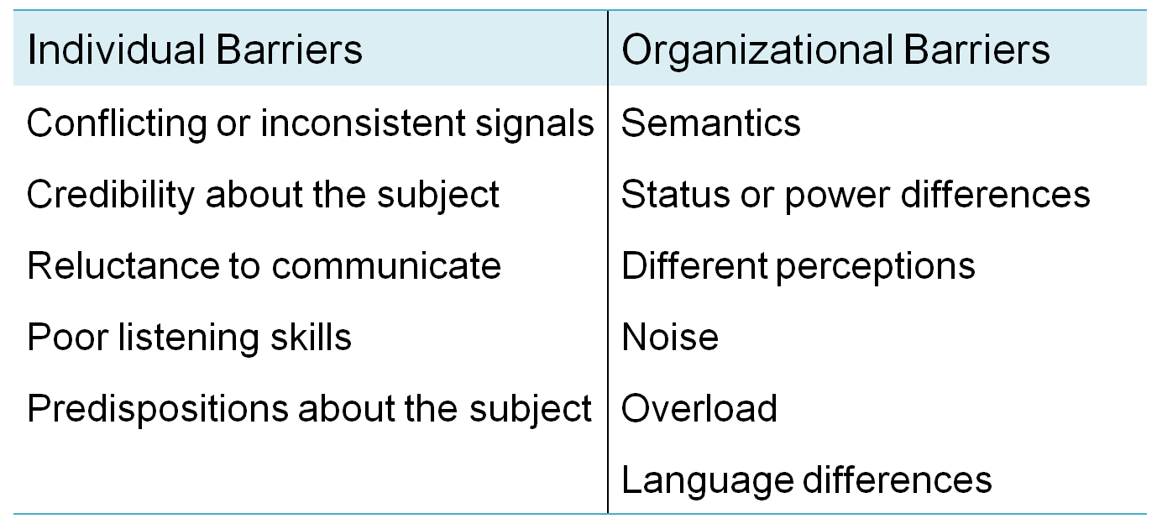
Table 17.1
Barriers to Effective Communication
Several factors may disrupt the communication process or serve as barriers to effective communication.

Slide 24
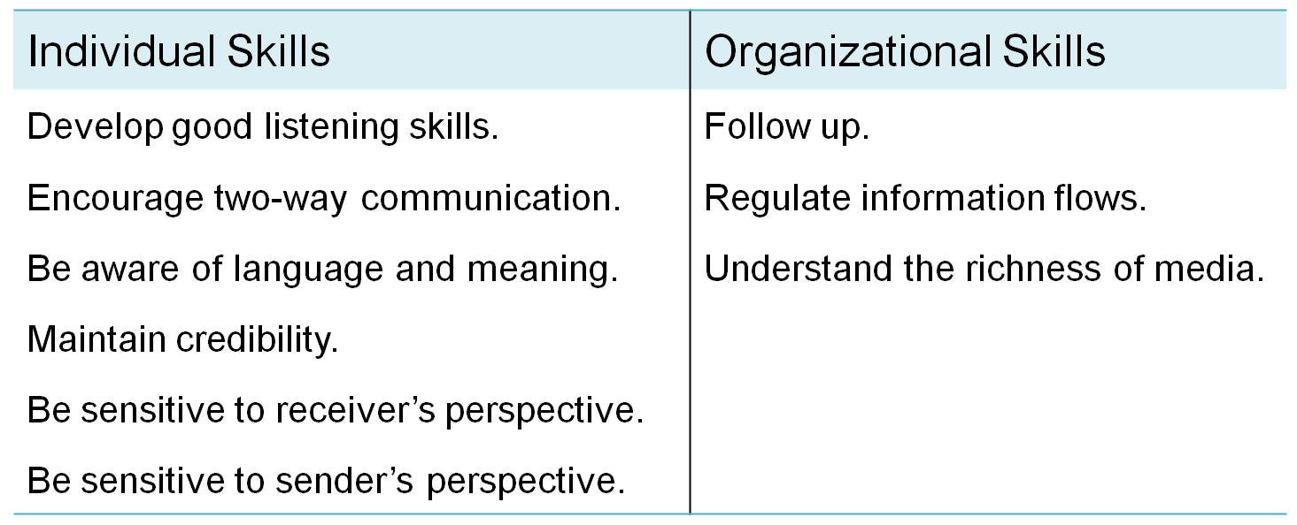
Table 17.2
Overcoming Barriers to Communication

Slide 25
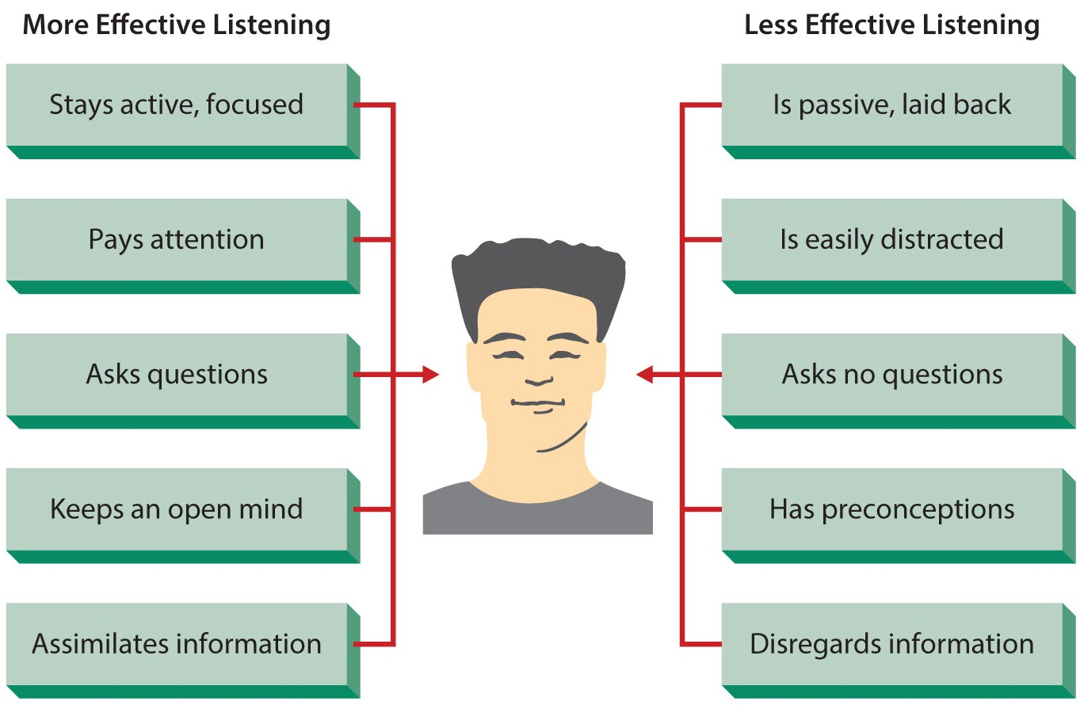
Figure 17.6
More and Less Effective Listening Skills

Slide 26
Summary
The chapter first established the interpersonal nature of organizations.
The text then discussed communication in the context of the manager’s job.
The chapter identified and discussed forms of interpersonal, group, and organizational communication.
After discussing informal communication, the text described ways of managing organizational communication.

