Slide 1
MANAGEMENT
TWELFTH EDITION
Ricky W. Griffin
Part Five: The Leading Process
Chapter Eighteen: Managing Work Groups and Teams

Slide 2
Learning Outcomes
Define and identify types of groups and teams in organizations, discuss reasons why people join groups and teams, and list the stages of group and team development.
Identify and discuss four essential characteristics of groups and teams.
Discuss interpersonal and intergroup conflict in organizations.
Describe how organizations manage conflict.

Slide 3
Groups and Teams in Organizations
Group
Consists of two or more people who interact regularly to accomplish a common purpose or goal.
Groups are a ubiquitous part of organizational life.

Slide 4
Types of Groups and Teams
A functional group
is a permanent group created by the organization to accomplish a number of purposes with an unspecified time horizon.
An informal or interest group
is created by its members for purposes that may or may not be relevant to those of the organization.

Slide 5
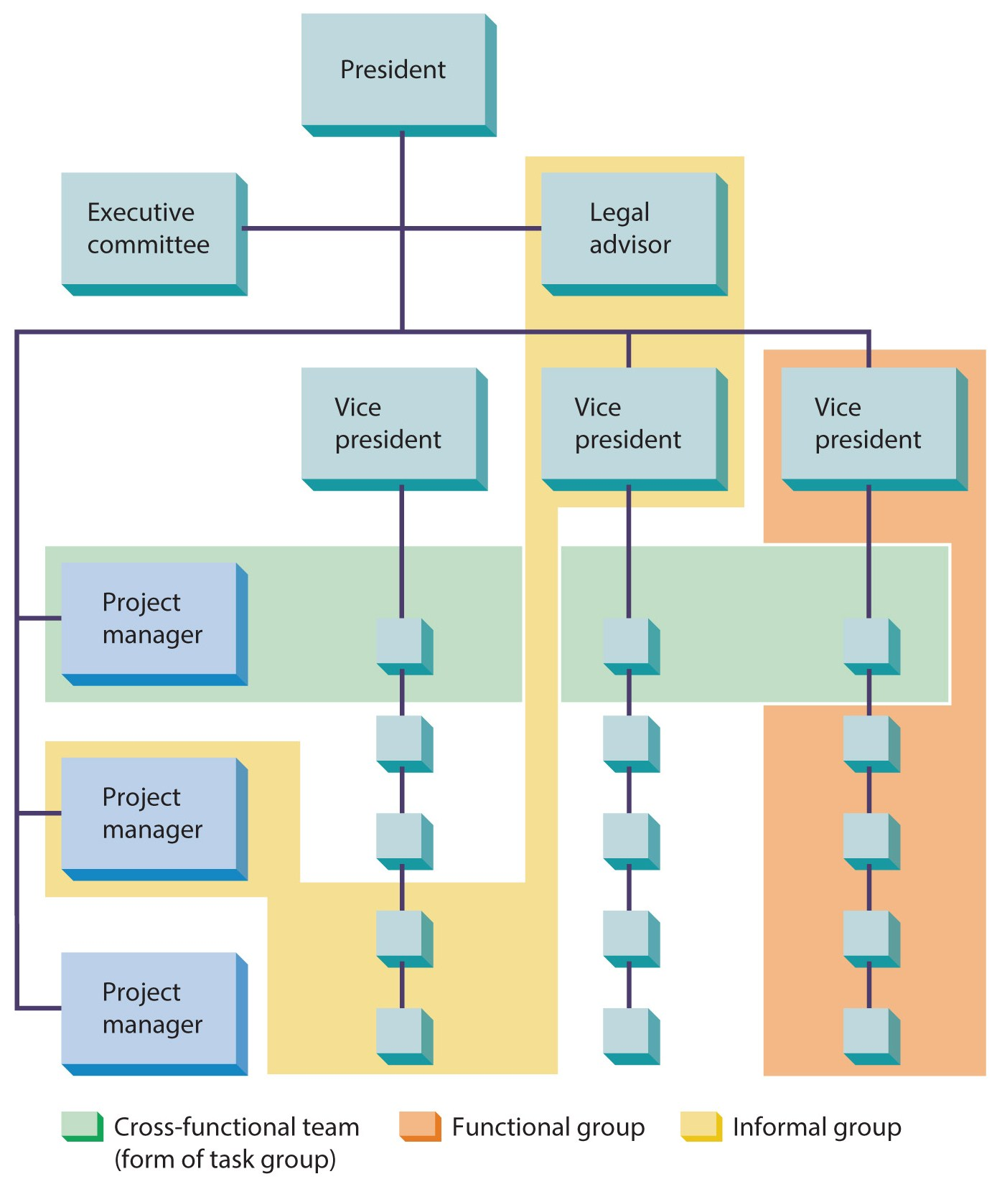
Figure 18.1
Types of Groups in Organizations

Slide 6
Types of Groups and Teams
A task group
is created by the organization to accomplish a relatively narrow range of purposes within a stated or implied time horizon.
A team
is a group of workers that functions as a unit, often with little or no supervision, to carry out work-related tasks, functions, and activities.

Slide 7
Types of Groups and Teams
A virtual team
is comprised of people from remote work sites who work together online.
If cohesive and managed correctly, teams contribute to the organization.
Poorly managed teams may contribute little or detract from performance.

Slide 8
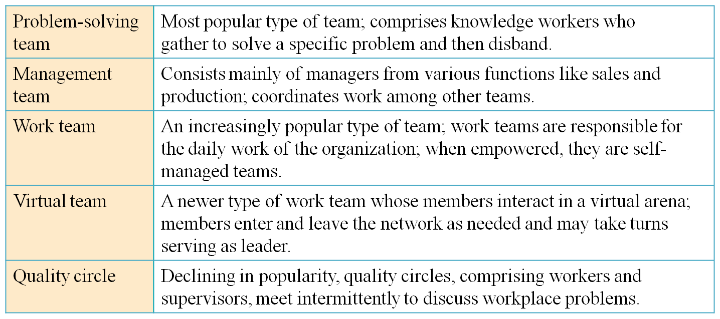
Table 18.1
Types of Teams
Source: From Fortune, September 5, 2004. Copyright © 2004 Time Inc. All rights reserved.

Slide 9
Groups and Teams in Organizations
Why people join groups or teams
Interpersonal attraction draws people to form informal or interest groups.
Group activities may appeal to some.
The group’s goals may appeal to some.
Joining a group may satisfy an affiliation need.
There are often instrumental benefits that come from joining a group.

Slide 10
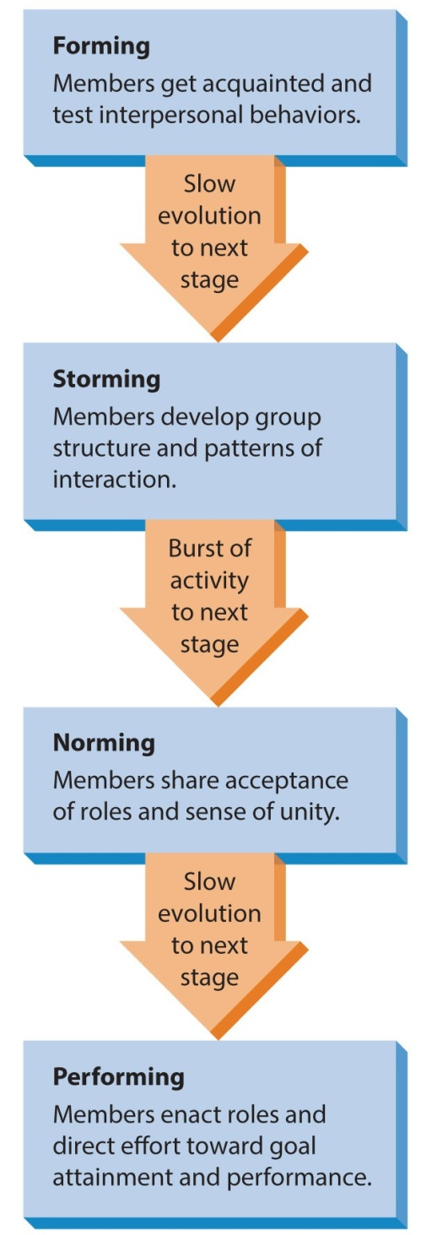
Figure 18.2
Stages of Group Development
When a new group is formed, it usually evolves through four stages of development.

Slide 11
Characteristics of Groups and Teams
Groups
Role structures
Behavioral norms
Cohesiveness
Leadership

Slide 12
Role Structures
A role consists of the part individuals play in groups in helping the group reach its goals.
A task specialist role concentrates on getting the group’s task accomplished.
A socioemotional role provides social and emotional support to others on the team.
The group’s role structure
is the set of defined roles and the interrelationships among those roles that group members define and accept.

Slide 13
Figure 18.3
Development of a Role
Role structures emerge as a result of role episodes.

Slide 14
Role Structures
When role structures are disrupted, people experience ambiguity, conflict, or overload.
Role ambiguity
arises when the sent role is unclear and the individual does not know what is expected of them.
Role conflict
occurs when the message and cues composing the sent role are clear but contradictory or mutually exclusive.

Slide 15
Role Structures
Role conflict
Interrole conflict occurs when a person has two roles that conflict with one another.
Intrarole conflict occurs when a person gets conflicting demands from different sources within the context of the same role.
Intrasender conflict occurs when a single source sends contradictory messages.
Person-role conflict occurs when the requirements of the role conflict with the enactor’s values, attitudes, and needs.

Slide 16
Role Structures
Role overload
occurs then expectations for the role exceed the individual’s capabilities to perform.
Clear and reasonable expectations minimize role ambiguity.
Consistent expectations minimize role conflict.
Manager’s can avoid role overload by recognizing an individual’s limits.

Slide 17
Behavioral Norms
Norms
Standards of behavior the groups accepts and expects of its members.
Norms define the boundaries between acceptable and unacceptable behavior.

Slide 18
Behavioral Norms
Norms do not generalize or transfer from one group to the next.
Norm variation allows some leniency.
Team factors, initial stimulus, individual traits, and situational factors affect norm conformity.
Group members can adapt to the norm or ignore it.

Slide 19
Behavioral Norms
Socialization
The generalized norm conformity occurring as a person makes the transition from being an outsider to becoming an insider.

Slide 20
Cohesiveness
Cohesiveness
Is the extent to which members are loyal and committed to the group, the degree of mutual attractiveness within the group.
In a highly cohesive team, members work well together, support one another, and effectively reach their goals.
A team that lacks cohesiveness is not very coordinated, members do not support one another, and they have difficulty achieving their goals.

Slide 21
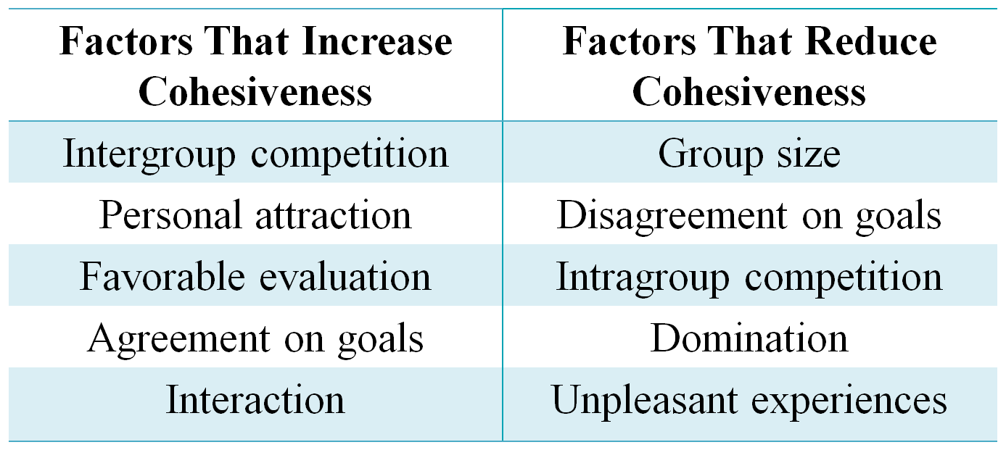
Table 18.2
Factors That Influence Group Cohesiveness

Slide 22
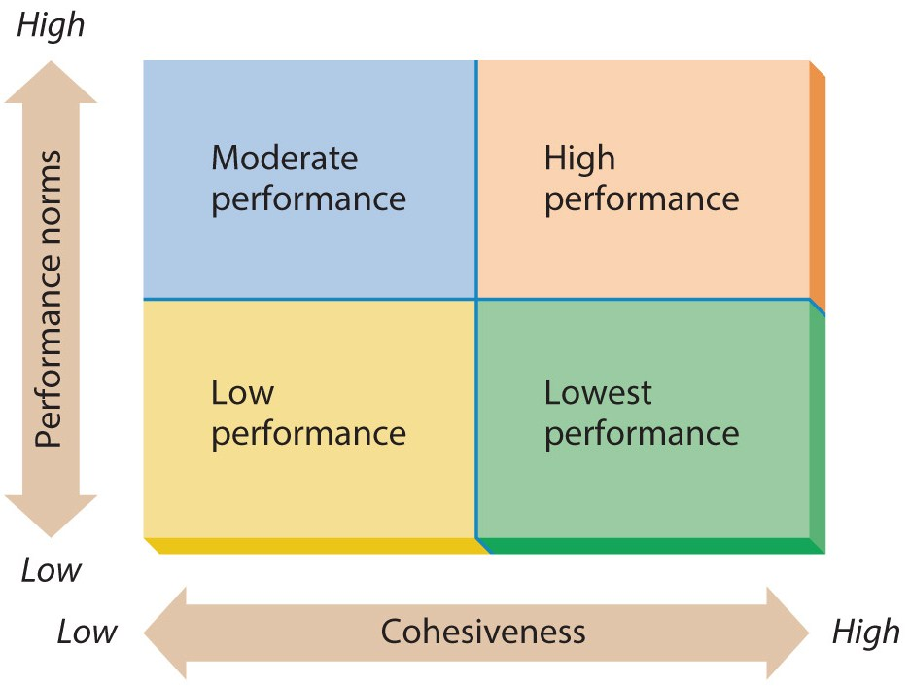
Figure 18.4
The Interaction Between Cohesiveness and Performance Norms

Slide 23
Formal and Informal Leadership
Most functional groups have an appointed, formal leader.
An informal leader
is a person who engages in leadership activities but whose right to do so has not been formally recognized by the organization or group.
These may be the same person, but may not.
Desirable if working in the best interests of the organization, detrimental if not in the best interests.

Slide 24
The Nature of Conflict
Conflict
Is a disagreement between two or more individuals or groups.
Conflict is an inevitable element of interpersonal relationships.

Slide 25
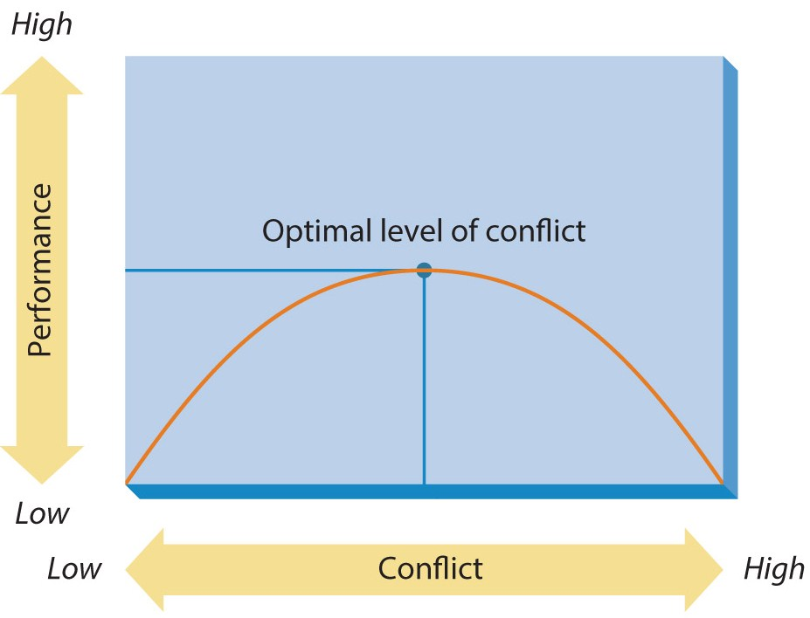
Figure 18.5
The Nature of Organizational Conflict

Slide 26
Causes of Conflict
Interpersonal conflict
can be caused by differences in personality, beliefs, perceptions, or excessive competitiveness.
Intergroup conflict
may occur due to interdependence, differences in goals, and resource competition.

Slide 27
Causes of Conflict
Conflict between an organization and its environment.
Interorganizational conflict happens between two organizations.
Conflict may arise between the organization and an outside entity.
Conflict may arise between an individual manager and a group of workers.

Slide 28
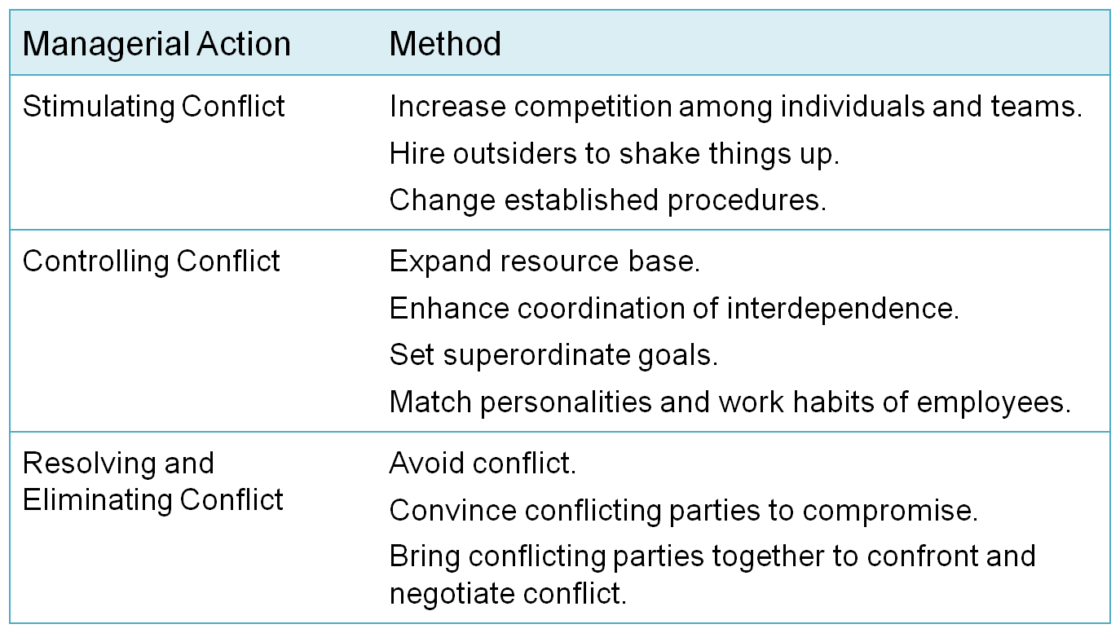
Table 18.3
Methods of Managing Conflict

Slide 29
Managing Conflict in Organizations
Negotiation
Is the process in which two or more parties (people or groups) reach agreement on an issue even though they have different preferences regarding that issue.

Slide 30
Managing Conflict in Organizations
Four primary approaches to negotiation dominate the research.
Individual differences – identify a negotiator with appropriate characteristics and personality.
Situational characteristics are often beyond control of the negotiators.
Game theory is dependable but complex and tedious with unrealistic assumptions.
Cognitive approaches know negotiators deviate from rationality and attempt to predict when.

Slide 31
Summary
The chapter began by introducing basic concepts of group and team dynamics.
The chapter explained the characteristics of groups and teams in organizations.
Next, the text described interpersonal and intergroup conflict.
The chapter concluded with a discussion of how conflict can be managed.

