Slide 1
MANAGEMENT
TWELFTH EDITION
Ricky W. Griffin
Part Six: The Controlling Process
Chapter Twenty: Managing Operations, Quality, and Productivity

Slide 2
Learning Outcomes
Describe and explain the nature of operations management.
Identify and discuss the components involved in designing effective operations systems.
Discuss organizational technologies and their role in operations management.
Identify and discuss the components involved in implementing operations systems through supply chain management.
Explain the meaning and importance of managing quality and total quality management.
Explain the meaning and importance of managing productivity, productivity trends, and ways to improve productivity.

Slide 3
The Nature of Operations Management
Operations management
Is the total set of managerial activities used by an organization to transform resource inputs into products, services, or both.
Operations management is at the core of what organizations do as they add value and create products and services.

Slide 4
The Nature of Operations Management
Operations management provides utility to the organization.
In manufacturing it provides form utility.
It provides time and place utility in a service.
Manufacturing
transforms inputs into tangible outputs.
A service organization
transforms resources into intangible output.

Slide 5
The Nature of Operations Management
Operations management is very important
It directly impacts competitiveness, quality, and productivity.
It directly influences the organization’s overall effectiveness.
Strategy affects operations management and operations management affects strategy.

Slide 6
Designing Operations Systems
The goal of operations managers includes both efficiency and effectiveness.
Decisions
Product-service mix
Capacity
Facilities

Slide 7
Designing Operations Systems
The product-service mix
determines how many and what kinds of products and services, or both, to offer.
Based on corporate, business and marketing strategies.
Capacity decisions
involve choosing the amount of products, services, or both that can be produced.
A critical decision, based on demand.

Slide 8
Facilities Decisions
Facilities
are the physical locations where products or services are created, stored, and distributed.
Decisions pertain to facility location and layout.
Location is the organization’s physical positioning or geographic site.
A company may need to be near amenities such as a railroad, or an airport.
Some companies may need to locate near their customers.

Slide 9
Facilities Decisions
Layout
is the physical configuration of the facilities, the arrangement of equipment, or both.
Product layout is arranged around the product.
Process layout is arranged around the process.
Fixed-position layout is arranged around a single work area.
Cellular layout is used when families of products follow similar flow paths.

Slide 10
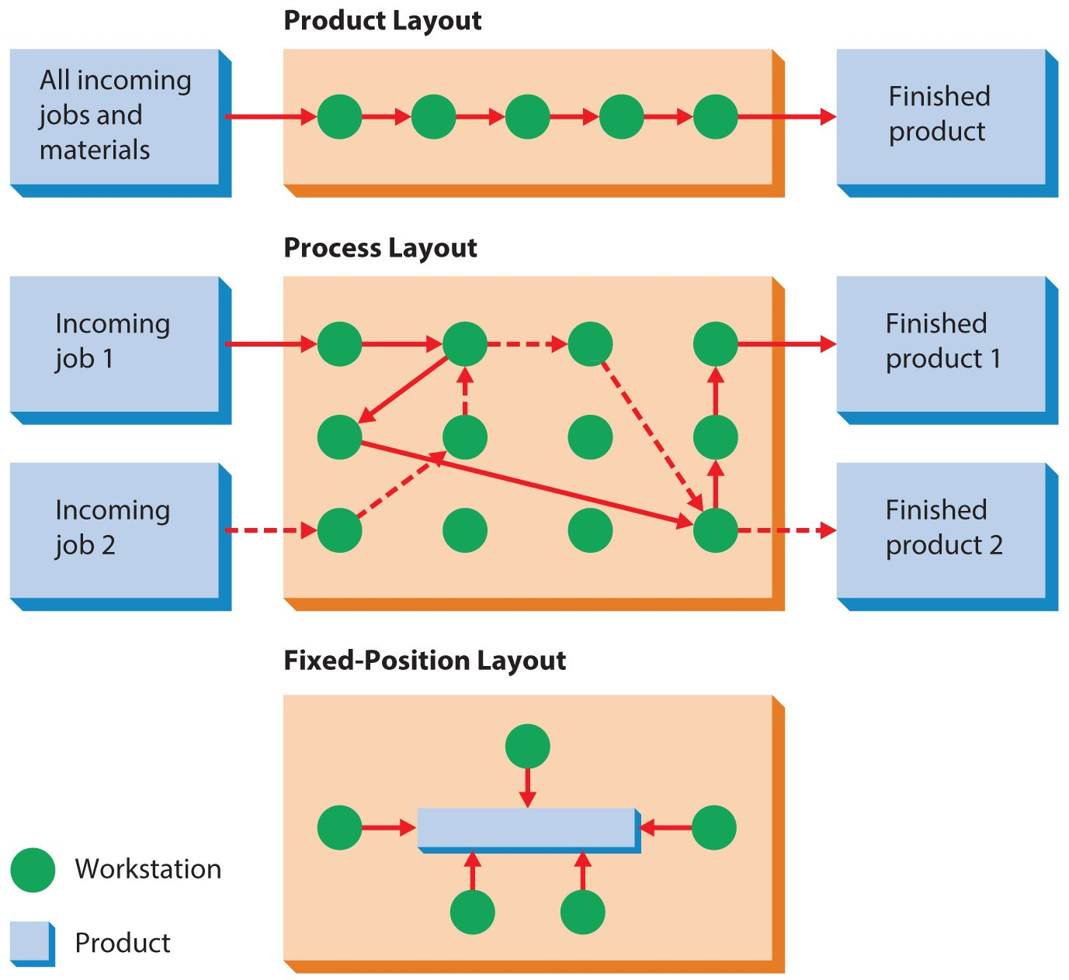
Figure 20.1
Approaches to Facilities Layout

Slide 11
Organizational Technologies
Technology
is the set of processes and systems used to convert resources into products or services.
Manufacturing technology.
Automation is the process of designing work so it can be partly or wholly performed by machines.
Computer assisted manufacturing relies on computers to design or manufacture products.
Robot is any artificial device performing functions ordinarily thought to be appropriate for humans.

Slide 12
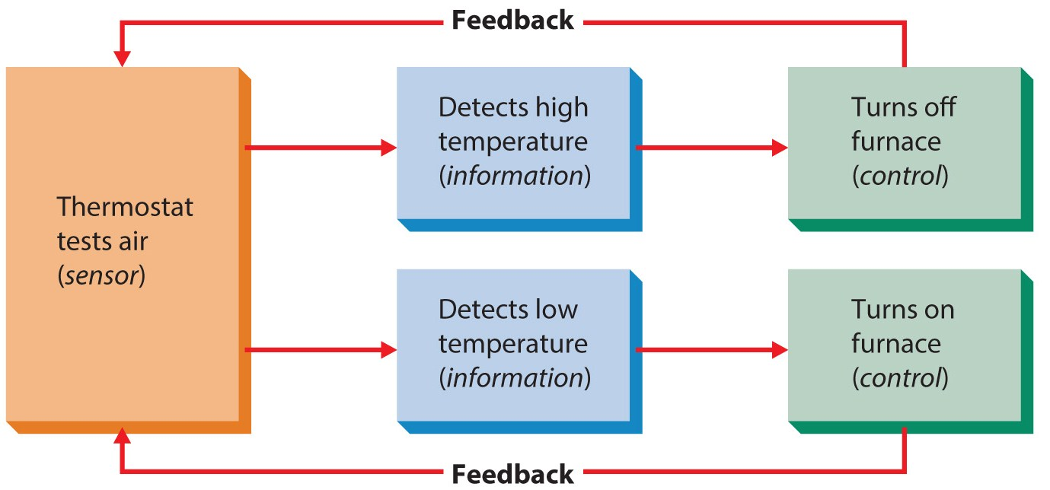
Figure 20.2
A Simple Automatic Control Mechanism
Feedback is a critical component of automation.

Slide 13
Organizational Technologies
Computer-assisted manufacturing
Computer-aided design (CAD)
uses computers to design parts, complete products, and simulate performance.
Computer-aided manufacturing (CAM)
uses computers to plan and control the process.
Computer-integrated manufacturing (CIM)
allows for coordination of CAD and CAM.
Flexible manufacturing systems (FMS)
uses computers to move materials from one part of the system to another.

Slide 14
Organizational Technologies
Service technology is changing rapidly.
Moving more and more toward automated systems and procedures.
Examples include:
ATMs.
Online hotel reservations.
Electronic textbooks, journal articles, etc. at universities.
Hospital’s handling of patient records.

Slide 15
Implementing Operations Systems
Supply chain management
Is the process of managing operations control, resource acquisition and inventory to improve overall efficiency and effectiveness.

Slide 16
Implementing Operations Systems
Operations management works as a control if coordinated with other functions.
Operations managers are responsible for different kinds of results depending on the strategic role of operations.
If using bureaucratic control, accountability is defined by rules and regulations.
If decentralized, it is understood by everyone.

Slide 17
Implementing Operations Systems
Purchasing management
is concerned with buying materials/resources needed to produce products and services.
Also called procurement.
This is the heart of effective supply chain management.
The manager must pay attention to
quality, reliability of the supplier, and getting the best financial terms.

Slide 18
Implementing Operations Systems
Inventory control
manages raw materials, work-in-progress, finished goods, and products in transit.
Also called materials control.
The just-in-time (JIT) method
has necessary materials arriving as soon as they are needed so the production process is uninterrupted.
Reduces investment in storage space and material costs.
Requires high levels of coordination and cooperation.

Slide 19
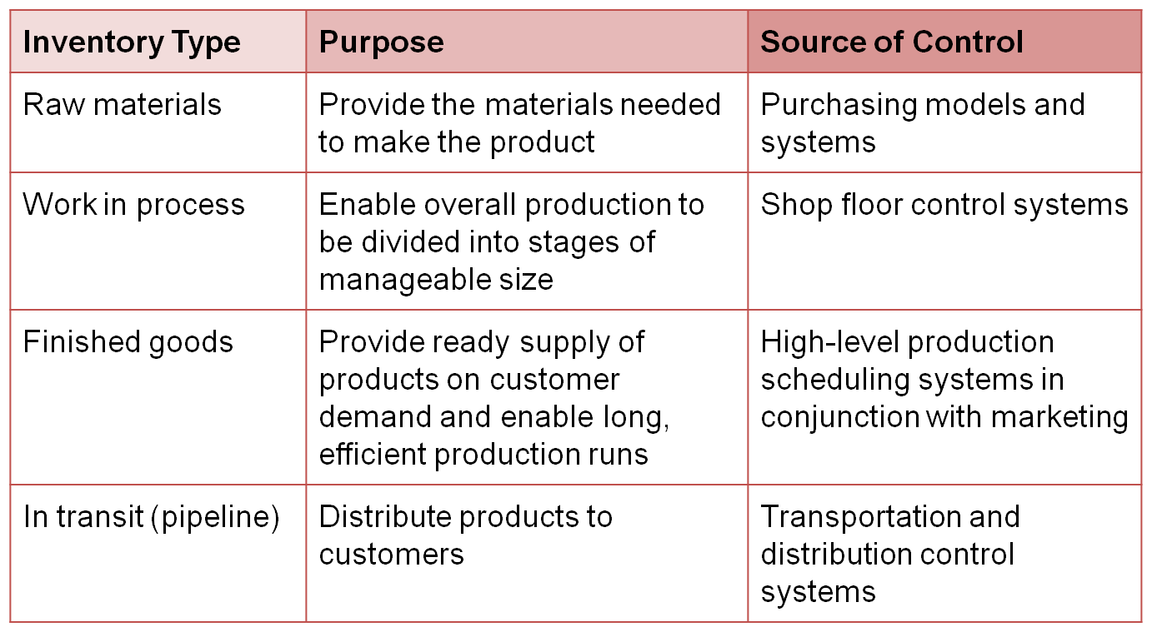
Table 20.1
Inventory Types, Purposes, and Sources of Control

Slide 20
Managing Total Quality
Quality
Is the totality of features and characteristics of a product or service that bears on its ability to satisfy stated or implied needs.

Slide 21
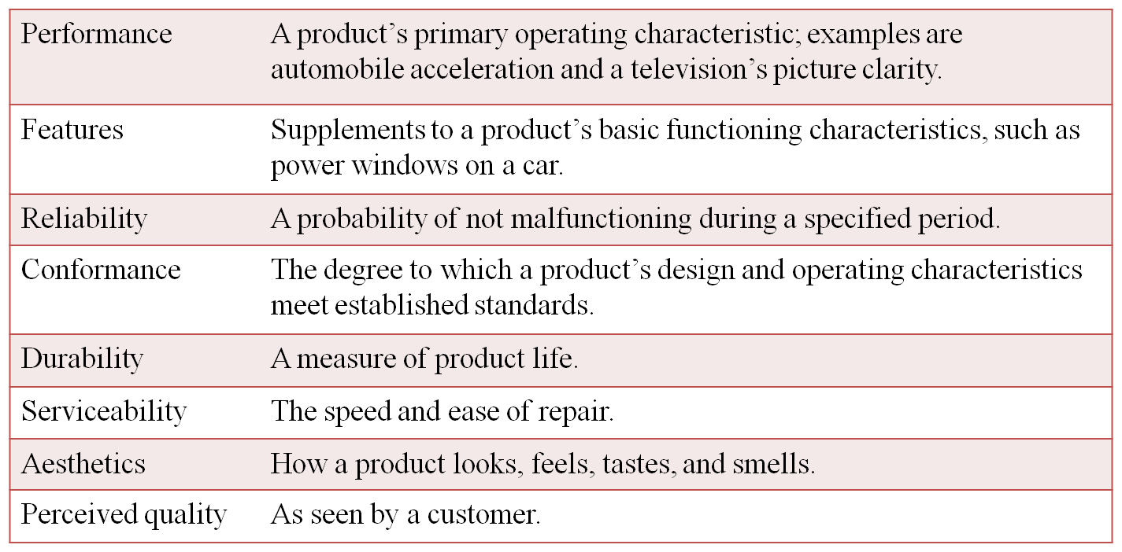
Table 20.2
Eight Dimensions of Quality
Source: Reprinted by permission of Harvard Business Review. Exhibit from “Competing on the Eight Dimensions of Quality,” by David A. Garvin, November/December 1987. Copyright © 1987 by the Harvard Business School Publishing Corporation, all rights reserved.

Slide 22
Managing Total Quality
The Malcolm Baldrige Award
is given to firms who achieve major quality improvements.
Quality is one of the most competitive points.
Productivity and quality are related but it is possible for both to increase.
Improved quality can lower costs.

Slide 23
Managing Total Quality
Total quality management (TQM)
Is a strategic commitment by top management to change its whole approach to business to make quality a guiding factor in everything the organization does.
Sometimes called quality assurance.

Slide 24
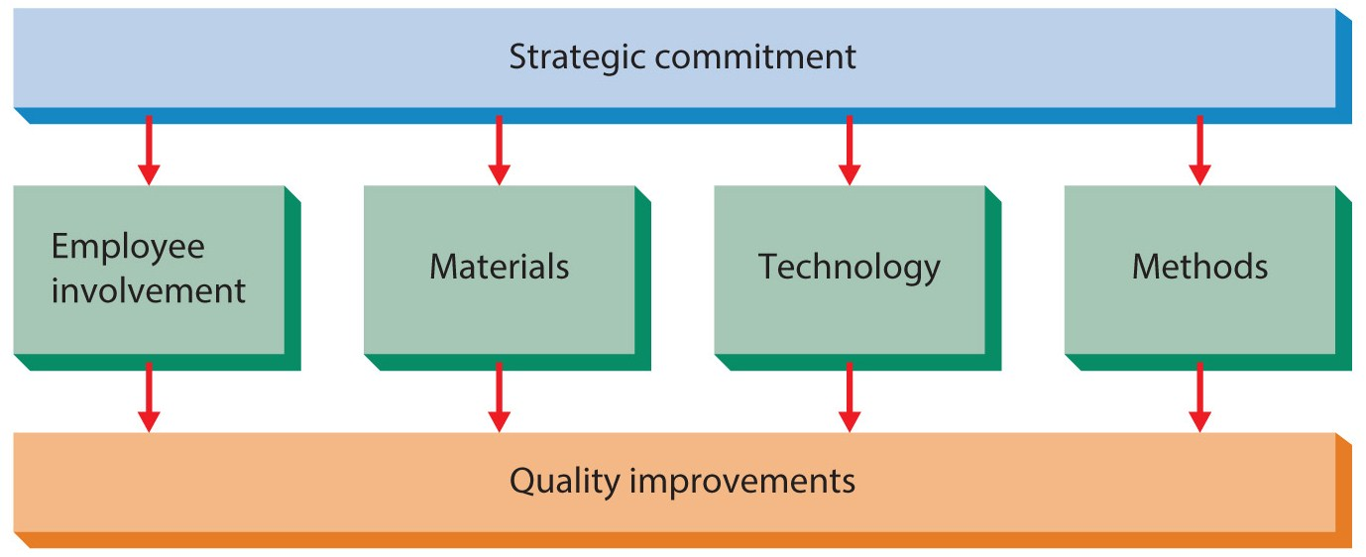
Figure 20.3
Total Quality Management

Slide 25
TQM Tools and Techniques
Value-added analysis
is the evaluation of all work activities, material flows, and paperwork to determine the value they add for customers.
Benchmarking
is the process of learning how other firms do things in an exceptionally high quality manner.
This may be direct, as in examining competing products, or indirect by examining competitors processes.

Slide 26
TQM Tools and Techniques
Outsourcing
is subcontracting services and operations to other firms that can perform them cheaper and/or better.
Cycle time
refers to the time needed by the organization to accomplish activities such as developing, making, and distributing products or services.

Slide 27
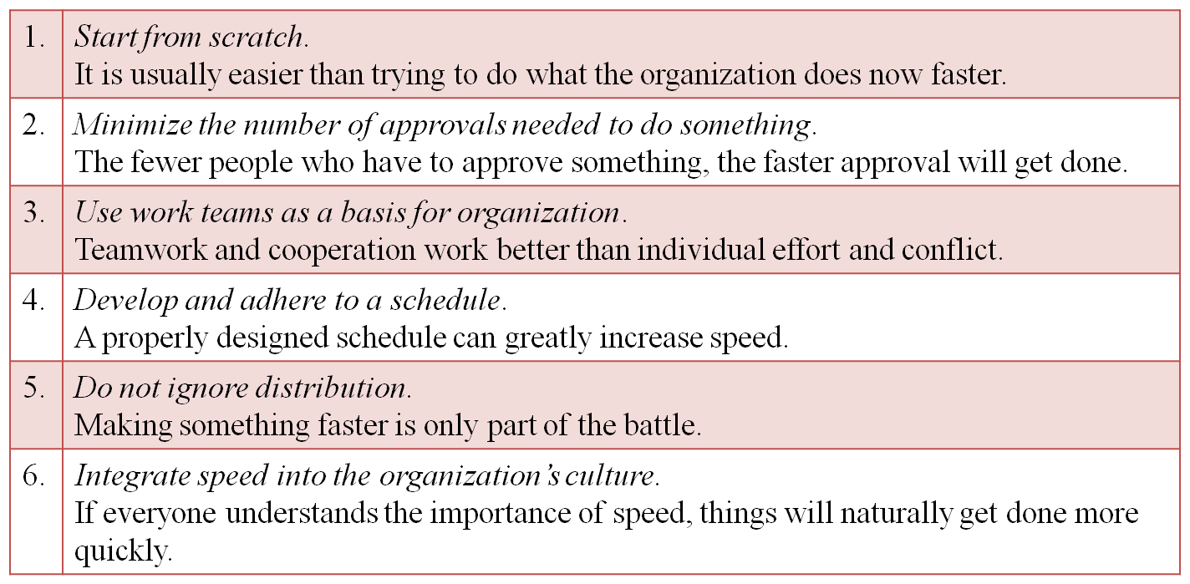
Table 20.3
Guidelines For Increasing the Speed of Operations
Source: From Fortune, February 13, 1989. Copyright © 1989 Time, Inc. All rights reserved.

Slide 28
TQM Tools and Techniques
ISO 9000:2000
is a set of quality standards created by the International Organization for Standardization.
Covers such areas as product testing, employee training, supplier relations and more.
Firms apply for certification and get audited.
ISO 14000
is a similar set of standards for environmental performance.

Slide 29
TQM Tools and Techniques
Statistical quality control (SQC)
is a set of specific techniques used to monitor quality.
Acceptance sampling involves sampling finished goods for quality standards.
In-process sampling involves evaluating products during production, making changes if needed.
Six Sigma tries to limit mistakes to within six standard deviations.
Sigma refers to standard deviations.

Slide 30
Managing Productivity
Productivity
Is an economic measure of efficiency and summarizes what is produced relative to the resources used to produce it.
Productivity is often assessed at different levels of analysis and in different forms.

Slide 31
Managing Productivity
The level of productivity refers to the units of analysis used to define productivity.
Aggregate productivity is the total level of productivity achieved by a country.
Industry productivity is total productivity achieved by all the firms in an industry.
Company productivity is the level achieved by an individual company.
Unit and individual productivity is achieved through a department (unit) or an individual.

Slide 32
Managing Productivity
There are many forms of productivity
Total factor productivity defines productivity as outputs divided by inputs.
Firms also calculate partial productivity ratios using only one category of resources.
Labor productivity is outputs divided by labor costs.
Productivity is responsible for two things
Organizational profitability and survival.
People’s standard of living.

Slide 33
Managing Productivity
The U.S. remains one of the most productive countries in the world.
Suggestions for improving productivity fall into two broad categories.
R&D for new products or revamp facilities.
Increase employee involvement.

Slide 34
Summary
The chapter introduced operations management and discussed its role in general management and strategy.
The chapter discussed, in order,
the design of operations systems, organizational technologies, implementing operations systems.
Various managing for quality and total quality issues were then discussed.
The chapter closed with a discussion on productivity, closely related to quality.

