Slide 1
“Expect More. Pay Less.”
Andreana Harrison

Slide 2
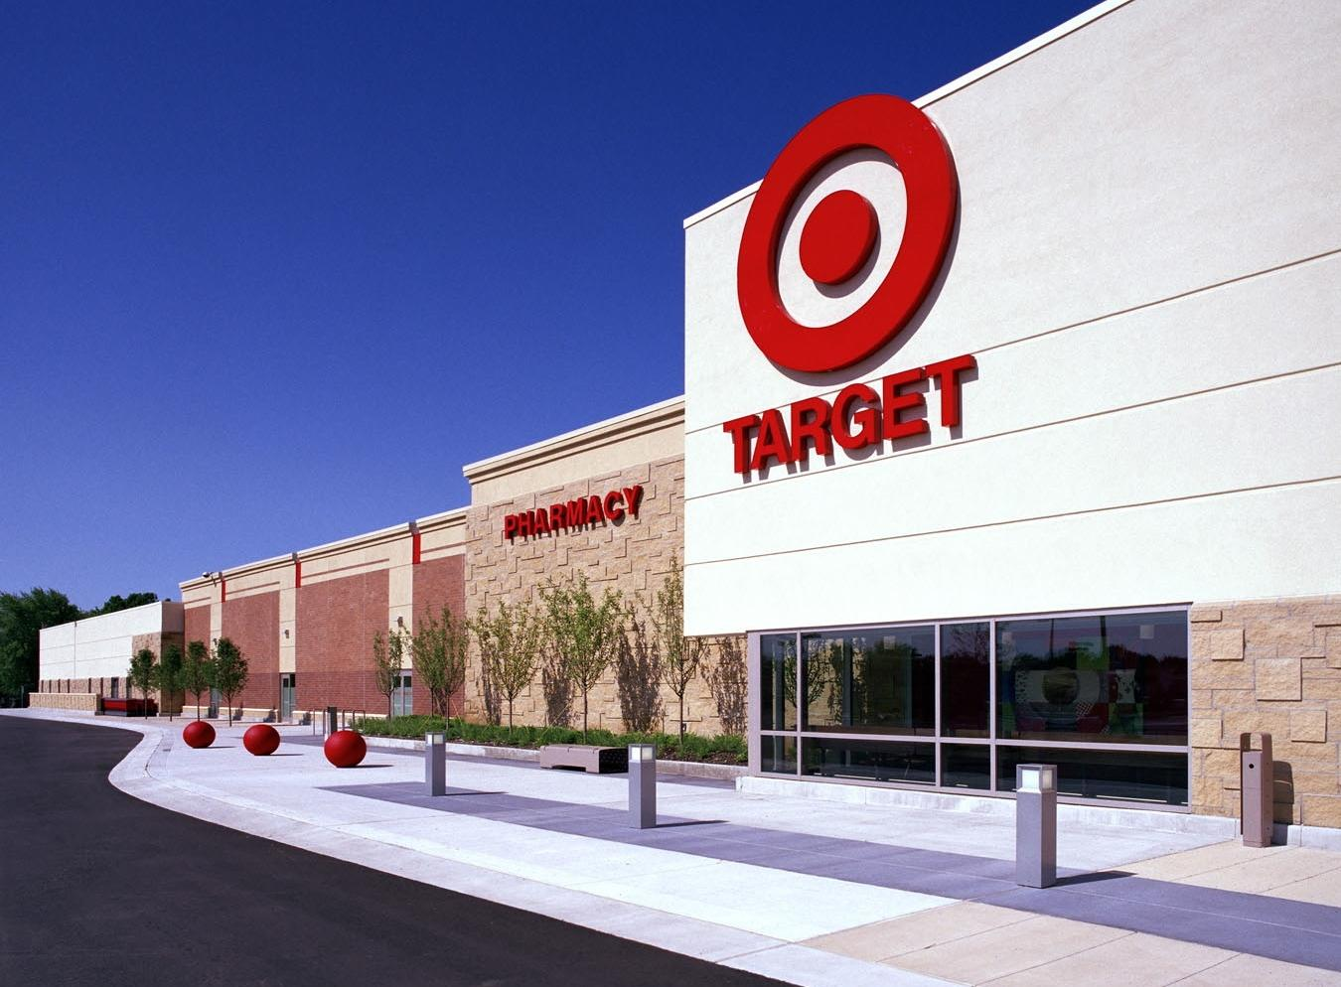
Who is Target?
Company information, history and background
Mission statement
Products
Target Market
6 Company values
“What We Believe In”

Slide 3
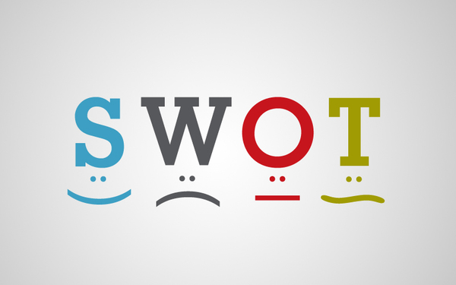
Internal Environment
Strengths
Strong brand awareness
Good quality products
Customer oriented
Competitive retailer
Image of cleanliness
Fashion/design forward thinking
Charity
Weaknesses
Revenue declining slowly
Not open 24 hours
No locations outside U.S.
Online purchases don’t compare to Walmart or Costco
Quality products increases prices

Slide 4
External Environment
Opportunities
Expanding nationwide
Implementing a fresh produce section in stores
Providing longer shopping hours
Increased celebrity endorsements
Self-checkout systems
Threats
Competition is already well established
Barriers to entry
Competitors competing for lowest prices
Competitors

Slide 5
Strategies & Implementation
Advertising
Location and expansion
Innovation

Slide 6
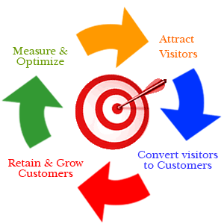
Advertising Strategy
Television, radio, magazine, billboards, social media, and etc.
Benefits
Increase brand awareness
Introduce new products
Appeal to a mass audience
Celebrity endorsements
Boost sales by 4%
Expensive but rewarding to the company
Many followers

Slide 7
Location & Expansion Strategy
College town
Currently opening 30 small formats
Provide discounts to student clubs/organizations
Give back a percentage of profit to the schools
Global expansion
Major source of income
Increase competitiveness
New environment
Benefits
Faster revenue growth
Diversified revenue stream
Improved return on capital
Increased reinvestment rate

Slide 8
Innovation Strategy
Customers are our top priority
Introduce new clothing lines partnered with designers
Loyalty programs and promotion
Reduce supply chain
Coupons
87% use coupons
95% like coupons
60 % actively look for coupons

Slide 9
Recommendations & Conclusion
Implement all 3 strategies
Management style - employee satisfaction
Daily operations – customers are top priority
Focus on expanding
Better pricing
Bring in celebrity endorsements
Improve global brand awareness

