Slide 1
Google Company
Ibtesam Cockrell
Strategic Management

Slide 2
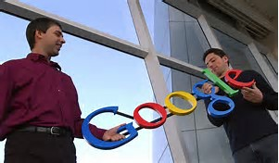
Summary
Google started in 1996, by Larry Page and Sergey Brin when they were both studying at Stanford University California
In 1998 google, opened its door in Menlo park California
In 2000 they introduce AdWords
In 2002 google news lunched in beta, offering access to 4500 leading news sources from around the world
In 2004 new web based mail service called Gmail included a Gigabyte of free storage for each user
New lunches in 2006, page creator, finance, calendar, custom search

Slide 3
Internal Analysis
Strengths
Strong brand image
Patented pranded products
Diversified business
Large organizational size
A worldwide market share of 70%
Weaknesses
Dependence on the internet
Minimal physical presence
Marketing control the cost and position of their advertisement
Impact of click fraud practice on the business

Slide 4
External Analysis
Threats
Opportunities
Tap more mobile users
Expand google fiber
Penetrate markers with consumer electronics
Providing private search service to business
tough competition
Imitation of some products
Privacy and security concern
Copyright Issues

Slide 5
Strategies Formulation
Google prices and Pricing strategies
Freemium pricing
Market –oriented pricing
Penetration pricing
Value-based pricing

Slide 6
Strategies Formulation
Google Marketing strategies
It's Free-for-All
Culture of Conversation
Quality to Create a Society of High Authority

Slide 7
Recommendation
We recommend Google to hire more experienced people instead of the good academic results for the good future of the organization.
Google also can implement a cultural assessment for the organization to investigate to ensure that the organizations also maintaining and keeping the core value in this competitive business environment
Fight spammers- impact on search quality and accuracy
Resolve private search services to companies using technology

