Slide 1
General Motors
Bioncha Benally
Steven Gonzales
Natasha Lee-Arthur

Slide 2
Contents
History
Mission and Vision of the Company
Brands of the Company
Board of Directors
Financial Statements
SWOT Analysis
Mergers and Acquisitions

Slide 3
HIstory
Founded by William C. Durant on September 16, 1908 in Flint, MI
General Motors is a multinational corporation that designs, manufactures and sells cars, trucks and automobile parts. GM also provides automotive financing services through GM Financial Company, Inc.
Global Headquarters located in Detroit, MI
Employs about 181,000 people world wide

Slide 4
Mission and Vision Statements
Mission
To earn customers for life by building brands that inspire passion and loyalty through no only breakthrough technologies but also by serving and improving the communities in which we live and work around the world.
Vision
To become the world’s most valued automotive company.

Slide 5
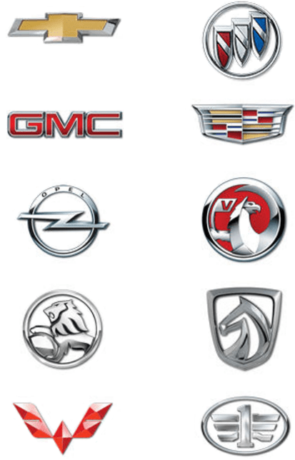
Company Brands
Chevrolet GMC Opel Holden Buick Cadillac Vauxhall AutoBaojun Wuling FawJiefang

Slide 6
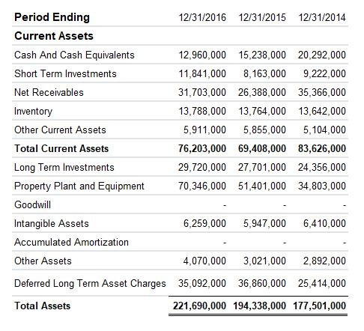
Financials

Slide 7
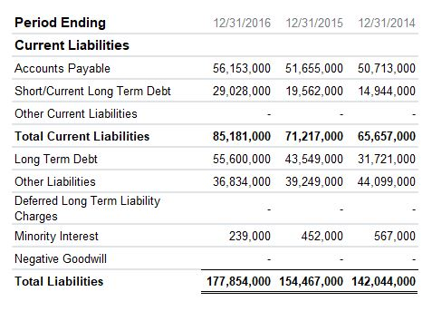
Financials

Slide 8
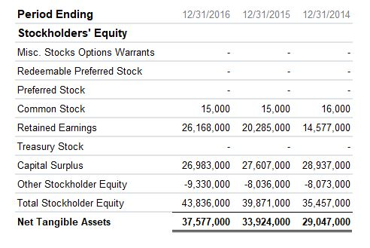
Financials

Slide 9
Strengths and Weaknesses
Strengths
Weaknesses
Strong presence in China
Strong position in the US Market
Strong brand portfolio
Low rate of product recall
Heavily reliant on US Revenues
Weak employee/management relations
Low brand awareness
Reliant on trucks and SUVs for growth

Slide 10
Opportunities and Threats
Opportunities
Threats
Low fuel prices in Europe
Employee/Manager relations
Expansion in the Indian market
Increasing competition
Fluctuating exchange rates
Increasing government regulations
Rising fuel prices

Slide 11
Mergers and Acquisitions
General Motors is Financially stable enough to avoid the need for a merger.
General Motors would benefit from acquiring smaller companies that are not as financially stable.

