Slide 1
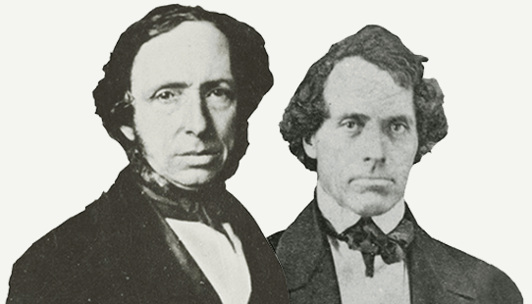
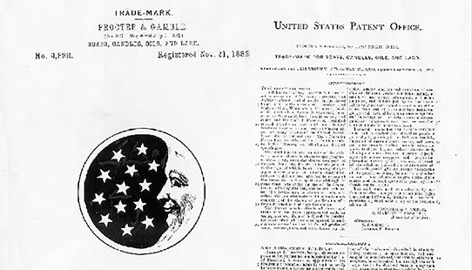
Procter & Gamble

Slide 2
COmpany
William Procter, emigrating from England, established himself as a candle maker in Cincinnati. James Gamble, an immigrant from Ireland, apprenticed himself as a soap maker. They might never have met had they not married sisters — Olivia and Elizabeth Norris. It was their father, Alexander Norris that noted his two new sons-in-law were competing for the same raw materials. He suggested they become business partners. What began as a family-run candle and soap business would eventually grow into the largest and most profitable consumer goods company in the world.

Slide 3
Vision Statement
Be, and be recognized as, the best consumer products and services company in the world.

Slide 4
Products
P & G is focusing on 10 product categories with about 65 brands. P & G is a leader in all these categories, with significant growth potential .

Slide 5
Internal analysis
Strengths
Weaknesses
Target Market
Consumer Understanding
Innovation
Brand Building
Go-to-Market Capabilities
Scale
Loss due to closure of brands
Organization Structure causes slow decision making
Low organic growth
Regular change is needed
P & G has a huge target market. They sell products in 180+ countries, in ten product categories, and have been in business for over 179 years. Their target market is men, women, teens, different races, and different sexes, just to name a few.

Slide 6
External Analysis
Treats
Opportunities
Competition
Trends
Intense Competition
Increased local/ Unbranded competition
Private labels
Rural markets
Increase purchasing power
Mergers and acquisitions
Overseas growth
Increase organic growth
Kimberly-Clark
Johnson & Johnson
Estee Lauder
Colgate-Palmolive Co
Clorox Co
Unilever
L'Oréal
P & G trends are thoroughly monitored through the company’s specified departments, such as; business units and market development organizations. Market development organizations keep watching the market segments and their trends, however business units specify the appropriate strategies.

Slide 7
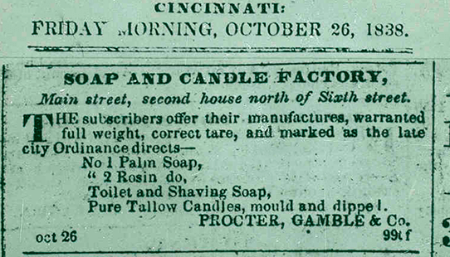
strategies
Marketing Strategies
Promotional Strategies

Slide 8
Marketing strategies
Market Penetration
Attaining more of the market
Market Development
Trends
Diversification Strategy
Stakeholders
Price
Based on competitors
Place
Eight locations around the world

Slide 9
Promotional strategies
The company’s promotional strategies are very fine as it let the customer follows the product through its promotional channel. The promotional channel of the company starts with electronic media, following the same on print media along with the bill boards, coupons, and sign boards.

Slide 10
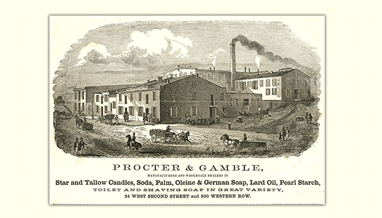
Conclusion
Procter and gamble have been around for hundreds of years. They need to continue to be innovative with their products, keeping up with trends, continue to think about the customer’s needs/wants, continue to work as a unit, make a more sustainable future, make products affordable, making products for people around the world. If they continue to run the company this way, they will be able to be around for years to come. P & G has managed to stay ahead of their competitors, provided products that consumers love, and provide their stakeholders’ and investors with security.

